Slide 1
You Can’t Get the Right Results With the Wrong System
Some Thoughts on “The High Utilizing Patient” and “Addiction”
C. Patrick Carroll, MD
Director of Psychiatric Services
Sickle Cell Center for Adults
Johns Hopkins Hospital

Slide 2
Disclosures
No relevant disclosures

Slide 3
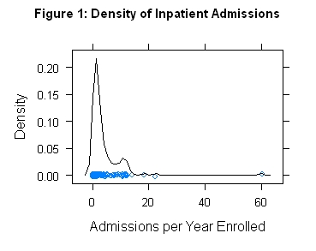
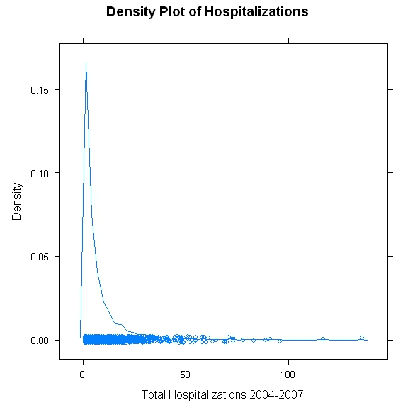
The Utilization Paradox of SCD
Density of Inpatient Admissions
Density Plot of Hospitalizations
Density
Density
Admission per Year Enrolled
Total Hospitalizations 2004‒2007
Carroll CP et al. Am J Hematol. 2009;84(10):666-670.
Carroll CP et al. J Hospital Med. In Press.

Slide 4
A Consult*
Very frequent visits to multiple hospitals, reports 7-10/10 pain, often abdominal or in sites of AVN
(> 1 visit or hospital day per three days)
He lies. A lot.
Seen by psychiatry inpatient and out-, diagnosed with a particular developmental disorder but “with no specific recommendations.” Occasionally suspected of depression.
Specific question: “Is this OUD?”
When I see him, he’s…pleasant. And very anxious about pain.
(He’s probably not taking his HU right)
AVN, avascular necrosis; OUD, opioid use disorder; HU, hydroxyurea
*which never works

Slide 5
Addiction and “Pseudo-addiction”
Relief of Pain
Behavior
Drug Reward

Slide 6
Maybe We Should Stick With What We Can See
OPIOIDS
Relief of Pain
Behavior
Drug Reward
Do we have good reason to believe this is a problem and needs to change?

Slide 7
Principles of Behavior Change: ABCs
Elements
Antecedents: Things that reliably happen prior to the behavior–“triggers,” contexts
Behaviors: Verifiable, countable (in principle) things people do
Consequences (or Contingencies): What happens immediately after the behavior?
Application
Extinction: Stop reinforcing the behavior
It also helps to increase the work of the undesirable pattern
Substitution: Start reinforcing successive approximations of the desired behavior
Reduce the difficulty of desired behaviors
Make reinforcement as easy and frequent as you can to start
Reduce predictable antecedents to the target behavior; or better yet pair them with the new behavior

Slide 8
He’s actually NOT in the hospital all the time
(But he still manages to have ~1 visit/hospital day per three days)
OME Dose
Time in Days
OME, oral morphine equivalent; OP, outpatient

Slide 9
Outpatient doses are not high, but often staggered and chaotic
ED doses are not out of line with his outpatient doses, though often IV
However, when he gets admitted, the dose available is ~10 times his outpatient dose
?
?
?
OME Dose
Time in Days

Slide 10
A Behavioral Analysis/Hypothesis
Antecedents:
Reduction or “impending reduction” of opioid dose below ~50-60 OME
ALSO: Crises
Behaviors:
Presenting to EDs and providing a history that minimizes chances of discharge and maximizes chance of admission
Reinforcers (Possible):
Opioids (- Relief of pain, - Reducing withdrawal, + Reward)
Relief of fear, support, etc
A thought: “Slot machine” dynamic might explain the intensity of his ED utilization
Desired alternate behavior:
Regular outpatient visits with a single provider who manages the SCD and chronic pain

Slide 11
2 ED visits
9 day inpatient
DC script, 5d worth, lasts 7 days
OP script,
14d worth

Slide 12
2 ED visits
9 day inpatient
DC script, 5d worth, lasts 7 days
OP script,
14d worth

Slide 13
2 ED visits
9 day inpatient
Weekly visits
Chronic transfusions
Disseminate care plan
DC script, 5d worth, lasts 7 days
OP script,
14d worth

Slide 14
Home pain regimen: Morphine (MS-IR) 15 mg po prn. Typical consumption between 45 and 60 oral morphine equivalents per day.
Disease modifying therapy: Chronic q4 week partial exchange transfusions to target % HbS = 30%
Suggested acute care treatment:
When presenting for acute care, the patient should have a full assessment for complications of SCD as well as any other conditions reasonably indicated (see below for important notes). All management should be guided by assessment and good clinical judgment.
After complete assessment, morphine sulfate 15 mg orally q4hr prn for pain; do not give intravenous opioids
Do not use iv bolus diphenhydramine (Benadryl) unless absolutely indicated (eg anaphylaxis)
Check CRISP for recent visits and updates
In the absence of complications, hospitalization outside ??? Hospital should be avoided without input from his primary hematologist, Dr. ??? The patient has weekly appointments with Dr. ???
If hospitalized, treat with oral opioids as above until contact can be made with his primary team
His port (if present) should be accessed only by staff at ??? Hospital
Contact primary team: (Our numbers here)
Assess him
Absent other considerations,
treat as chronic pain
Don’t hospitalize without good reason.
We’ll see him quickly.
Do no harm and don’t mess up the plan

Slide 15
2 ED visits
9 day inpatient
DC script, 5d worth, lasts 7 days
OP script,
14d worth

Slide 16
Plan
Consult
q6w
q5w
ED visits
Hospital days
Transfusion Change
ED Visits/Hospital Days
0
3
1
1
3
Month

Slide 17
Plan
Consult
q6w
q5w
ED visits
Hospital days
Transfusion Change
ED Visits/Hospital Days
0
3
1
1
3
Month

Slide 18
A Funny, Funny Story
Regular Visit
Missed Visit
Bridge
ED Visit
Planned
Denial

Slide 19
Q4 week exchanges
45 OME/d prescribed q 1-2 weeks
No complications or severe crises

Slide 20
The Paradoxes…
We continued to prescribe a disease-modifying treatment we knew he wasn’t taking, rather than alter treatment or declare failure
Our concerns about opioid use/ED visits/hospitalizations didn’t change our behavior in any effective way
Referred out repeatedly; which was unproductive
Much talk in the chart about his behavior, little about ours
As an outpatient, he was suspected of “OUD” while being provided opioids at a fluctuating but fundamentally unchanged dose
Payment systems designed to limit access to opioids failed, and punished stable, highly supervised prescribing while incentivizing higher doses and more dis-coordinated care

Slide 21
Q: Is it real pain, “psych,” or addiction?
A: What if it’s us?

Slide 22
Disease modifying therapy
A care system that can handle people with complex problems
Behaviorally informed
acute pain management plans
Acute Care
Stable, sufficiently intense outpatient care
SCD
Crises
Chaotic, unmanageable
regimen

Slide 23
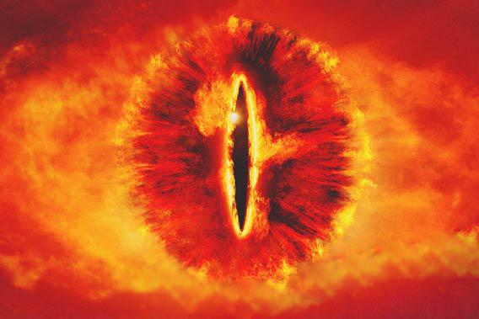
Disease modifying therapy
A care system that can handle people with complex problems
Behaviorally informed
acute pain management plans
Acute Care
Stable, sufficiently intense outpatient care
SCD
Crises
Chaotic, unmanageable
regimen

Slide 24
The Four Priorities (plus 1)
(0. Be the team running the case)
Treat the SCD as aggressively as possible
If the patient’s acute care utilization* itself is a problem, modify your behavior to shift it to an appropriately intense outpatient chronic care model
Once the patient is treatable as an outpatient, evaluate chronic pain, stabilize the regimen, and assess its effectiveness relative to its risk. Act on that assessment.
Diagnose and attempt to manage other relevant comorbid conditions/complications
* Or any other behavior pattern

Slide 25
Priority 3: Buprenorphine Is an Option
It works for pain¹
It is safer; probably qualitatively safer than high-dose opioid therapy
It is different; and if chronic opioid therapy at reasonable (or supra-reasonable) doses is failing it provides an alternative for rotation
It has a favorable profile of behavioral effects
Reduced positive reinforcement
Modest withdrawal²
Long-acting
Lazaridou A et al. Pain Med. 2020;25;21(12):3691-3699.
Tompkins DA et al. J Pharmacol Exp Ther. 2014;348(2):217-226.

Slide 26
 | Initial Pain | Pain Improvement | Opioid Use | Total Time
Infusion | 0.06 (0.13) | -0.09 (0.16) | -100.12 (8.47) | 0.07 (0.19)
ED | -0.34 (0.12) | -0.49 (0.24) | -239.71 (24.67) | -1.25 (0.94)
Inpatient | -0.21 (0.17) | -0.16 (0.27) | -277.76 (38.23) | -0.39 (0.77)
David MS et al. Am J Hematol. 2022;97(11):1435-1442
Linear mixed-effects models predicting changes post-induction in acute pain outcomes

Slide 27
4. Identify and Deal With Other Causes
Why is this last?!

Slide 28
Let’s Take Depression…
SCD
Pain
Specific
Treatments
Major Depression

Slide 29
Let’s Take Depression…
Pain Behaviors
Systemic Response
SCD
Pain
Meds
Specific
Treatments
Major Depression

Slide 30
How About Just Going After Chronic Pain Itself?
If the current regimen is failing, you may decide to add other agents or taper/switch
Pharmacotherapies for chronic pain tend to have modest effects (NNTB ~5-7)
Small effects are hard to see with frequent acute pain or a chaotic regimen
Similar problem if an opioid taper is happening–what’s having the effect?
Non-pharmacological options for chronic pain require the same sorts of interventions as most of the comorbidities we discussed
NNTB, number needed to treat to benefit

Slide 31
Q & a

