Slide 1
Building a Pediatric-to-Adult Transition of Sickle Cell Care Program
Wally R. Smith, MD India Sisler, MD Shirley Johnson, LSW

Slide 2
Disclosures
Dr. Wally Smith-
Dr. India Sisler-
Shirley Johnson- NASCC

Slide 3
WHY Do we need Transition???

Slide 4
Mortality
In just one generation, the average survival of patients with sickle cell anemia has increased from 14 years to nearly 50 years¹
Adult patients > Pediatric patients in the US
The percent will grow
At the same time, mortality in SCD adults rising
US mortality rate
Increased by 0.7% each year for all SCD patients
Increased by 1% each year for adults (> 19 yrs)
1. Mehta SR et al. Am Fam Physician. 2006;74(2):303-10.

Slide 5
SCD Is Now an Adult Disease in the US
Childhood survival 96%-98% for all genotypes
In 2014, most deaths (66%) occurred at ages 25–54 years
More recent surveillance data from Georgia and California show mean age at death 43 years for women, 41 years for men
Quinn CT et al. Blood. 2010;115:3447;
Paulukonis ST et al. Public Health Reports. 2016;131:367-375.
Slide courtesy Sophie Lanzkron, MD, Johns Hopkins U.

Slide 6
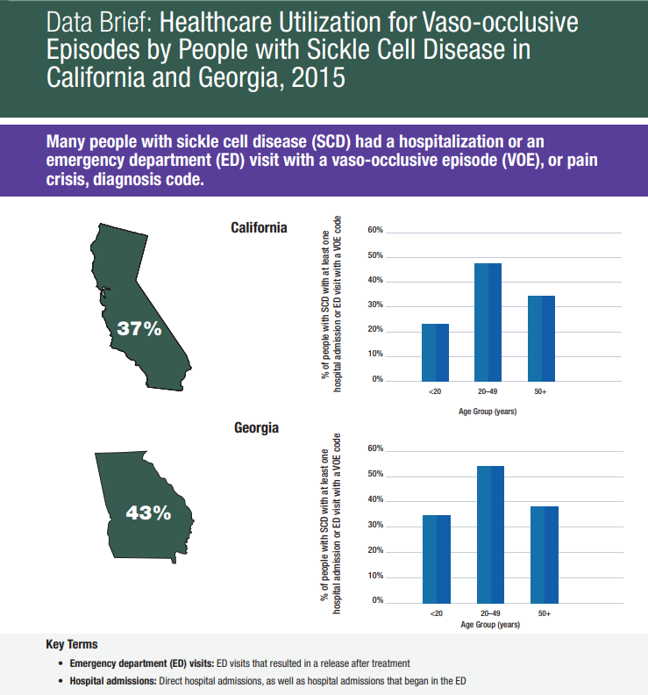
Utilization
Increases around the time of transition
Acute Care Utilization can be impacted by the availability of Preventative Outpatient Care
Provider Shortage
Insurance
CS 316407-A April 29, 2020
https://www.cdc.gov/ncbddd/hemoglobinopathies/scdc-voe-data-brief.html

Slide 7
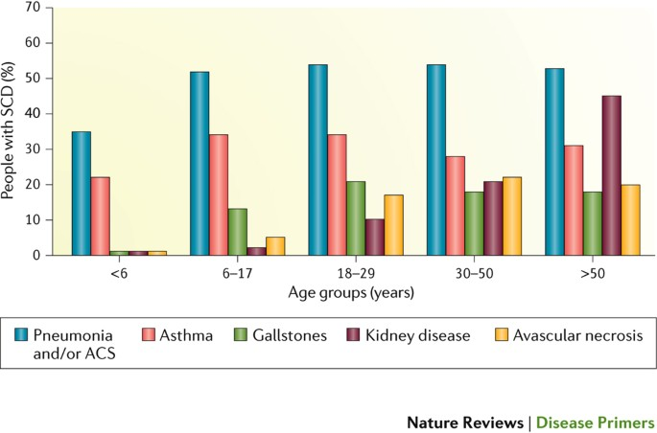
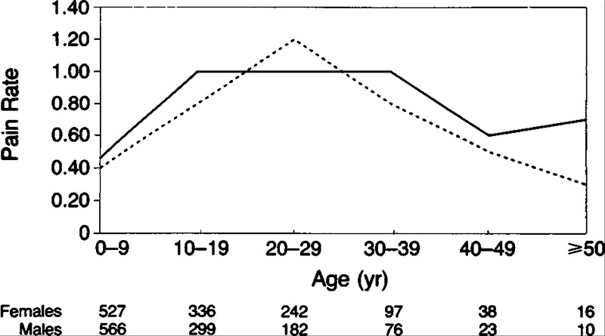
An Evolving Phenotype
Kato GJ et al. Nat Rev Dis Primers. 2018;4:18010.
Platt OS, Thorington BD, Brambilla DJ, et al. N Engl J Med. 1991;325(1):11-16.

Slide 8
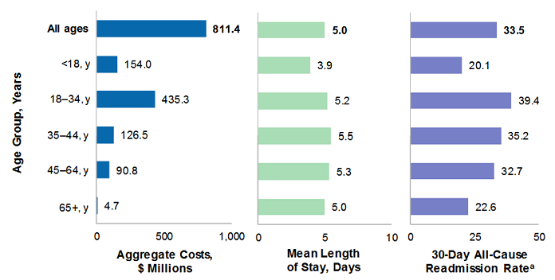
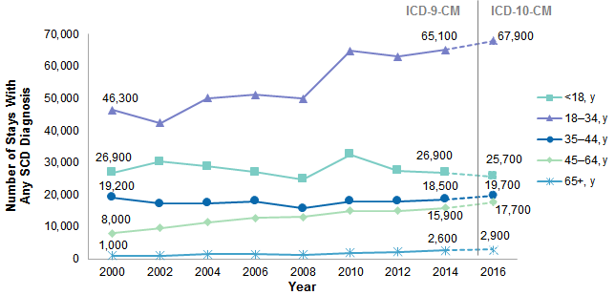
Rising Healthcare Costs
Healthcare Costs and Utilization Project (HCUP) National Inpatient Sample (NIS)
Fingar KR., et al. Healthcare Cost and Utilization Project (HCUP) Statistical Briefs, Agency for Healthcare Research and Quality (US), 3 September 2019.

Slide 9
What is Transition???

Slide 10
Transition—Definition
A gradual shift in:
Medical decision making
Medical oversight
Does NOT require a new provider! Just a new model of care!
Parent
Adolescent/Parent Unit
Adolescent/Young Adult
Notes:
Historically done at a certain age or some other milestone
Also when patient exhibited “adult behaviors”
Now considered a process with a beginning middle and end

Slide 11
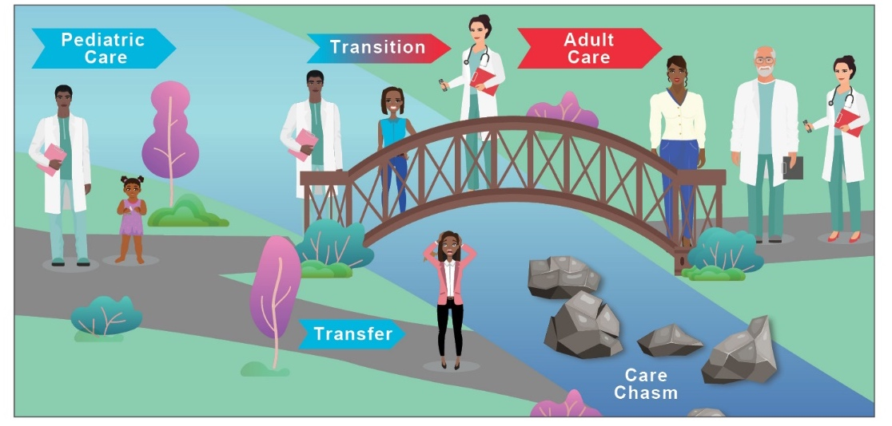
The Ideal: Lifespan SCD Care

Slide 12
From the Pediatric Feathered Nest to the Adult Medical Shack
Notes:
Should we accept the medical home to function like this for adults and young adults with SCD?

Slide 13
American Academy of Pediatrics (AAP) Principles of Transition
AYA–centered, strength-based focus
Self-determination, self-management, and family and/or caregiver engagement
Note individual differences, complexities
Note vulnerabilities, take distinct AYA population health approach
Early and ongoing preparation, integration into adult model
https://pediatrics.aappublications.org

Slide 14
AAP Principles of Transition (cont’d)
Shared accountability, effective communication, care coordination between pediatric and adult care
Adjust for cultural beliefs, attitudes, and SES
Achieve health equity, eliminate disparities
Parents, caregivers support AYA in building health knowledge, skills, decisions, self-care, and utilization of care
https://pediatrics.aappublications.org

Slide 15
How do you transition???

Slide 16
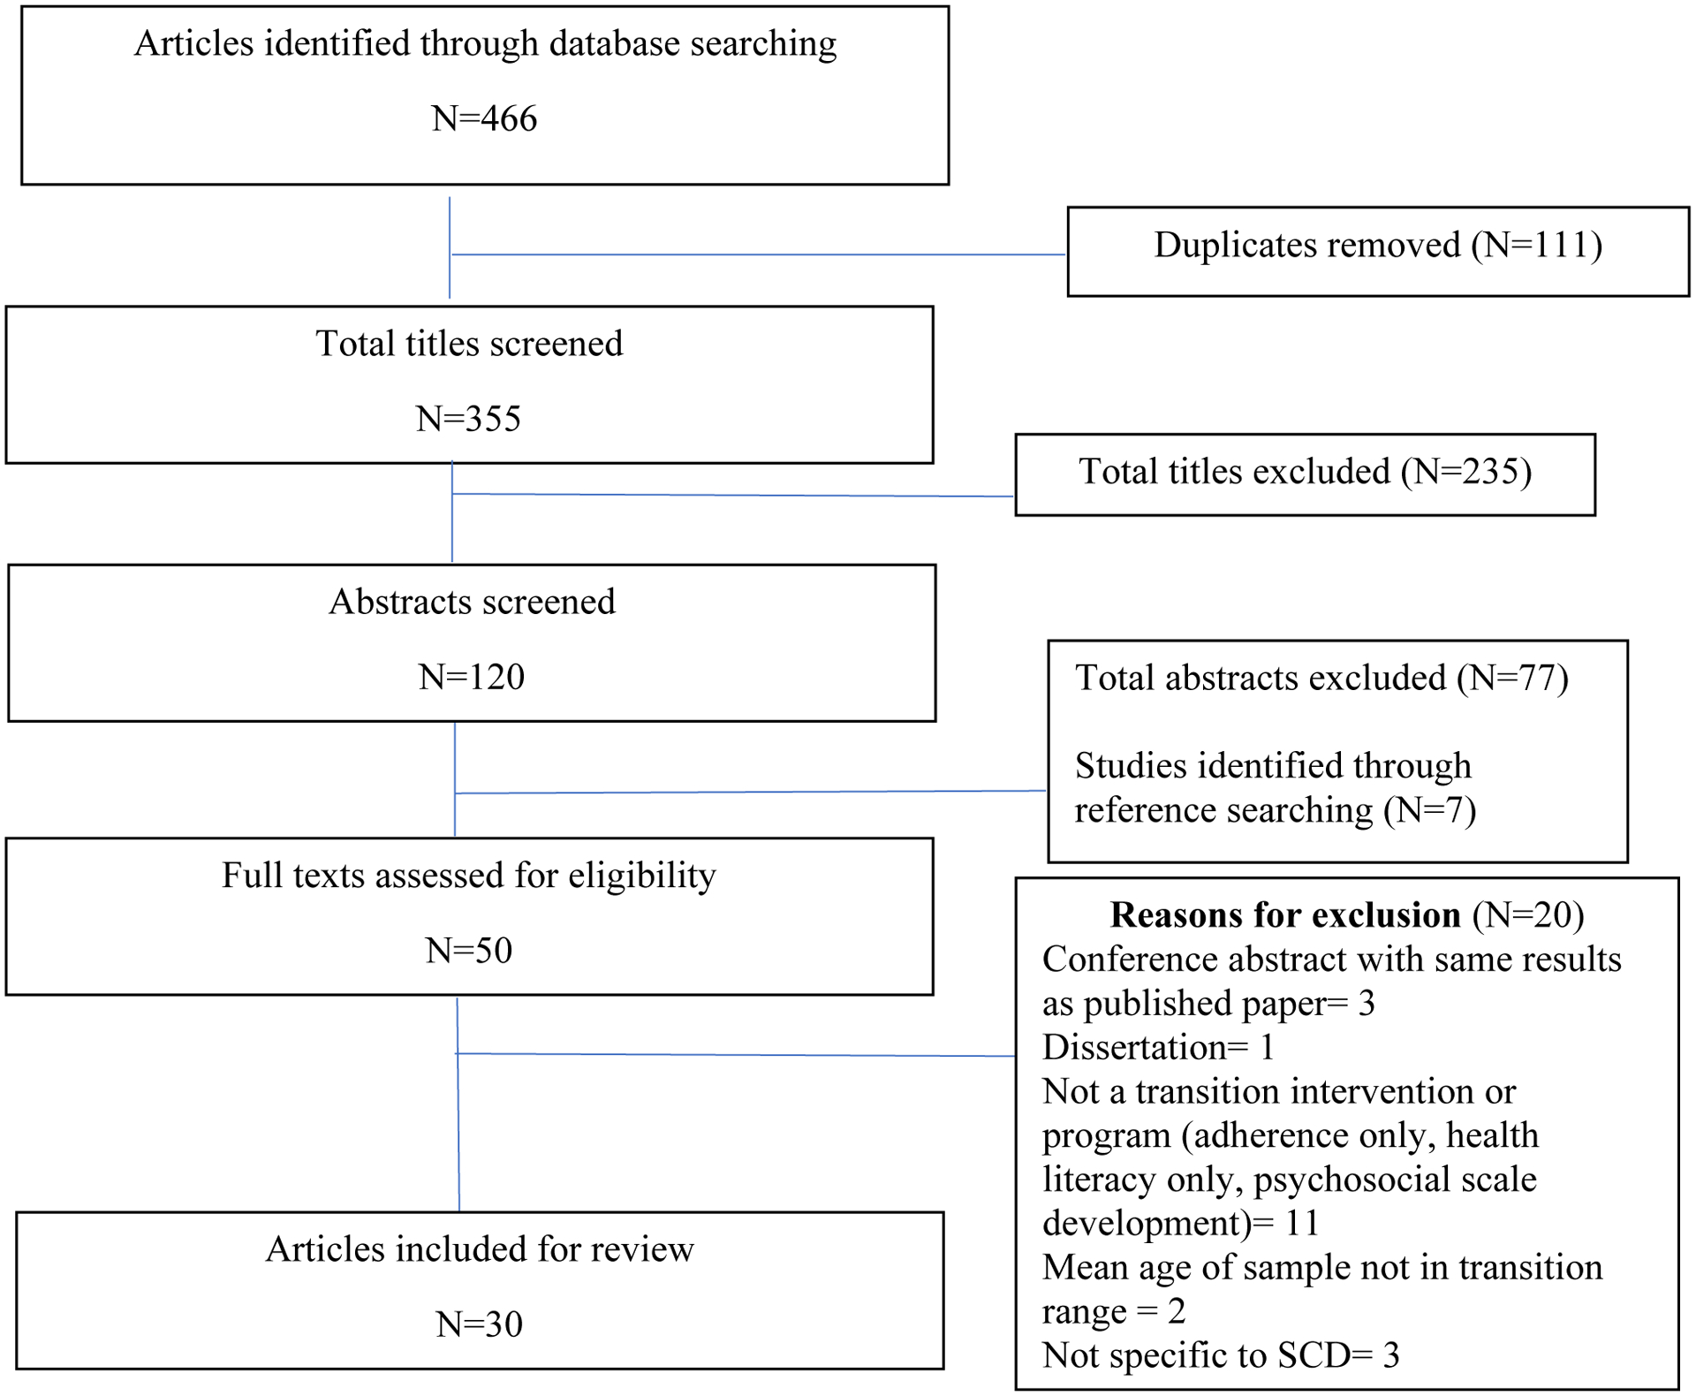
A Scoping Review of Transition Interventions for Young Adults With Sickle Cell Disease
2 RCTs
All limited to single institution
Most rated high risk for bias
Viola A et al. Pediatr Blood Cancer.2021;68:e29135

Slide 17
Data Outside of SCD
www.gottransition.org

Slide 18
Six Core Elements of Transition—Pediatrics
Age 14 to 18
Age 14 to 18
Age 18 to 26
Transfer to adult-centered care
Integration into adult practice
Confirm transfer completion
Elicit consumer feedback
Discuss transition policy
Track progress
Assess skills
Develop HCT plan, including medical summary
Age 12 to 14
Age 14 to 18
Age 18 to 21
1
2
3
4
5
6
Transfer and/or integration into adult-centered care
Transition completion and ongoing care with adult clinician
Transition tracking and monitoring
Transition readiness
Transition planning
Transition policy
https://www.gottransition.org/

Slide 19
Six Principles of Transition-Adult
www.gottransition.org

Slide 20
SICKLE Recommendations
Task force of experts from across the world used literature and expert opinion/experience
S: Skills Transfer
I: Increasing Self Efficacy
C: Coordination
K: Knowledge Transfer
L: Linking to Adult Service
E: Evaluating Readiness
Inusa BPD et al. Lancet Haematol. 2020; 7(4):e329-e341.

Slide 21
It takes a TEAM NOT two separate kingdoms

Slide 22
Typical Transition Team Members
Pediatrics:
Physicians and Advanced Practice Providers
Clinical Social Worker
Educational Coordinator
Clinical Psychologists
Nurse Navigator
Transition Coordinator
Adults:
Physicians and Advanced Practice Providers
Clinical Social Worker
Patient Navigators
Inpatient Nurse Practitioner
Transition Coordinator

Slide 23
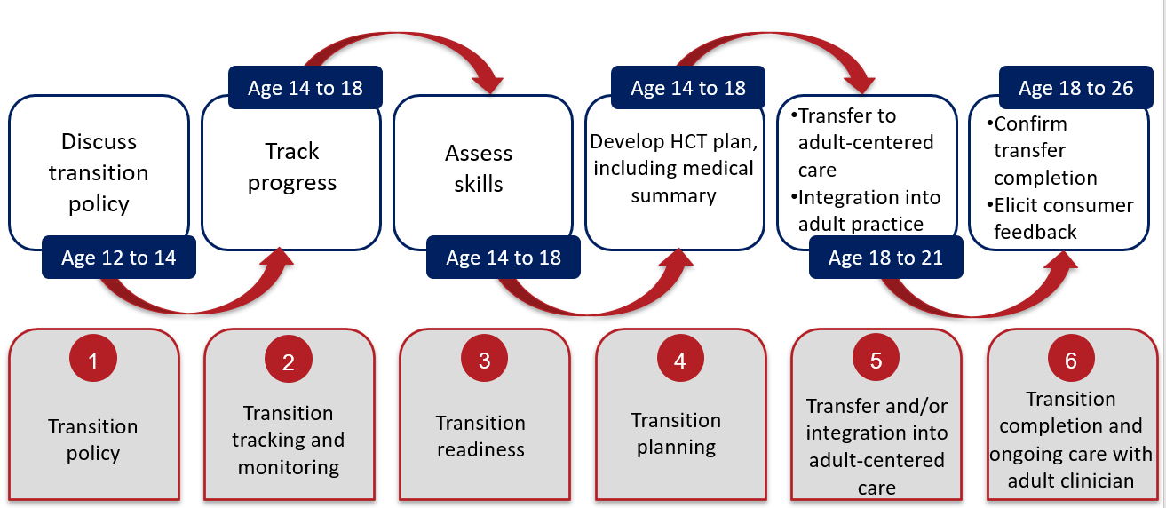
The TEAM
www.gottransition.org

Slide 24
Typical Assessments
Feelings and Attitudes
Readiness
Transfer Success Rate
Satisfaction
www.gottransition.org

Slide 25
Readiness Assessments
ASH
Transition Intervention Program-Readiness For Transition (TIP-RFT)
SCD-specific
22 items
Four subscales (clinical, not psychometric)
Independent Living Skills
Healthcare Knowledge and Skills
Education and Vocation Planning
Social Support Skill Set

Slide 26
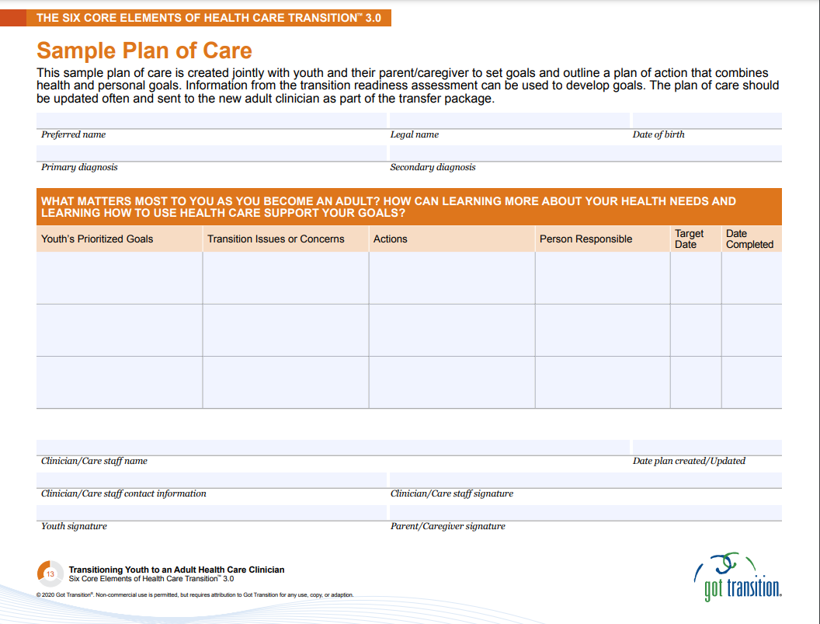
Transfer of Skills and Knowledge

Slide 27
Transfer of Care
Adult and pediatric teams agree on information transferred, how, when, and where
VCU–annual meeting

Slide 28
Integration Into Adult Care
Takeoff
Preparing to leave Pediatric Sickle Cell care for Adult Sickle Cell care
Limbo
Landing
Second and following clinic appointments with the Adult Sickle Cell Team
Settling
The time period between the last pediatric appointment and the first adult appointment
First clinic appointment with the Adult Sickle Cell Team

Slide 29
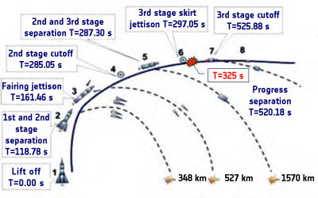
Phases of Transfer–Risks
Taking Off
Limbo
Landing
Settling
Crash is a danger at each phase
System often forces untimely transfer, depending on:
Individual patient (pregnancy, drug use, jail)
Individual medical structure and governance
College or no college?
Lost to follow-up prior to transfer?
Willing adult provider available?
Willing patient?
https://www.esa.int/ESA_Multimedia/Images/2011/08/Soyuz-U_launch_sequence#.ZEAwYAthfxQ.link

Slide 30
Barriers to Transition
Time
Money
People
Lack of adult (or pediatric) teams/providers
The whole system has to be involved

Slide 31
Case study: vcu

Slide 32
Program Structure and Environment at VCU ca. 2009
Shared governance under one medical center
Two silos of care: MDs and teams (peds > adult)
Ten years to build
Supported by three grants, state, and hospital

Slide 33
Skeleton: 2009-2012
Pilot Grant $50,000 over 3 years
One part-time coordinator hired
Collaborative quarterly meeting, peds, adult providers
Focus: Readiness assessment (developed scales from scratch, used Telfair and existing scales including ASH)
Focus: Transfer “landing rate” (> 1 adult visit)
Rose to 92% from 50% at the start of the grant
Focus: Education, daily living skills
Didactics, games featuring adult, pediatric providers
In pediatric clinic
Pediatric support groups, retreat

Slide 34
Between Grants: 2013-2018
Grant ran out 2012
No more cross-disciplinary didactics, less team meetings → annual
Adults
Director went to hospital for full-time program coordinator
Publications: transition readiness scale (TIP-RFT), program experience
Pediatrics–state mandate for education
Clinic appointments
Social worker shared with cancer
Educational specialist shared with cancer
Bi-annual camp retreats

Slide 35
Second, Third Grants, Hospital Funding: 2019–Present
PCORI: ST3P-UP (cluster randomized control trial of peer navigation)
NIH: randomized controlled trial of Case Managers
More hospital funding for pediatric and adult behavioral health team to begin a more collaborative effort of program development
TIP-RFT widely adopted as tool to assess transition readiness
Monthly meetings with both teams to address pediatric and adult policy
Gradually enlarged clinical and behavioral health teams

Slide 36
Transition at VCU ca. 2023
Transition services start in pediatrics and continue into the adult clinic environment for patients to age 25 (ish)
Young Adult Support Group
High school seniors invited to make early introductions to adult staff
Adult Patient Navigator/SW assigned to every transition patient
Continued access to appropriate pediatric psychosocial services (some after transfer)
Orientation to adult services and assessment at transfer
Full-time coordinator rebuilding bridges to connect services

Slide 37
Transfer of Care at VCU: How We Hand Off Care
Annual Transfer Meeting between Pediatric and Adult teams
Also attended by dedicated Inpatient Hospitalists (new in 2018)
Patient medical, psychosocial, and educational goals reviewed with adult team
Outpatient Nurse Practitioner meets with pediatric clinical team for complete medical demographic form on patients' history (new in 2019)
Appointments scheduled in adult clinic and provided to pediatrics for patient notification
Patient Navigator assigned to each transfer patient to “reach out” during initial transition process
Clinical Social Worker assigned to all patients for complete behavioral health assessment

Slide 38
Phase I @ VCU: Taking Off
Process
The adult team’s social worker, + transition coordinator practitioner will attend the patient’s last pediatric clinic appointment(s)
Purpose of visits
Build rapport with patient and family (if present)
Collect information about patient’s care and concerns
Answer any questions
Important notes
Transition process involves the patient and the patient’s family
Notes:
Taylor’s Slide

Slide 39
Phase II @ VCU: Limbo
Process
Patient assigned a navigator/community health worker or social worker
Schedule first adult clinic appointment
Discuss plan to meet with patient, before clinic appointment, and orient patient to adult program
Important notes
During this period, some patients visit the ED in-between the last pediatric and first adult appointment
ED visit sometimes serves as a “rude awakening” to the “adult world”
Heavy coordination on the spot during VOCs
CRASHES OCCUR
Notes:
Taylor’s Slide

Slide 40
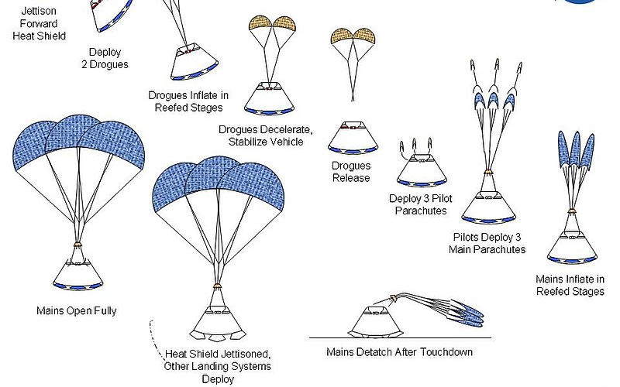
Phase III @ VCU: Landing
Process (sometimes between May and December after high school graduation)
A FAMILY AFFAIR-Transfer the mom and dad!!
Assigned patient navigator/community health worker
Social worker evaluates
Assigned adult Sickle Cell provider
If assigned patient navigator
Navigators will introduce themselves, discuss the adult program, and review transition policy
Appointment with social worker
Conduct the TIP-RFT assessment with the patient
Appointment with medical provider
Start building provider-patient relationship and help
patient establish care (parents come too!!!)
Important notes
During this time period, patients typically drop off
Adult team must reach out multiple times to encourage care
Notes:
Taylor’s Slide

Slide 41
Phase IV @ VCU: Settling
Process
Follow-up appointment with social worker
Conduct additional assessments
Triage patient care into one of the following:
“empty nest” care, case management care,
therapeutic care, or a combination care with
case management and therapy
Follow-up appointments with medical provider
Continue establishing care and building
patient-provider relationship (parents come too!!!)
Typical questions/comments:
“Why don’t you do it like pediatrics does it?”
“You didn’t come see me in the hospital!”
“Can I still call my pediatrician (specialist)?”
“Can you make adult Dr. (outside hospital) take better care of me?”
Notes:
Taylor’s Slide

Slide 42
Questions/discussion
Panel discussion

