Slide 1
Best Practice for Case Management and Coordination of Care
Shirley Johnson, LSW
Notes:
This is where you can add notes

Slide 2
Expected Takeaways
Learners will be able to:
Identify best levels of case management for their practice
Utilize levels of staff within the team to meet the needs of the patients
Includes screenings, case management, coordination of care, transition, mental health evaluations, behavior plans, and educational goals for patients

Slide 3
Best Practice for case management and Coordination of Care

Slide 4
Case Management Focuses on Patient-centered Care
An approach to health care that puts patients in the driver's seat
Health professionals have found that when patients play an active role in their own care they're empowered and results improve
Patient-centered care reduces unnecessary procedures, honors patient preferences, and improves patient health
Notes:
Care is collaborative and coordinated and goes beyond physical well-being to also include emotional, social, and financial aspects of a patient's situation.
Patients should always be in complete control when it comes to making decisions about their own care and treatment.

Slide 5
Patient-centered Care
Patient-centered care is achieved when an individual’s specific health needs and desired health outcomes are the driving force behind all health care decisions and quality measurements
Notes:
Eight primary goal is to improve individual health outcomes, not just population health outcomes, even though health outcomes may improve
Improved satisfaction scores among patients and their families
Enhanced reputation of providers among health care consumers
Better morale and productivity among clinicians and ancillary staff
Improved resource allocation
Reduced expenses and increased financial margins throughout the continuum of care

Slide 6
Benefits of Patient-centered Care
Primary goal is to improve individual health outcomes, not just population health outcomes, even though health outcomes may improve
Improved satisfaction scores among patients and their families
Enhanced reputation of providers among health care consumers
Better morale and productivity among clinicians and ancillary staff
Improved resource allocation
Reduced expenses and increased financial margins throughout the continuum of care
Notes:
Physicians were autonomous 30 years ago in their practice, leaders of their “firm” and left administration duties to administration; describing their problems in biomedical terms using their knowledge and skills from medical school.
Years ago, a patient went to the doctor when they felt ill, needing to know what was wrong with them or just obtaining a prescription to get better.
Today, the physician’s office may be calling the patient and the treatment is dictated by the evidence, which can be imprecise, equivocal or conflicting.
Patient’s values may not be considered and the solution to your problem will unlikely come in a bottle but rather a multidisciplinary team.

Slide 7
Polling Question
Where does your program stand in case management development?
1) Just starting or no progress
2) Staff approved but not hired
3) Hired and trained

Slide 8
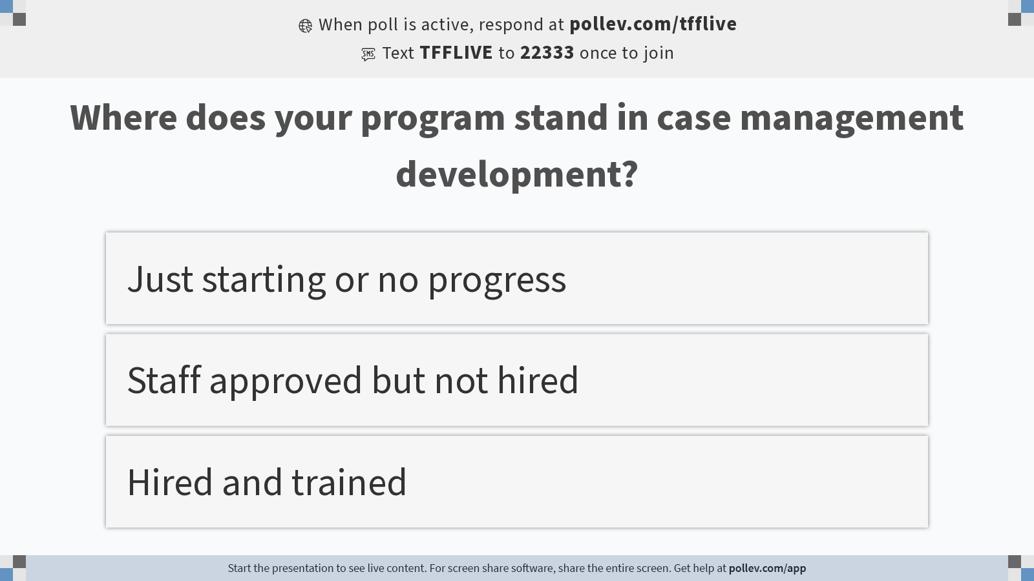
Notes:
Poll Title: Do not modify the notes in this section to avoid tampering with the Poll Everywhere activity. More info at polleverywhere.com/support Where does your program stand in case management development? https://www.polleverywhere.com/multiple_choice_polls/NVpPyw2kbpM94KzedE5Gj?display_state=instructions&activity_state=opened&state=opened&flow=Engagement&onscreen=persist

Slide 9
Notes:
Poll Title: Do not modify the notes in this section to avoid tampering with the Poll Everywhere activity. More info at polleverywhere.com/support Where does your program stand in case management development? https://www.polleverywhere.com/multiple_choice_polls/NVpPyw2kbpM94KzedE5Gj?display_state=chart&activity_state=opened&state=opened&flow=Engagement&onscreen=persist

Slide 10
Notes:
Poll Title: Do not modify the notes in this section to avoid tampering with the Poll Everywhere activity. More info at polleverywhere.com/support Where does your program stand in case management development? https://www.polleverywhere.com/multiple_choice_polls/NVpPyw2kbpM94KzedE5Gj?display_state=chart&activity_state=closed&state=closed&flow=Engagement&onscreen=persist

Slide 11
Define Case Management
The Case Management Society of America (CMSA) defines case management as “provided healthcare professionals working with people to identify issues and barriers that may prevent them from getting better and uncovering mutually agreed upon solutions to achieve their healthcare goals”
CMSA says CM is a collaborative process of assessment, planning, facilitation, care coordination, evaluation, and advocacy as options and serves to meet an individual’s and family’s comprehensive health needs through communication and available resources to promote patient safety, quality of care, and cost- effective outcomes”

Slide 12
Skills for Case Management
Case management requires professional skills and a variety of soft skills to perform the tasks and serve the client in the best way possible
Responsible
Organized
Strong communication skills
Able to delegate
Understanding
Adept at conflict resolution
Computer/Technology savvy
Efficient time manager

Slide 13
Boundaries of Case Management
Case managers should not:
Allow their own personal problems, psychosocial distress, legal problems, substance abuse, or mental health difficulties to interfere with their professional judgment and performance
Jeopardize the best interests of people for whom they have a professional responsibility

Slide 14
Six Key Elements of Case Management
Patient Advocacy
Cultural Competence and Social Determinant Awareness
Leadership Support
Communication Skills
Data-informed Patient Prioritization
The Human Element
https://www.healthcatalyst.com/insights/care-management-success-6-key-elements

Slide 15
What is care coordination?
According to the Agency for Healthcare Research and Quality (AHRQ), “Care coordination in the primary care practice involves deliberately organizing patient care activities and sharing information among all of the participants concerned with a patient's care to achieve safer and more effective care
The main goal of care coordination is to meet patients' needs and preferences in the delivery of high-quality, high-value health care. This means that the patient's needs and preferences are known and communicated at the right time to the right people, and that this information is used to guide the delivery of safe, appropriate, and effective care.”
https://www.healthstream.com/resource/blog/2021/04/01/the-importance-of-patient-care-coordination-for-outcomes

Slide 16
Two Ways of Achieving Care Coordination
There are two ways of achieving coordinated care:
Using broad approaches that are commonly used to improve health care delivery
Using specific care coordination activities
Examples of broad care coordination approaches include:
Teamwork
Care management
Medication management
Health information technology
Patient-centered medical home

Slide 17
Why is care coordination important?
Care coordination has been identified as an important way to improve how the healthcare system works for patients, especially in terms of improved efficiency and safety
Most importantly, care coordination applied in a targeted way has the potential for improved outcomes for patients, providers, and payers
All case management involves an element of care coordination, but not all care coordination merits being called case management

Slide 18
Care Coordination Has Four Components
Satisfaction
Function
Clinical
Cost of Care
https://www.elationhealth.com/care-gaps-blog/management-coordination/
https://www.jhsph.edu/offices-and-services/practice-and-training/_documents/PHASE-past-projects-PDF/year10_2012-2013/SinghManasvini_MSPH.pdf
Notes:
Satisfaction:
Achieve patient/family goals
Reduce unmet needs
Increase provider and staff satisfaction
Function:
Facilitate access to resource information
Achieve self-management skills
Enhance communication among providers/family/community partners
Increase functional abilities
Support achievement of optimal developmental trajectory
Act as single point of entry into multiple services
Provide positive social supports
Clinical:
Enhance communication among providers/family/community partners and increase measures of health
Increase activity: developmental screening and health promotion (early and periodic screening, diagnosis, and treatment)
Improve access to health and mental health care
Cost of Care:
Reduce emergency department visits
Reduce hospitalization/hospital days
Reduce duplication of tests, services
Reduce repeat data gathering by service providers
Reduce caregiver work days lost

Slide 19
How do you build the team to meet the need?
Plsek P, Greenhalgh T. BMJ. 2001;323:625-628.

Slide 20
Defining a Team
Strong leadership
Vision for the project
Sense of ownership
Respectful of timelines
Diversity
Transparency
Good communication
Generosity/Giving credit and appreciation
Notes:
Strengths-individuals flourish as they use and develop their Strengths
Teamwork-people come together building relationships that result in effective Teamwork
Alignment-the leader Aligns through effective communication of purpose, so each person’s strengths combine with teamwork, achieve results
Result-together everyone achieves more as performance flows and Results that are meaningful and rewarding to the team are achieved
No I in team

Slide 21
Components of One Multidisciplinary Team
Physicians
APP’s
Program Manager
RN’s
LCSW
CHW
Prior Authorization Specialists
Research Scientists
Data Analysts
*Job descriptions can be downloaded from the meeting’s website resource page
Notes:
How to Build a Sickle Cell Team:
Demonstrate to leadership outcomes they can relate to:
Cost savings
Reducing 30-day readmission rates
Reducing Inpatient Day stays
Improving Staff satisfaction
Improving Patient Care

Slide 22
Interchange of Roles of CHW’s, Social Workers, and Nurses
Each role in a team provides support. However, there are overlapping roles in the role of Patient Navigator (CHWs), Clinical Social Worker, and Nurses.
These roles may work in collaboration if your team has each of these staff personnel, or there may be a need for some positions to act independent if they do not have all personnel
However, nurses have clinical background and can provide medical advice, but CSW’s and PN’s cannot
Nurses cannot provide mental health treatment and should defer to a clinical social worker
Listens to needs and concerns
Teaches about wellness and skills for achieving goals
Helps in emergency situations
Helps make inpatient discharge plans
Helps find wellness resources
Helps make a plan to achieve goals for living with sickle cell
Checks in during hospital stays and clinic appointments
Runs peer support groups
Meets with you regularly to get updates on your progress and ask questions about your mental well-being
Helps with scheduling and transportation to appointments
Helps manage filing and taking medications
Helps find community resources

Slide 23
Training, Training, and More Training for the Team
Establish roles and responsibilities to avoid overlapping of services
Teach knowledge of sickle cell disease, medication, and understanding of patients’ needs
Share extensive knowledge of community resources and engagement with patients
Stress key components of motivational interviewing, care coordination, and case management training

Slide 24
Empathy and the Impact on Patient Care
All the training in the world will not be successful with patients if the healthcare professional does not make the patient feel understood and cared for
"Clinician empathy” improves patient satisfaction over 65%
Patient satisfaction is improved despite the care outcomes
Patients should feel heard
Treat others in the context of how you want to be treated
Navigators must still at times provide challenging news to a patient, however if the patient has a good relationship with them, the outcome may still be achieved
https://patientengagementhit.com/news/consumers-say-patient-provider-relationship-key-to-quality-care

Slide 25
Strong Communication by ALL Team Members
Essential for positive patient-provider/CHW relationship
Clear medical instructions
Patient education
Other important clinical information
Recognize literacy issues
Patient teach back
Understanding the patient’s literacy and cognitive impairments are important to properly educate and support patient
https://patientengagementhit.com/news/patient-provider-communication-strategy-may-boost-education
https://patientengagementhit.com/news/3-key-traits-of-a-positive-patient-provider-relationship

Slide 26
Positive Patient Relationships: Knowledgeable, Listens, and Trustworthy
Shared decision-making is central to building trust
Three main points:
Patient education (sound familiar?)
Understanding patients’ culture and personal preferences
Engaging family/caregiver
https://patientengagementhit.com/news/3-key-traits-of-a-positive-patient-provider-relationship

Slide 27
Recruitment and Hiring Barriers
Institutions and hiring practices may inhibit your hiring path
Ex: Historical Black Colleges and Social Work Program
The institution immediate need vs your need differs
Posting, interviews, and hiring timelines are long and with the current labor shortage, this is a major issue
Great candidates may not be available once interviews and offers are completed
Staff may get frustrated with burden of other responsibilities

Slide 28
Interviewing Screening Tools
Look for community, experience in challenging roles, and passion
Involve team members if possible
Indicate the positive and negatives of the role
Positives: attitude to job; passion for underserved; admits challenges and resolve to them; willingness to learn and TEAM focused
Negatives: lack of flexibility, lack of team ability, lack of “fire” in their eyes

Slide 29
Attitudes Versus Experience
Throughout my experience, attitudes mean more to the success of the program than actual experience
Training can assist with deficiencies
Attitudes cannot typically be taught
Knowledge of sickle cell is a plus but not necessary
Notes:
All staff are CITI trained
Staff review the existing training now developed through the SCCAPE conference on disease, nutrition, roles and responsibilities, motivational interviewing,documenting and so much more.
Pair employee with seasoned staff for on the job intervention
Develop Talent Goals for employee to focus on during their probationary period.
Pre/Post test on training outcomes

Slide 30
Key Points
Offer independence yet be available
Recognize burnout and fatigue
Recognize key team members
Work with staff that have compassion with patients to improve skill sets that are not strong
Have an “open door” concept to stay connected to conflict and offer suggestions or support
Be a CHAMPION to the program
Recognize the challenges of TODAY

Slide 31
Job Descriptions
A lists of all job descriptions for the entire medical home team are on the web and can be located at:
www.sccape.org (the official link will need to be added, not ready yet, due to SCCAPE conference)
Or contact Shirley Johnson at Shirley.Johnson@vcuhealth.org or Rachel.Walls@vcuhealth.org

Slide 32
Determination of Case Load for CHW/ Navigators in Clinical Care Setting
Focus on your highest needs patients
Metrics:
Length of stay
30-day re-admissions
Total cost
No standards established
How do you effectively manage your caseload?
Identify what your ideal schedule would look like
Based on your ideal schedule, determine your ideal caseload
Set up an efficient management system that allows you to streamline as many tasks as possible
Notes:
How we began to identify high utilizers and continue to re-evaluate.

Slide 33
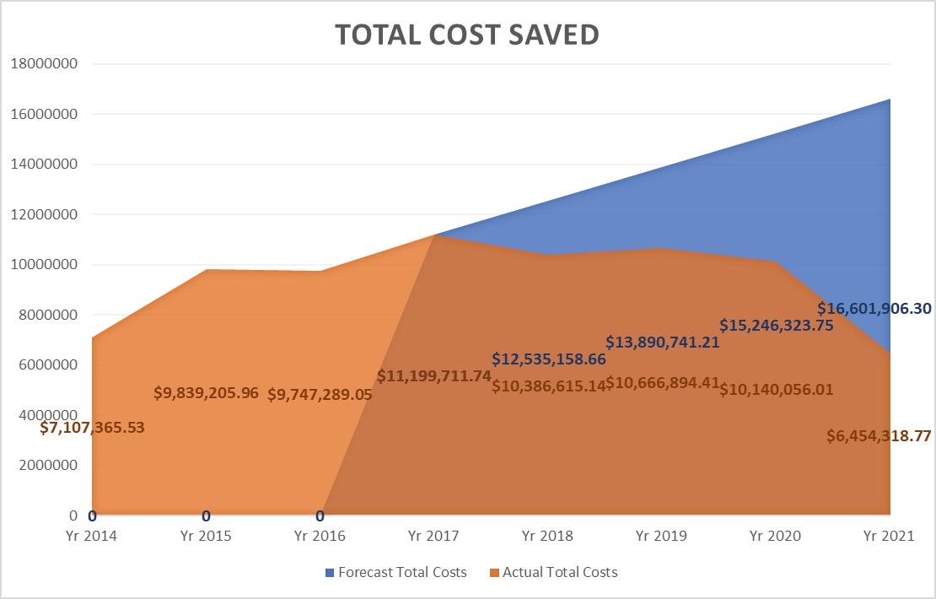
Developing a Standard at VCU
Stratified patients by cost of care:
Red: 2-year health care costs > $199K
Yellow: 2-year health care costs > $100K < $199K
Green: 2-year health care costs < $100K
Each navigator responsible for 25 patients in Red category and 25 in Yellow category
New Class of patients each year
In 5 years saved over $11 million
Notes:
The chart shows Projected vs Actual Total Costs from 2014 through 2021.

Slide 34
Best Hiring Practices
Full-time is a MUST
Why?
Employee has accountability to their role and obligations
Commitment to the program and population
Establish a sense of commitment to the other team members
Builds relationships with patients
Can evaluate and offer rewards in compensation or bonus
Employee may feel more valued; highly discourage hourly staff

Slide 35
Attrition
The best interviewing team can underestimate the candidate and commitment to the program
Manager needs to be attentive to concerns and address problems as much as can be expected
The challenging employee can “TIP” the boat of success
Have staff cross-trained on other caseloads for follow-up
Try and offer raises, bonuses, or recognition to the team members when they work at higher level
Evaluate success and support lack of success

Slide 36
Questions?

Slide 37
Auxiliary Slides
These slides can assist with roles and responsibilities of a behavioral health practice and can be used as an information for teams
Any questions please reach out to:
Shirley.Johnson@vcuhealth.org
Rachel.Walls@vcuhealth.org

Slide 38
Community Health Worker
Role
Outcomes
Liaison between medical team and patient
Advocate
Case management support
Relationship builder and trustworthy to patient
Ensure patients case management needs are met
Assist with medical compliance
Reporter to medical team
Notes:
So important to the program. SCD patients have medical needs of course, but what they have lacking, especially in adult care, is therapeutic support. Many patients suffer from anxiety, depression, PTSD(all a result of their disease and the trauma they have expeinced in the healthcare system). Trust is Key

Slide 39
Transition Coordinator
Role
Outcomes
Liaison between pediatric and adult programs
Assist with educational plans from pediatric through adult to provide insight into potential educational/vocational planning
Ensuring successful transfer to adult medical care
Builds trustful relationship with patient/families to secure successful adult transfer
Patient has consistent staff supporting them through pediatrics and adults
Educational planning begins earlier and remains consistent
Assists with adult provider transfer and ensures follow through
Notes:
So important to the program. SCD patients have medical needs of course, but what they have lacking, especially in adult care, is therapeutic support. Many patients suffer from anxiety, depression, PTSD(all a result of their disease and the trauma they have expeinced in the healthcare system). Trust is Key

Slide 40
Licensed Clinical Social Worker (LCSW)
Role
Outcomes
Provide necessary behavioral health treatments, diagnosis, and assessments
Transition liaison for adults
Therapy for the team
Being part of the team provides behavioral health insight into patients needs
Partner with pediatric social worker on streamlining of care for young adults
Generates revenue by billing
Notes:
So important to the program. SCD patients have medical needs of course, but what they have lacking, especially in adult care, is therapeutic support. Many patients suffer from anxiety, depression, PTSD(all a result of their disease and the trauma they have expeinced in the healthcare system). Trust is Key

Slide 41
Social Work...
WHAT IS IT?
Originally created for the National Alliance of Sickle Cell Centers.
Presented at NASCC Conference 2022

Slide 42
Social Work Breaks Barriers
Social work is a practice-based profession that promotes social change, development, cohesion and the empowerment of people and communities
Social work practice involves the understanding of human development, behavior, and the social, economic, and cultural institutions and interactions. Social work professionals working with families and institutions have helped to provide and advance the following social impacts:
Civil Rights
Unemployment Insurance
Disability Pay
Workers’ Compensation
Reduced Mental Health Stigma
Medicaid and Medicare
Child Abuse and Neglect Prevention

Slide 43
Social Work is a way of understanding individuals in relation to their environment Systems Theory

Slide 44
Challenges You Encounter as a Social Worker
Working with vulnerable people
Unpredictable schedule
Time spent doing admin is time spent away from the patients
Caseloads are down but workloads are not
Staying up to date on changes in society and human behavior
Notes:
Hurt people, hurt people
You never know when a crisis will arise

Slide 45
Burnout in Social Work and Why
Staff shortages (93%), unmanageable caseloads (90%), and long hours (80%) are identified by social workers as major concerns affecting their ability to do their job​s, according to the union
Low salary, lack of organizational support, and not feeling appreciated
Why are so many social workers leaving the profession?
"Workers are leaving the profession in droves due to excessive paperwork, too high caseloads, ridiculously complicated procedures, constant changes in procedures, cultures of bullying, poor management, and lack of funding and resources to arrange services for the people they are meant to be supporting.”

Slide 46
LEVELS OF
SOCIAL WORK
BSW
LSW
MSW
LMSW
LCSW

Slide 47
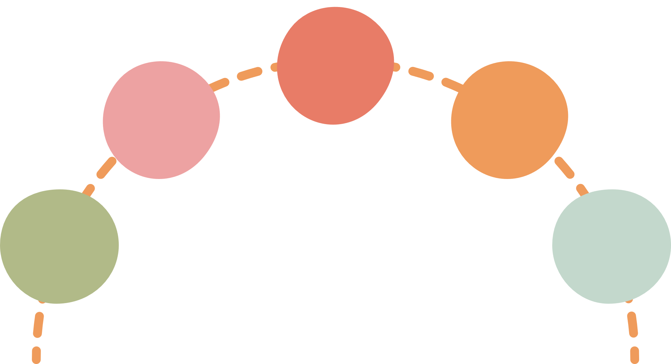
Focus:
Human Development and Behavior
Casework Planning
Direct Service
120 Credits
over the course of 4 years
Individual & family support services
Bachelor of Social Work (BSW)
Not Required for Licensure
Internship
400 hours
May be Certified/Licensed as LSW or CSW in some states.
Entry Level Position

Slide 48
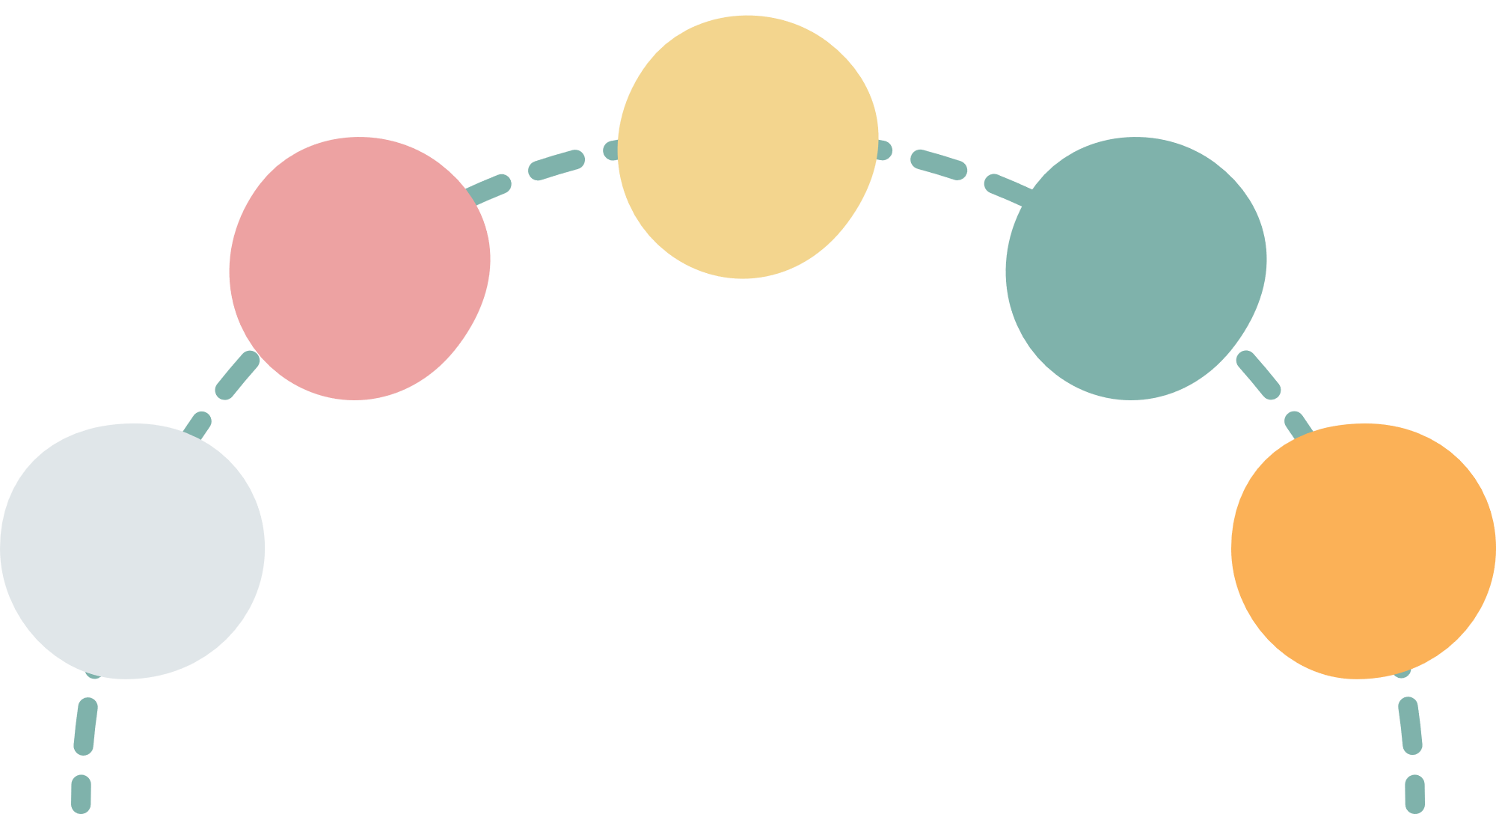
Assessments
Psychotherapy (must be under supervision)
Case Management
Advocacy
Liaison
Consultation
Focus
Macro, Meso, Micro
60 Credits
Scope of
Practice
Community Engagement
Community Organizing
over the course of 4 years
Internship
Master of Social Work (MSW)
Ethics
1,000-2,000 hours of supervised clinical fieldwork in specialty
Study NASW Code of Ethics
May be Certified/Licensed as LMSW, LBSW, or ASW depending on the state

Slide 49
Focus
Diagnosing
Assessments
Psychotherapy- Intervention and Treatment
Supervision
National Exam
100+ hours of 1:1 Supervision with a Licensed Mental Health Practitioner
Passing score on ASWB Clinical Exam
Clinical Practice
Able to practice psychotherapy independently, can bill for insurance
Licensed Clinical Social Worker
2,000-3,000 + hours of 1:1/group
May be Licensed as LCSW, LICSW, LCSW-R, LCSW-C depending on the state

Slide 50
Psychotherapy
(mental health counseling)
Licensed Clinical
Social Worker
(LCSW)
Licensed Mental
Health Counselor
(LMHC)
Licensed Professional
Counselor
(LPC)
Clinical
Psychologist
(PsyD, PhD)
Licensed Marriage &
Family Therapist
(LMFT)

Slide 51
MEDICAL SOCIAL WORK
SICKLE CELL DISEASE
What social workers do NOT do:
Prior Authorizations
Indirect Reporting
LCSW does NOT do:
Case management
... but they can when needed

Slide 52
Appointment Navigation and Management
Referrals to social services and government agencies
Discharge Planning
Liaison with providers
Transition Coordination
Transportation
Supportive Counseling (Active listening, Crisis Intervention)
Deescalate Situation and refer to clinical profession if needed
Case Management (Transportation, Housing, Disability, Insurance)
Referrals to Community Based Organizations
Advocacy
Vocational and Job Support
Financial Navigation
Assist with filing for disability (Medicaid/Medicare)
Bachelor of Social Work
(BSW)

Slide 53
Everything a BSW can do, but also...
Master of Social Work
(MSW)
Support Groups/Focus Groups
Educational Groups
Program Development
Reviews discharge summary with patient
MSW can provide therapeutic support as long as they are supervised by a LCSW

Slide 54
Providing therapeutic interventions
Program Development
Assessments and Diagnosis
Referring to Psychiatry
Referring to Community Resources for Special therapeutic interventions
Supervision (if certified by state)
Billing (LCSW can generate income for the institution)
May be certified to offer alternative pain management/coping i.e., Pain Reprocessing Therapy (PRT), CBT, Mindfulness-based therapies
Licensed Clinical Social Worker
(LCSW)

Slide 55
Behavioral Health Role Clarity
Patient Navigator/CHW
Transition Coordinator
Clinical Social Worker/Psychologist
MSW Intern
Works 1:1 with high-risk patients, high utilizers of ER/hospital services, and transition aged patients
Case management
SDOH Support
Medical liaison
Liaison between pediatric team, adult team, and CBO
Planning, organizing events, camps, workshops, etc for TAP
TIP-RFT assessments
Referrals to LCSW, as needed
Present at first adult appointment
Individual Psychotherapy and Treatment planning
BH/Substance Use Assessments
Refers out to psychiatry
Group facilitator (workshops and therapy groups)
CBO Referrals
Initial MH Assessments
Data entry
Managing Tiers of Engagement

Slide 56
Transition Assessment Review and Delegation Chart for Adult SCD Team
LCSW
Therapy
Patient Navigator
Transition Coordinator
MSW
Intern
Assessments completed at first adult appointment visit by either LCSW or MSW intern. Each week LCSW reviews assessment outcomes with all behavioral health team members above in a meeting and team determines roles and responsibilities for patients based on assessment outcomes.
LCSW: therapy appointment scheduled ___yes___ no_____ date
MSW Intern follow-up___ yes___ no___ assignment
Transition Coordinator follow-up:___ yes___ no Educational Plan in EPIC:____ yes___ no
Patient Navigator follow-up:___ yes___ no___ assignment
Transition Coordinator will update team members weekly during morning
meeting after this is completed.

