Slide 1
SICKLE CELL CENTERS: Alternative Models for Delivery of Care
Julie Kanter, MD
Director, Adult Sickle Cell Program
University of Alabama Birmingham

Slide 2
Disclosures
Consultancy: Bluebird Bio, BPL, ECOR-1, Forma, Fulcrum Tx, Graphite Bio, Guidepoint Global, Novartis,
Membership on an entity’s Board of Directors or advisory committees: Astrazeneca, Baush, Beam Therapeutics, Bluebird Bio, BPL, Forma, NHLBI, Novartis, ORIC, Sickle Cell Disease Association of America

Slide 3
Introduction
Sickle Cell Disease: a rare disease that still limits life expectancy through chronic complications despite childhood survival and availability of therapies
At the individual level, it is about where you live:
Healthcare opportunities and insurance are state-based and even more local than that
Insurance may be available but ≠ access to necessary care
Best care often equilibrates to best advocates or knowledge
This workshop is designed to shift programmatic emphasis to how to build a system of care to enhance access and coordination of care for affected adults

Slide 4
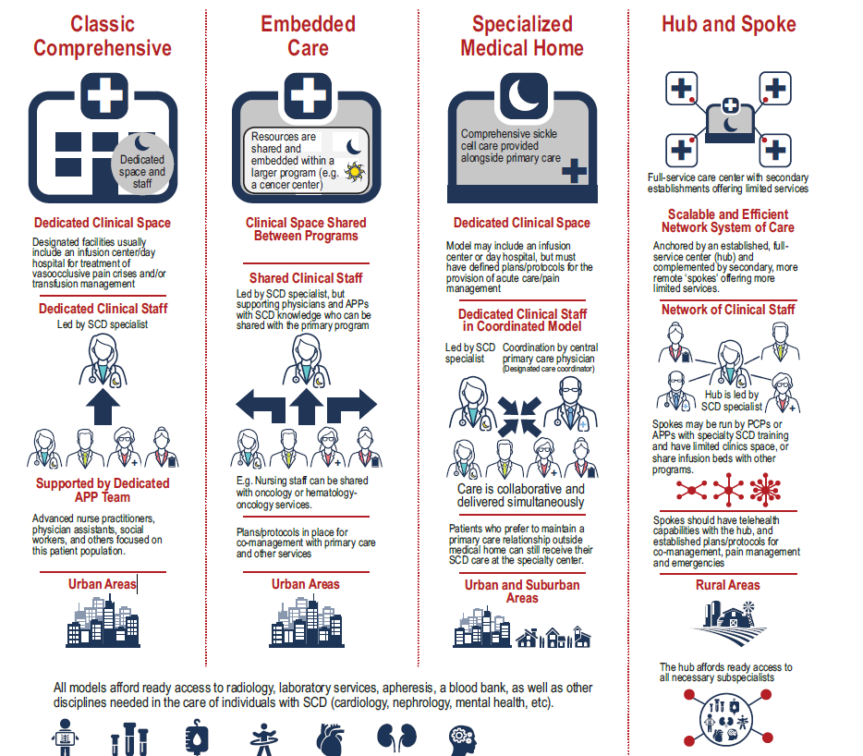
Lanzkron S: 2021
Q1 What kind of space?
Q2 Status of the clinical staff
APP Team associated with secondary care centers
Shared APP Team
Coordinated APP Team
Q3 Status of the APP team
Q4 Where is your center located?
Ready access to subspecialists
Subspecialists

Slide 5
Lanzkron S: 2021
Ready access to subspecialists

Slide 6
Comprehensive SCD Center: Urban

Slide 7
Urban Comprehensive SCD Center
Faculty: Sickle Cell Specialist lead center with other SCD specialists
Embedded full time psychologist
Dedicated APPs
Dedicated clinic space and infusion/day hospital
Extended hours (7a-7p)
Tele-mentoring to other colleagues
Full time social worker
ER Observation unit
Transition clinic
Apheresis unit
Notes:
Hopkins

Slide 8
Urban Comprehensive SCD Center
Faculty: 2 physicians and one outpatient NP
Day Hospital with extended hours (7:30 am−8:00 pm)
Inpatient benign hematology service w/ 3 NPs/PAs +1 that rotates in the day hospital
Two SW (one outpatient/one inpatient)
Two PCRM (coordinator with nursing background) for outpatient and inpatient
Part time pharmacist and part time psychologist
Urgent care/obs infusion that can see patients from 4:00 pm till 6:00 am
Shared non malig-heme educator
Home visiting primary care program that really helps with the complex patients and coordination of care
Monthly multi-D clinic with psychology, addiction medicine, pharmacist and hematology
Subspeciality support

Slide 9
Comprehensive SCD Center: Suburban

Slide 10
Comprehensive SCD Center (Suburban)
Faculty: A SCD specialist
May have additional providers from internal medicine or hematology
A patient care navigator
APPs
Embedded clinic coordination with transfusion medicine and psychiatry
Infusion center
Physical therapist
Apheresis unit
Notes:
UNC

Slide 11
Comprehensive SCD Center (Suburban)
Faculty: 4 physicians that provide clinical care for 10-15% of FTE
2 PAs and 2 NPs
Sickle Cell Infusion center with extended hours
(8:00 am−8:00 pm M-F and weekend hours 8:00 am−4:00 pm S/S)
Full time SW with 2 social work interns
SCD educator
Dedicated nursing staff (2 RN)
Psychologist is embedded 1/2 day/week
Broad subspecialty support including transfusion medicine, pain, gyn, MFM, surgery, pulm, cardiology, nephrology, etc
Notes:
Duke

Slide 12
Embedded SCD Program in a Large Cancer Center Program
Serve a very large urban area with a large population
Primary hematologist lead
Dedicated APP (2) who rotate in/outpatient
Non-malignant heme physicians in the practice see many of the less complicated patients and refer in the more complicated patients
Non-malignant physicians cover inpatient with APP from the clinic
Consults for pain plans and all patients have individualized care plans (no infusion center)
Educated nursing team (take messages, schedule follow up, do depart summaries, check message box and respond to all refills and PA requirements)
Full time Social worker
Notes:
Atrium Health

Slide 13
Specialized SCD Medical Home
Led by a sickle cell specialist
Supported by dedicated APPs with SCD training
Dedicated clinical space and staff for SCD
Provides excellent team-based SCD Care
Includes primary care within the medical home
Embedded psychologist
Must have a care coordinator within the medical home
Specialized infusion center
Suburban or urban model where individuals may come in from further away or have difficulty coordinating care

Slide 14
Hub and Spoke Model of Care (GENERAL)
Provides excellent team-based SCD Care
The HUB: Should resemble one of the above centers
Led by a sickle cell specialist
Has access to all necessary subspecialists
The spokes:
May be run by primary care physicians with contacts to the hub
May have SCD infusion areas or (more likely) shared infusion space in which they can provide pain management
Should include telehealth/outreach with the HUB
Includes a plan for co-management and emergency management

Slide 15
Augusta Center for Blood Disorders
Adult Sickle Cell Operations:
Augusta Clinic:
Monday−Friday
1 Hematologist, 1 APP, and 2 RNs
VOC Management:
ED Observation Unit: Rapid triage and admission (up to 24 hours)
Individualized pain plan with PCA
Inpatient Management:
Admission to Hem-Onc Service (attending, fellow, resident, and 2 APPs)
Average LOS: 4.5 days
Outreach Clinics:
1 MD and 1 APP travel to outreach sites monthly (Macon, Albany/Sylvester, and Savannah)
Telemedicine incorporated in 2016
Currently monthly Telemedicine clinics; on-site every 6 months
PCA, patient controlled administration

Slide 16
Sickle Cell Outreach Clinic Sites (Affiliates)
Sylvester (Albany Area)–Hematology Specialists:
Phoebe Putney Cancer Center
Staff: Nurse Navigator (embedded)
Savannah–Primary Care / Consultation Clinic:
HCA Family Medicine Clinic
Staff: Family Medicine Residents

Slide 17
Affiliate Clinics: Two Models
Savannah:
HCA Family Medicine (FM) Clinic
Staffed by FM Residents
Monthly onsite clinics, SCD expert supervising residents
Monthly lectures to residents on SCD care
Currently monthly telehealth
SCD expert available for phone/telehealth consultation
ED fast track pathway available for Family Medicine patients
Albany/Sylvester:
Phoebe Putney Cancer Center Clinic
Staffed by RN Navigator (MCG employee)
Currently twice monthly telemedicine clinics
Long-term partnership with Phoebe Cancer Center (7 adult Hematology-Oncology providers)
Interest in SCD care
SCD expert available for phone/telehealth consults
ED fast track pathway for VOC available

Slide 18
Affiliate-outreach: Pro and Cons
PRO:
Evidence-based SCD care in rural Georgia
Patients do not have to travel > 200 miles
Multi-specialty care available locally
Local ED fast track care for VOC
Possibility of enrollment in clinical research
Routine labs performed locally
CON:
Residents change annually (Savannah)
Need for ongoing SCD education
Risk of reducing SCD care to monthly opioid Rx
Inappropriate HU dosing
Lack of adequate monitoring (Fe overload, microalbuminuria, ECHO, and ophthalmology)
Lack of local technology for monitoring Fe overload (liver and cardiac MRI)
Lack of subspecialty expertise:
High Risk OB
Orthopedic procedures (core decompression)
Exchange transfusion capability

Slide 19
APP-run Affiliate Model

Slide 20
Alternative Models of Care for Affiliate Clinics
AFFILIATED with a Hub
APP trained in SCD management by a HUB
Manages a small outpatient population (suburban or rural)
APP-HUB in contact frequently
Telehealth appointments between HUB MD and the APP
Patients can be transferred to the HUB if needed and are seen by the HUB annually
Local infusion center/Day hospital

Slide 21
Affiliate to Associate to FULL Center

Slide 22
Regional Affiliate (in training to be a HUB)
A county with a large number of people with SCD who had to travel >/-45 minutes to an infusion clinic or specialty care
Supported by MD with SCD specialty training
Established with joint EFFORTS between hospital leadership and the HUB
FUNDING: Grant funding from the state for a full time APP, part time social worker to open the infusion clinic
SAPPORT-trained APP was trained through SAPPORT
Weekly meetings with the HUB to review patients and administration issues.
Usually have daily contact with APP’s at the HUB
GOAL: This spoke will need to grow into a hub to meet the needs of the local community and that is the hope for the future
Notes:
Univ Maryland Cap region spoke (who will be there at this meeting) is located in Prince George’s County

Slide 23
Affiliate + Hub Collaboration
All affiliates must provide comprehensive SCD medical practice but may work in collaboration with the HUB to have full access to these items
Affiliate: Disease modifying therapy
Affiliate + HUB to ensure SCD prevention practice
May need the HUB for brain/liver MRI, etc
Affiliate: Iron overload program
Blood transfusion management with extended cross-matching of blood
Pain management plan/program (collaboration with HUB)
Family planning plan
Mental health access likely to be referral based

Slide 24
Other opportunities:
TELEHEALTH
ECHO-SUPPORTED PROGRAMS
ED-OBS PROGRAMS

Slide 25
Questions

