Slide 1
Quality Improvement
2019 ASH Workshop Participant: Real World Lessons Learned
Ken Rivlin
NYC Health and Hospitals/Jacobi

Slide 2
Disclosures
Nothing to disclose

Slide 3
Learning Objectives
Understand the challenges and barriers faced when implementing comprehensive sickle cell disease (SCD) care within a public hospital system
Discuss strategies to enhance access to comprehensive SCD care through quality improvement
Recognize the importance of driving forces and collaboration in advancing SCD care and overcoming systemic obstacles

Slide 4
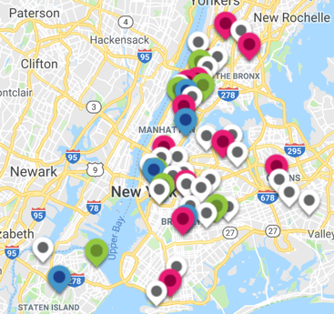
NYC Health + Hospitals: Overview of Hospital System
Largest public hospital system in US
Serve all regardless of ability to pay
Serve 1.2 million New Yorkers
11 hospitals
5 long-term care facilities
6 Diagnostic and Treatment Centers
Federally Qualified Health Center-Gotham Health
28 Centers
70+ Ambulatory Centers
MetroPlus Health Plan (Medicaid CMO)
500,000 members
6 of the 28 NYS Designated Newborn Screen Hemoglobinopathy Centers
2 life-span SCD Centers

Slide 5
NYC Health + Hospitals: Overview of SCD Patients Served
Unique SCD Patients Served
Overall: 2,500 patients
Providing consistent care:
1,200 patients
Note: Other NYC Hospitals 40% Medicaid/Uninsured
Payer Mix

Slide 6
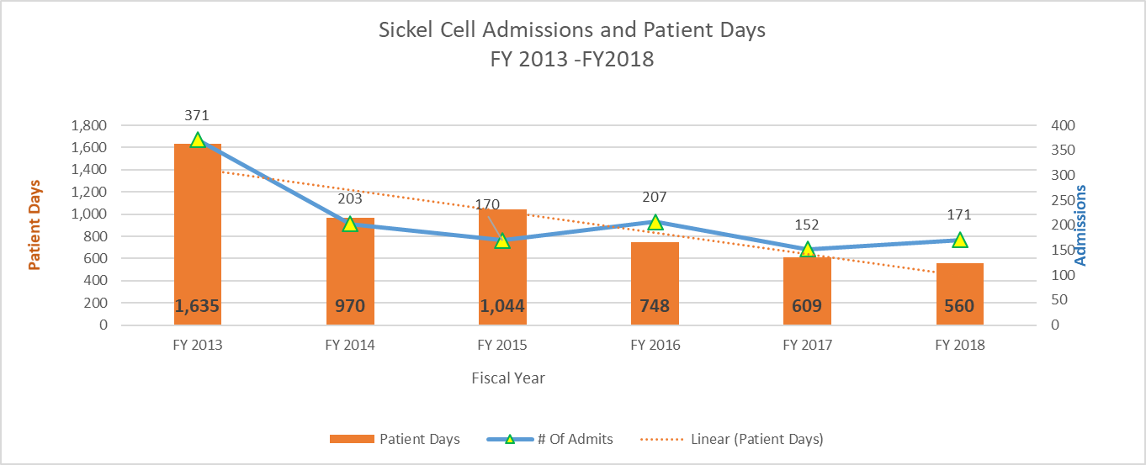
Post-Workshop Challenges: The "Yes, But...” Phenomenon
Executive Sponsor for Workshop
CMO for Ambulatory Care – Harlem Hospital
Goal rebuild adult comprehensive SCD center
Business plan showing savings
$1.7 million save by hiring SCD NP
Yes, but we need to show income generation
340B
Yes, but not part of C-suite thinking
PCP taking care of SCD patients left
Can’t find hematologist
Can’t find LCSW
CMO left
CEO of another hospital
Yes, this is a critical need
Major complaint of his ED doctors–not having a real center to refer patients
But, right now we have other priorities such as cancer, we will get back to you
Of note – he helped create a comprehensive SCD center at another hospital

Slide 7
The "Yes, But...” Phenomenon (cont’d)
CMO, Accountable Care Organization
Yes, it is important
But we have other priorities, there is no bandwidth to prioritized SCD
You need local hospital buy-in and the leadership as champions
CEO of NYC H+H
Yes, it is a horrible disparity
Work with Health Equity Council, Office of Population Health, and Office of Quality and Safety
Goal–One adult comprehensive SCD center in each borough
Added to priority list for the Office of Finance to develop business plan

Slide 8
Equity and Access Workgroup Proposal and Accomplishments
Proposal
Enhance Access to Comprehensive Adult SCD Care
Accomplishments
Utilization of Sickle Cell Disease Registry and EPIC Navigator across NYC H+H
Address the Transition and Transfer of Care from Pediatrics to Adult Care
Address Barriers to Obtaining Appropriate Pain Treatment
Mitigate the Negative Stigma of Individuals Affected by SCD
Address Insufficient Use of Disease-modifying Therapies
Create a Structure for Robust Continuous Quality Improvement
Leverage Support From H+H and Legislators to Supplement Inadequately Resourced SCD Community-based Organizations
Provide Access to Clinical Trials
Partner with Metro-Plus and Health Homes to Provide Case Management for Patients
Mitigate the Neurocognitive Effects of SCD on Mental Health and School Achievement/Performance
Leverage our Enterprise-wide Clinical Data to Inform Best Practices and Engage in Clinical Research/Publications/Presentations
Create referral system for Community Health Worker Within our System and With CBOs

Slide 9
Differences Through Quality Improvement
EPIC SCD Patient Registry
Standardized EPIC Documentation Through SCD Navigator
Dashboards for Quality of Care (HU, TCDs, and Vaccinations)
Patient Summary (Modeled on ASH Summary)
Import and reconcile data from non-EPIC systems (via RHIO/HealtheX)
EPIC Pain Action Plan or standardized ED pain protocol
Includes ”humanizing documentation”–what patients want ED providers to know
EPIC ASH Transition Tools
Referral system for community health workers (HU education/connect unaffiliated patients to medical home)
Use of Health Homes for case management (MetroPlus)
Educational module for reducing SCD stigma in ED
EPIC, an electronic health record system provider; TCD, time critical diagnosis; HU, hydroxyurea.

Slide 10
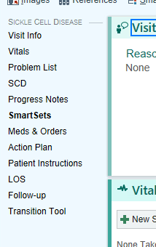
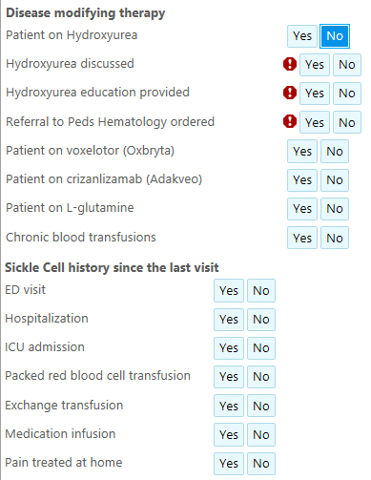
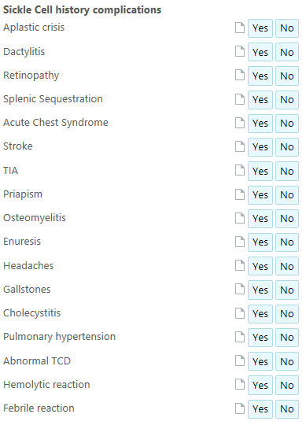
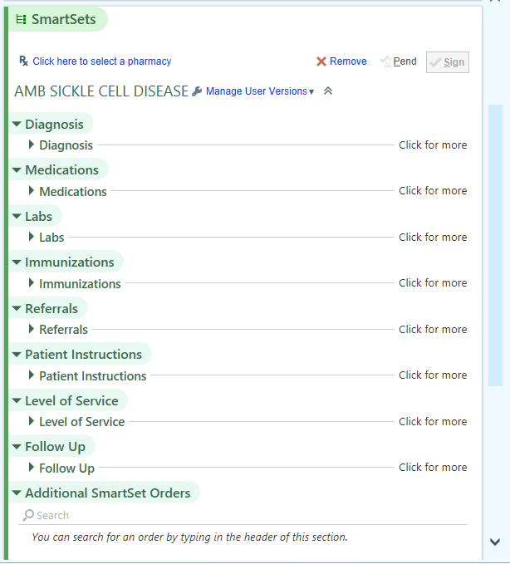
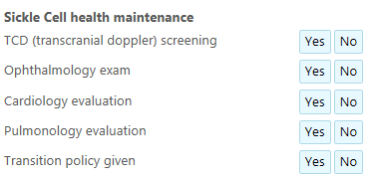
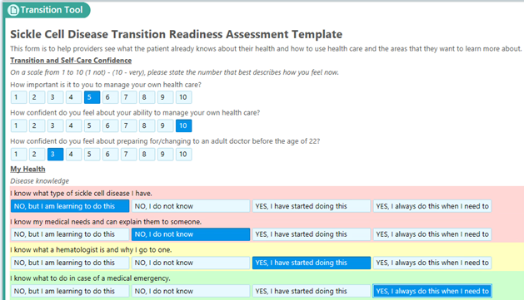
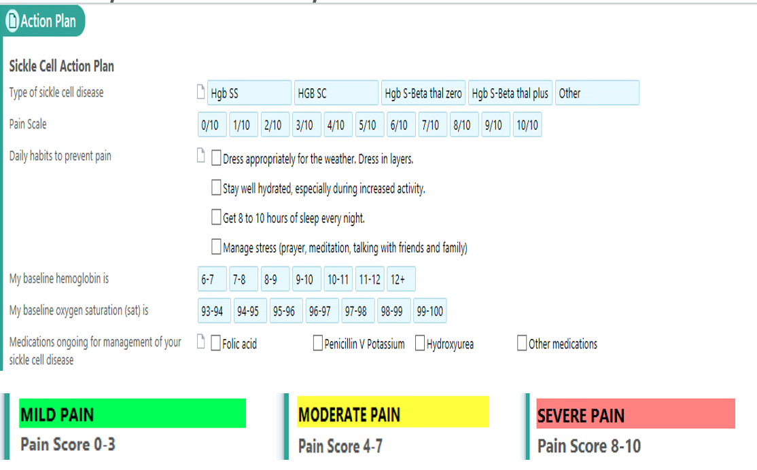
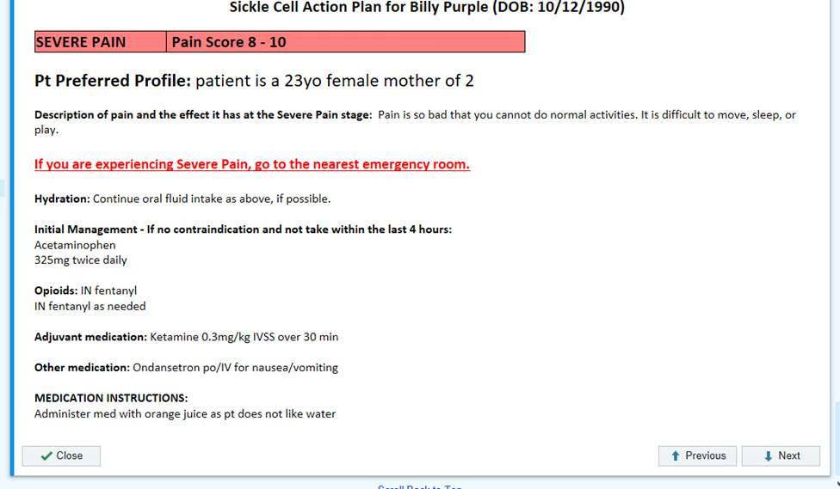
Building an Electronic Medical Record SCD Toolkit for Quality Improvement
Notes:
Will discuss:
Present content from FSCDR talk
What quality indicators need to be recorded?
How should quality indicators be measured?
How do we improve?
What QI needs to be done to say we have improved our clinical quality?

Slide 11
Collaboration for Change
Note
Systems are perfectly designed to get the results they get
To improve you need to change the system
To change a system, you need a driving force
My organizational culture is Top Down
Driving force: “They say it is important”
Driving forces at work at NYC H+H
ASH Adult Working Group
HRSA Sickle Cell Treatment Demonstration Project–SCD QI Project ECHO
HHS OMH–hydroxyurea grant (shared mental model)/partnership NYSDOH
National Alliance of Sickle Cell Centers
ASH SCD CTN, ASH Data Hub, and Learning Collaborative
Local SCD CBOs: SCTPN, QSCAN, and CSCF
Unions: CIR and NYSNA

