Slide 1
Data Analysis and Reporting - Review
ASH SCD Workshop Year 2 Cohort
Janis Bozzo, MSN, RN
Sr. Innovation Scientist
Yale New Haven Health
Notes:
Most of this content has been presented in previous live and module formats. This is a review to emphasize key concepts you should keep in mind as you continue to develop your program.

Slide 2
Content
Approaches to improving financial outcomes
Examples of data display and tracking

Slide 3
Overall Strategies to Improve Financial Outcomes
Best: New revenue
May be difficult to achieve for SCD population
Explore potential 340B-eligible outpatient meds/infusions
Next best: Reduction in financial loss
Associated corollaries: Backfill and downstream utilization
Notes:
Will discuss in more detail during rest of presentation -
Best: New Revenue.
The simplest example: recruitment of new surgeon performing new procedure for new patients.
For the SCD population, “new revenue” is harder to achieve - pts already coming to your institution for care and often have an unfavorable payor mix.
Where might there be “new revenue” for the SCD population? Look into 340B.
Note that the rules around 340B differ by location and change.
Explore local reimbursement for 340B-eligible meds/infusions (e.g., crizanlizumab).
Next Best way to pay for new resources: Reduction in financial loss.
-Move care out of inpt/ED and into the outpt - less expensive & results in cost savings.
Associated corollaries: “backfill” and downstream utilization.
-Will discuss more later.

Slide 4
Inpatient/Outpatient Visit Volumes & LOS
Notes:
Will review some examples of data display.

Slide 5
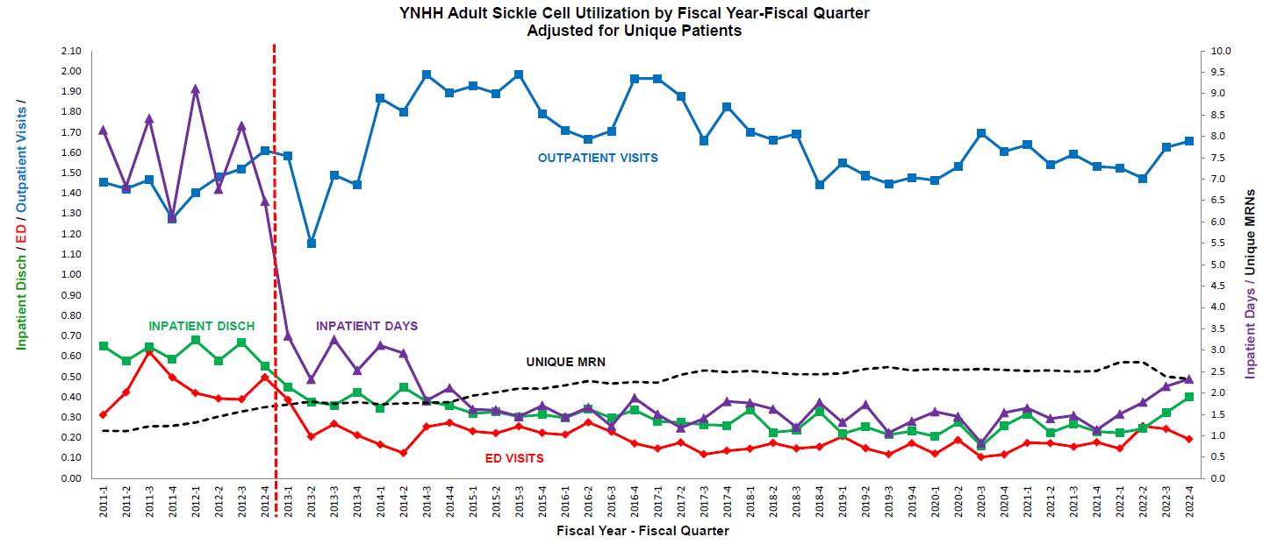
Outcome Measurement: Adult SCD Program Visit Volumes Adjusted for number of unique individuals
Notes:
Overall visit volume patterns by fiscal quarter, over time.
Keep pre-program baseline on chart as update.

Slide 6
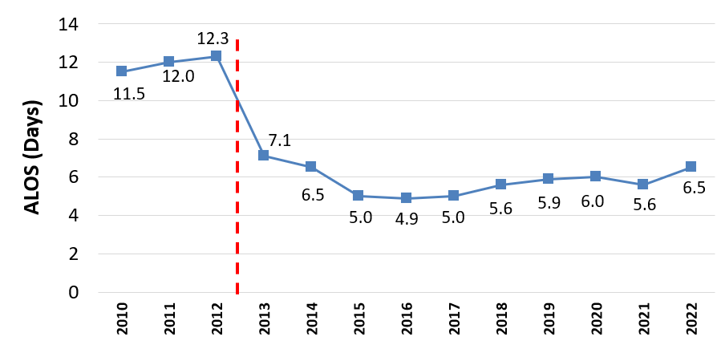
Outcome Measurement: Inpatient ALOS Reduction
Notes:
Same pattern as previous slide – this time looking at ALOS, which plummets in 2013 post program reorganization.

Slide 7
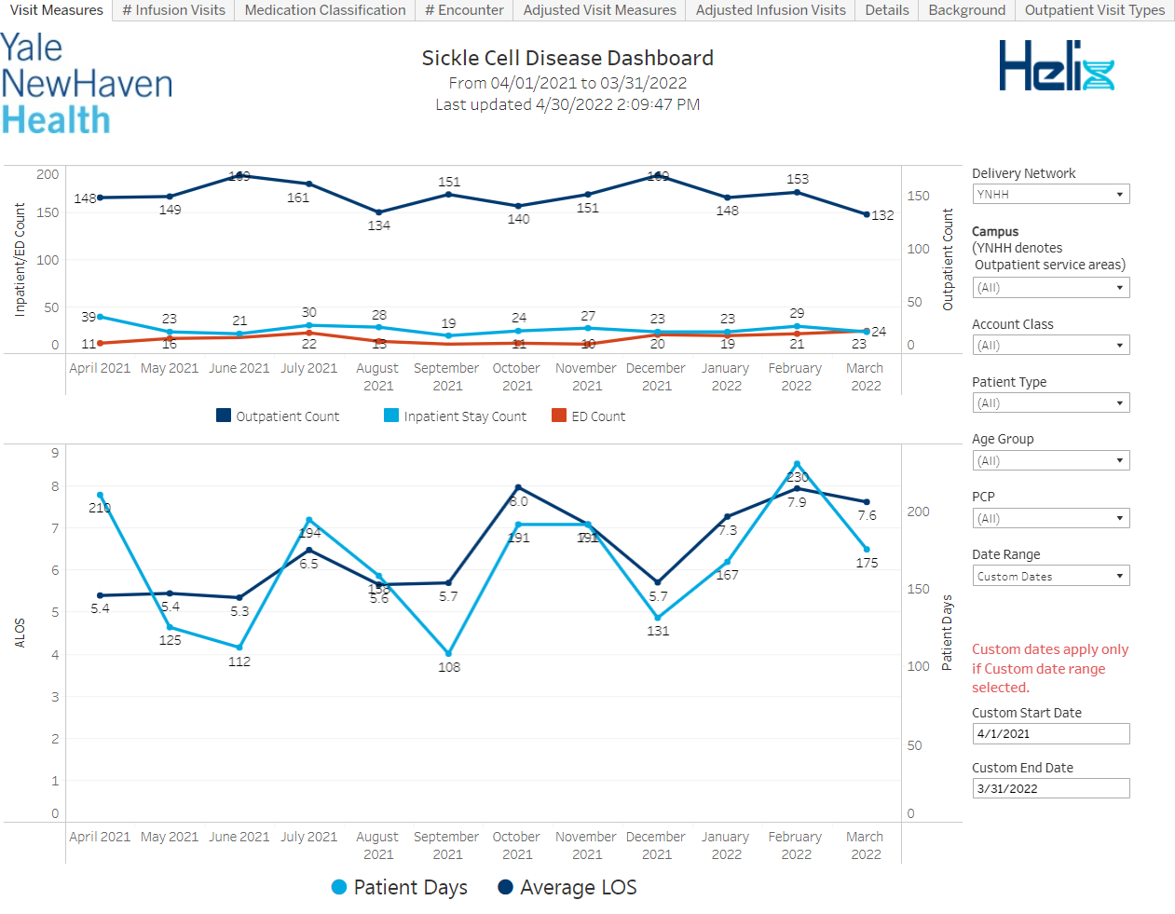
Online Dashboard
Notes:
Alternative to manually generated reports: electronic dashboard – linked to data repository and automatically updated with the latest data. Available to anyone with access to link.
Features: multiple report tabs; filers (right) for customization by end user.

Slide 8
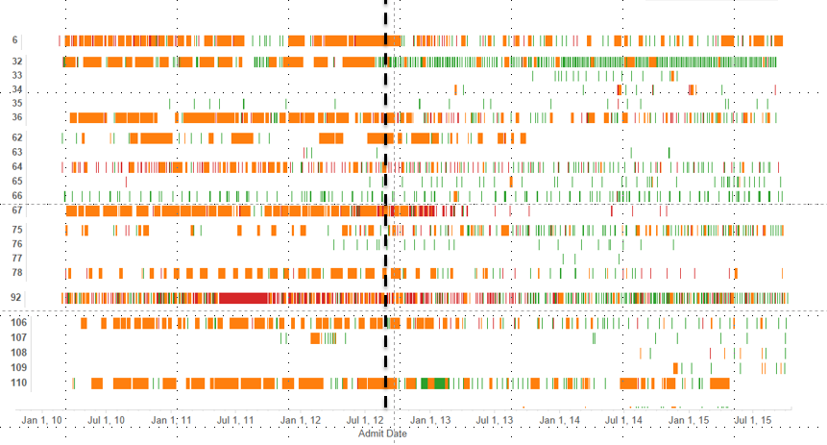
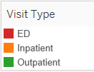
Outcome Measurement: Patient Level Visit Volumes
Pt ID
Notes:
Another example of a report to track inpatient and outpatient utilization – this one displays individual patients and shows visit patterns over time.

Slide 9
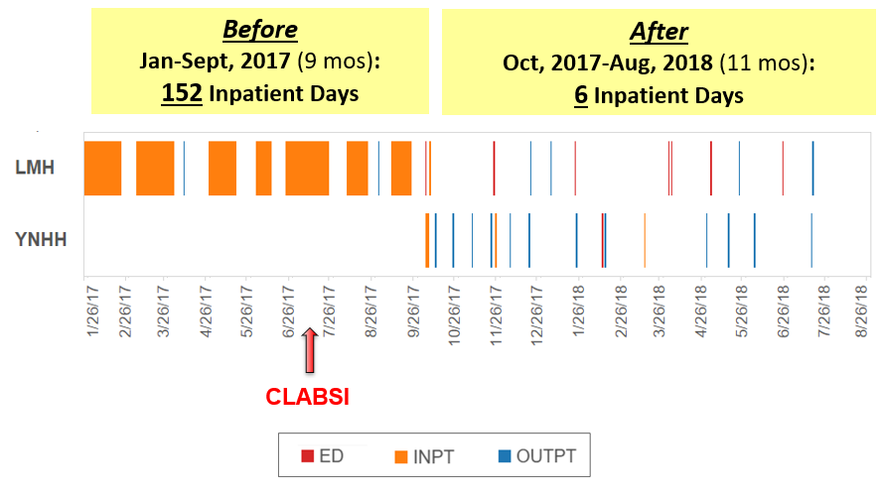
Measuring Outcomes: “Patient Story” Longitudinal Analysis of One Patient’s Visit Patterns
CLABSI, central line-associated bloodstream infection
Notes:
“Patient Story” of individual patient - powerful example of program success.
“Longitudinal analysis” – tells story of one patient whose care was shifted from another YNHH-S hospital (“LMH”) to YNH:
-30 y/o man with many psychological issues. In 2017 receiving lots of acute care services (ED/inpt) at LMH without engagement in long-term ambulatory care. Spent more than half of the days over 9 months in the hospital.
-IV access issues – ended up with CLABSI and Septicemia.
-In 2018, YNH SCD program director contacted providers at LMH and invited them to transfer patient to YNH for care. Transferred to YNH during LMH ED visit in early FY 2018, and continued to receive care in outpatient setting at YNH with much reduced acute care utilization (and better outcomes).

Slide 10
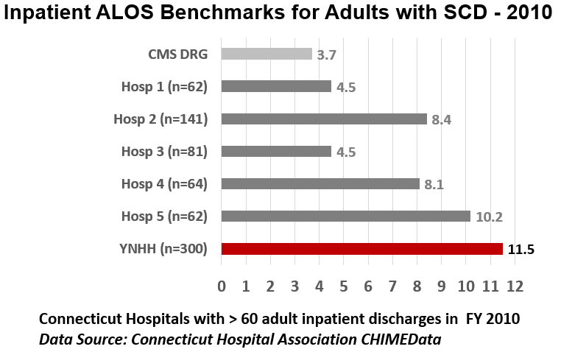
Benchmarking
Notes:
Another useful data point: benchmarking key metrics against outcomes of other institutions. This pre-program ALOS benchmark picture provided impetus for Administration to support $$ infusion to improve program.
Data Sources for benchmarking:
Hospital Association databases (by state) – e.g., YNHH submits data to this CT-wide database and the Strategic Planning Dept. runs benchmarking analysis in the data returned to YNHH from CHA.
Vizient (formally UHC) is a good source of benchmarking data with a robust data analysis platform.
There may be others – not all are national, but can network with providers in your region for suggestions.

Slide 11
EMR Support to Optimize Clinical Management: Care Signature pathways for adults with Sickle Cell Disease
Goals:
Provide high quality, evidence-based equitable care
Reduce unnecessary variation; facilitate best practices
Improve clinical and financial outcomes
Developed using up-to-date medical literature and local clinical expertise
Embedded in EMR, with hyperlinks to relevant orders, references and other content
Pathways may target treatments (e.g., “mechanical ventilation”) or diagnoses (e.g., “SCD”)
Notes:
I wanted to highlight a YNHHS care-improvement initiative up and running for 2+ years by Care Signature Department.
YNHHS partnered with AgileMD™ to create EHR-Integrated Clinical Pathways for inpatient and outpatient care.
The pathways are used throughout YNHHS-affiliated hospitals to promote uniform best practices.

Slide 12
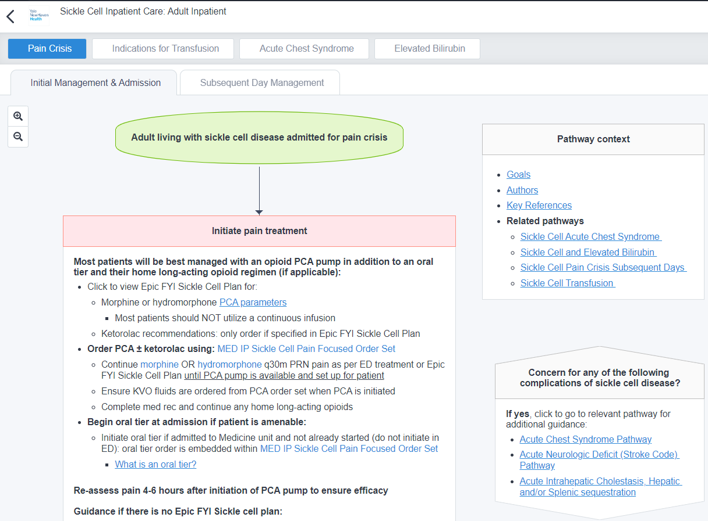
Care Signature pathways for adults with Sickle Cell Disease
Notes:
Adult SCD pathways launched in March, 2022.
This is the landing page shows the “Adult Sickle Cell Inpatient Initial Management and Admission” care pathway.
This screen shot displays only the topmost part of the pathway - it continues as a flow chart.

Slide 13
Care Signature pathways for adults with Sickle Cell Disease
Notes:
The pathways are interactive with hyper-links to additional content and links to other pathways that may be useful.
Note the tab leading to the “Subsequent Day Management” pathway.

Slide 14
Care Signature pathways for adults with Sickle Cell Disease
Notes:
Note also additional links to pathways for SCD-related conditions including Pain Crisis, Indications for Transfusion, Acute Chest Syndrome and Elevated Bilirubin.

Slide 15
Care Signature pathways for adults with Sickle Cell Disease
Notes:
Note links to other useful content to guide patient management.
As of February 2023, this pathway was in use for fully 50% of Adult SCD admissions.
We are working with our cost-accounting software partner, Strata, to track clinical and financial outcomes associated with pathway use.

Slide 16
Financial Outcome Metrics
Notes:
Review some examples of financial data display.

Slide 17
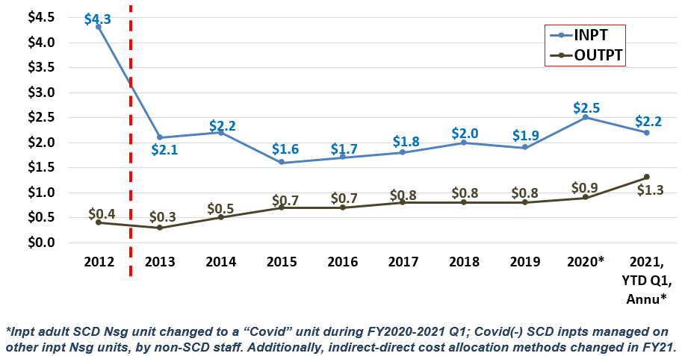
Outcome Measurement – Cost Per Year (in Millions)
Notes:
Financial Analyses
Overall cost per year before and after program improvements.
Note in 2020 some reversal in cost improvements: Dedicated SCD inpatient unit converted to “Covid” unit and patient w SCD dispersed to other units, with unfamiliar caregivers.
Note in 2021 – cost accounting system changed – some indirect costs converted to direct costs so overall direct costs higher. This highlights why it’s important to have relationship with financial data analysts to understand systematic changes in the data that are independent of program performance, but affect appearance of program performance.

Slide 18
Outcome Measurement – Cumulative Cost Reduction
Cumulative Savings over 6 years, FY 2013-2018*:
Inpatient direct cost decrease: $14.8M
Outpatient direct cost increase: $1.8M
Total Inpatient and Outpatient:
$13.0M in cumulative savings
*Sum of costs for each year, 2013 to 2018, minus cost of baseline year, 2012.
Notes:
*Cumulative* cost reduction – powerful view.

Slide 19
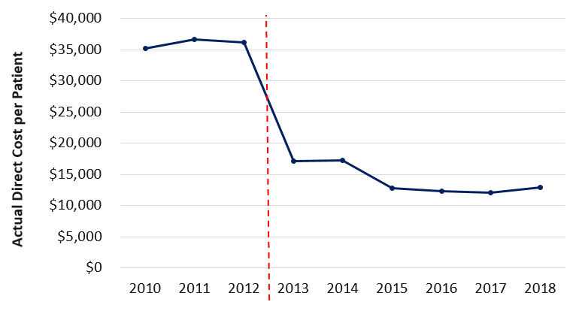
Population View: Cost per Patient
Notes:
Another way to look at savings – a “population” view – requested by Provider/Administrator who supports program.
Numerator: Total inpatient and outpatient actual direct costs.
Denominator: Number of unique people with SCD.
*Note: denominator includes just those MRNs that had SCD as Prin Dx in at least one visit (84% of total MRNs).

Slide 20
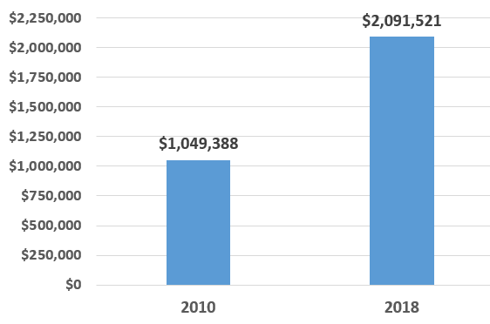
Financial Outcomes - Revenue: Inpatient Contribution Margin
Before
After
Notes:
Impact of reduced costs on program Revenue.
Since costs are reduced, the CM goes up, and the hospital now had $1M more to apply against indirect costs.
In fact, the FY 2018 Net Rev actually covered the *total* (direct and indirect) costs in 2018 (i.e., break even financially) which was a huge accomplishment.

Slide 21
Clinical & Financial Outcomes
Notes:
Clinical and financial outcomes together

Slide 22
FY 2022 YNH Hospital Adults with SCD 30-Day All-Cause Readmission Rates
Notes:
By end of FY22, all-cause readmission rates were trending around 50%.
But: How are the readmissions distributed among the individuals with SCD who had inpatient admissions? Do most individuals have readmissions, or are there a select few of individuals with most of the readmissions? The answer will drive the nature of interventions to reduce readmissions.

Slide 23
FY 2022 YNHH Adults with SCD - Individuals with Readmissions
Number of readmissions per individual, for the 18 individuals with readmissions.
28%
(N=18)
of individuals
had
Readmissions
72% (N=42) of individuals had no readmissions
Notes:
The 50% readmission rate was due to readmissions by 18 individuals, who were only 28% of the total individuals with inpatient admissions.
Of those 18 individuals with readmissions, only 6 individuals were responsible for 76% of the readmissions.

Slide 24
FY22 Visits and Costs per Patient
Pt #1 from previous slide: Fifteen 30-day readmits and 18 total inpatient visits, over $172,000 in Total Direct costs:
Visit Type | Total Visits | ALOS | Total Direct Cost | Avg Direct Cost
Inpatient | 18 | 7.3 | $158,563 | $8,809
Outpatient | 10 |  | $13,198 | $1,320
ED/Observation | 1 |  | $842 | $842
Total | 29 |  | $172,603 | $5,952
A different patient, who also had 29 total visits, but N=28 of these were outpatient, $100,000 less in Total Direct costs:
Visit Type | Total Visits | ALOS | Total Direct Cost | Avg Direct Cost
Inpatient | 0 | 0 | 0 | 0
Outpatient | 28 |  | $67,042 | $2,394
ED/Observation | 1 |  | $4,115 | $4,115
Total | 29 |  | $71,158 | $2,454
Notes:
Providing most patient care in the outpatient setting reduces costs.
This can be used in an appeal for resources to support a robust outpatient program.

Slide 25
Potential Revenue Opportunities: Backfill and Downstream Utilization

Slide 26
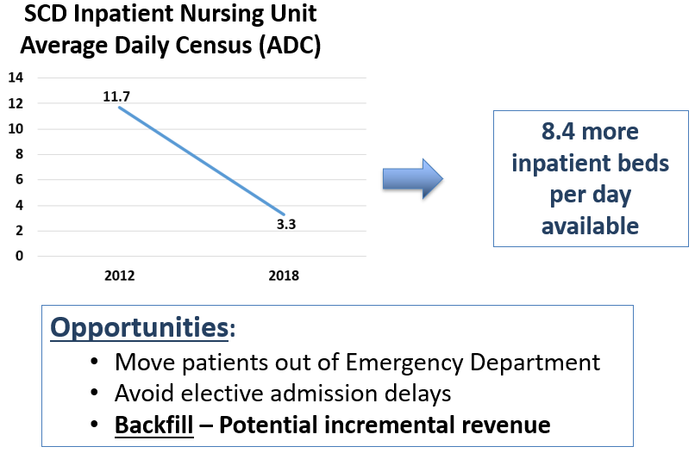
Revenue Opportunity from Freeing Up Inpatient Beds

Slide 27
Example of “Backfill” Calculation
Start with N=100 Sickle Cell Disease (SCD) inpatient discharges
An Average Length of Stay (ALOS) reduction produces a 0.75 day reduction per discharge.
0.75 days per discharge x 100 discharges = 75 “freed up” days
Estimate based on patients who are hospitalized on similar inpatient units to those of the patients with SCD
For example, if patients with SCD typically reside on general medicine units (ALOS = 5.0 days)
15 newly available inpatient hospitalizations for general medicine discharges
Assume the average margin for a general medicine discharge = $2,000
$2,000 x 15 newly available inpatient hospitalizations = $30,000 incremental margin
Notes:
Start with N=100 Sickle Cell Disease (SCD) inpatient discharges.
An average Length of Stay (ALOS) reduction of 5.5 days to 4.75 days per discharge produces a 0.75 day reduction per discharge.
0.75 days per discharge times 100 discharges produces 75 “freed up” days available for other inpatients.
Since you have no way to know what kinds of inpatients might be admitted to fill those 75 bed days, make an assumption based on the kinds of patients who are hospitalized on similar inpatient units to those of the patients with SCD.
For example, if patients with SCD typically reside on general medicine units, assume those 75 days are likely to be filled by general medicine admissions from the ED, and the institution’s ALOS for general medicine patients = 5.0 days.
75 “freed up” days divided by 5.0 day ALOS = 15 newly available inpatient hospitalizations for general medicine discharges.
Assume the average margin for a general medicine discharge = $2,000.
$2,000 times 15 newly available inpatient hospitalizations = $30,000 incremental margin.

Slide 28
“Backfill” Calculation - Caveats
Assumes your institution is running at capacity
If not, and there is excess capacity for admissions, that negates the advantage of freeing up additional beds for the purpose of incremental margin

Slide 29
“Downstream” Visits
Additional inpatient/outpatient visits resulting from follow-up to earlier visits
Includes preventative evaluations such eye exams
Payor drives financial outcome
Governmental (MCaid/MCare):
May avert financially unfavorable acute care visits
Commercial:
May produce financially favorable visits for work-ups/ procedures

Slide 30
Takeaways
Cultivate relationships with financial/data analysts
Track program volume and financial outcomes on an ongoing basis
Notes:
To support your program’s success in optimizing care for your patients:
1.Cultivate relationships with the staff who can provide financial and other data (similarly to how you are cultivating relationships with providers and clinicians in various other depts).
2.Track program metrics on an ongoing basis.

