Slide 1
Developing a Business Plan
Al Dunn, MBA, MPA
Associate Vice President Business Operations
University at Buffalo, Jacobs School of Medicine
May 9, 2023

Slide 2
Session Objectives
What are you trying to accomplish? What is the Vision?
(Begin with the end in Mind)
Provide a framework for creation of a business plan
Focused review of business plan components
  External Assessment
  Internal Assessment
  Financial Analyses
  Implementation Plan
Notes:
Acknowledge
Year 1 participants → Had a module on the components of business plan
Year 2 participants → This will be a refresher; new examples of data and financials

Slide 3
Where to Start | Resources
Talk to your practice administrator
Gather baseline knowledge of the current revenues and expenses associated with your program/clinic
Data Resources
Data Analytics or Decision Support Teams (may vary for different data sources-clinical, financial, and productivity)
Utilization Management (admissions, LOS, and re-admissions)
Emergency Dept (patients seen and discharged versus ED admission rates)
People/Roles to seek
Finance/Budget Managers; Billing/Revenue Cycle Managers; Financial Analysis Dept
Business Intelligence/Decision Support Analysts or Managers
These roles may be embedded within different departments (e.g., Utilization Management, Quality Improvement, Billing, Access, Patient Experience, Strategic Planning, Market Research)
Share the vision to brainstorm financial considerations

Slide 4
Why Use a Business Plan?
To demonstrate to the funding source why it is in your best interest, financially, and reputation to support this program
To provide an external assessment, internal assessment, and financial projections for the program
To detail the operating plan to be implemented as well as ongoing evaluation metrics
To demonstrate support for clinical and organizational strategic goals
Notes:
Recall why a formal business plan approach is necessary…..
Formal documentation of the comprehensive review and planning for your program → which will likely require investment from your organization to implement
Gives a roadmap for future expansion needs (e.g., JH expansion of weekend hours)

Slide 5
Components of a Business Plan
Section 1: Executive Summary
Section 2: Background and Methodology
Section 3: External Assessment
Section 4: Internal Assessment
Section 5: Financial Projections
Section 6: Situation, Background Assessment, Recommendation (SBAR, VCU Format)
Section 7: Goals and Objectives
Section 8: Positioning and Strategy Development
Section 9: Implementation Plan
Section 10: Evaluation Plan
Section 11: Conclusions

Slide 6

External Assessment
Market Overview
To evaluate the existing market for care delivery trends relevant to the new opportunity and project future demand for services
The assessment should consider:
Current and projected demographic trends
Current size of the inpatient and outpatient market in need of the service
Patient origin/geographic areas of opportunity/potential service areas
Supply and demand of resources available to meet the patients’ needs
Market segments or targets within segments
Barriers to entry
Present why your program would be beneficial to the organization

Slide 7
VCU Adult Sickle Cell Disease Medical Home (Background and Methodology)
Sickle Cell Disease Advanced Health Home Neighborhood
Community Based Organizations (CBO)
Patient

Slide 8
External Assessment
Competitor Analysis:
  To understand what other providers are doing, or can do, and determine their relative strengths and weaknesses
  This analysis may identify program development opportunities to differentiate your center
  Consider:
    Geographic location and service mix of competitor
    The competitor’s capabilities, including physician and hospital resources
    Health care financing/accountable care/population health initiatives
Technological developments (e.g., new medications, changes in treatment, composition of staff skills required for the new service, impact of telemedicine)
Regulatory requirements that would impact the service

Slide 9
Internal Assessment
Referral Sources Evaluation:
Current referral sources
Patient and Customer Evaluation:
Demographics (historical trend of patient population by sex and age group)
Who does the program serve? (zip code analysis; immediate market area; secondary cities or regions)
What is the program’s current market share/size?
Why do patients want to come to your organization?
Perceptions of the current program (e.g., patient experience data)
Potential referral sources

Slide 10
Geographic Breakdown of Adult SCD Patients for VCU
70% Are From the Metro Richmond

Slide 11
Internal Assessment (cont.)
Operational Evaluation:
Defines your practice’s ability to support substantial programmatic development
Determines what resources are required for the proposed services
Consider:
Current services available and where they are provided
Facility evaluation–space and equipment requirements
Inpatient and outpatient utilization
Customer service assessment (access, scheduling, amenities)
Is staged growth feasible
Will a new center impact other departments or entities (ancillary/support areas)

Slide 12
Internal Assessment (cont.)
Human Resource Assessment:
Create a profile the current providers and staff and their capacity to support the proposed program/service
Consider:
Number of Faculty and Advanced Practice Providers needed to support program
Type and number of staff required to support program
Provider/Staff characteristics–level of experience, active years remaining
Need to expand training for existing staff and/or hire incremental staff
Vulnerabilities–contractual obligations, research, or teaching commitments
Existing provider base and need in the local market based on data (e.g., AMA’s physician database or various sub-specialty organizations)

Slide 13
VCU Health Internal Assessment
Inpatient capacity and utilization
Outpatient access and efficiency
Expense reduction
Health and wellbeing of our teams

Slide 14
Inpatient Capacity and Utilization
The average length of stay in hospital started to drop since 2016 and went up in 2020 and 2021. Some of these data could be impacted by COVID.
Inpatient discharge continually dropped since program onset in 2018

Slide 15
Inpatient Capacity and Utilization (cont.)
Inpatient hospital staying days dropped after program onset, while the number of patients continually increased each year
Inpatient return within 30 days also decreased every year after 2018

Slide 16
Outpatient Access and Efficiency (cont.)
Total appointments number increased from 2018 to 2020, then dropped a little in 2021
Year 2019 has the highest appointment arrival rate.
Year 2020 and Year 2021 has higher cancellation rate.
This could be a result of COVID.

Slide 17
Expense Reduction
The total cost continually increased from 2011 to 2017, and it gradually dropped since program onset in 2018
Number of patients increased every year since 2011, while the cost started to drop since 2018

Slide 18
Health and Wellbeing of Our Team
Barriers
Team has experienced COVID burnout
Frustration over positions not being replaced and impeding their jobs
Lack of compliance and ongoing “Groundhog Day” situations for some patients
Monetary compensation
Solutions
Encourage staff to utilize PTO
Continue to work with leadership on outcomes to support staff replacement and other revenue resources for these positions
Daily huddle to work as a team and support one another
Approach leadership on some descriptions being “Reviewed in Place”
Team Building
  Bi-annual dinners with team from medical director, staff picnics, etc

Slide 19
Financial Projections and Analysis
This section presents the reasoning behind, and results of, the financial implications of the new or expanded program
Any financial schedules that support the proposed service should be referenced and explained
Three components in this section:
A. Scope
B. Methodology
C. Findings

Slide 20
Financial Projections and Analysis
A. Scope
Describes the extent of the financial analysis and business plan
Project the funding needs and financial returns for the three to five years
Include the corporate/organizational scope
Impact on admissions to your hospital (marginal income lost, backfill opportunity)
Impact on length of stay, ED visits, and/or transition of ED care
Accountable care plan, population health program, or value-based contracts
If analyzed, other effects of the new service should be included
Impact of the move to value-based payments
(e.g., does the analysis examine the impact of the program on other areas of the organization or is it limited to your business unit/ambulatory site?)
Notes:
The corporate scope is important.

Slide 21
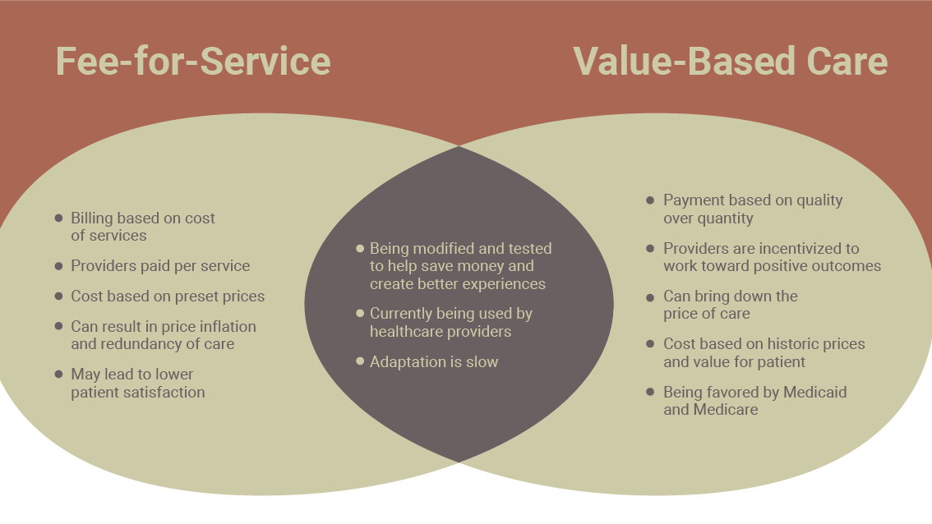

Slide 22
Financial Projections and Analysis (cont.)
B. Finance Methodology
Summary of the methods and sources of data used in the financial analysis
Underlying assumptions to the financial projections should be listed
The nature of the business plan indicate the preferred method for evaluating the opportunity
If the plan is meant to generate additional revenue for an existing operation, the contribution margin might be the primary indicator
A plan that requires a new facility or renovation may require full-absorption costing
Current revenues, salaries, and expenses extrapolated to fit the assumptions
Financial projections are only as reliable as the source of data on which they are based

Slide 23
Financial Exhibits
Projected P&L Sheet–the operating statement
Annual cash flow, as derived from the operating statement and balance sheet
Return on Investment (ROI)–payback statistics
Sensitivity Analysis–to show if the project can absorb unfavorable circumstances
Request assistance from your finance department to develop the applicable financial exhibits for your proposal

Slide 25
Financial Projections and Analysis (cont.)
C. Findings
Details the reasoning and the results of the financial analysis
The narrative should follow the order of the financial schedules supporting this project, referencing each exhibit in order
At times, projections may have to be based on less than certain assumptions
e.g., a new clinical procedure may not yet be included in the payer fee schedules so reimbursement assumptions will need to be made and footnoted
Note underlying facts or assumptions that are not obvious from reading the exhibit

Slide 26
Example | Expenses
Separate pages of the business plan for Methodology and Assumptions
Example of respective expense sections

Slide 27
Example |
Revenue Projection
Depending on the model, consider professional fees as well as fees for treatments or ancillary services
Volumes, site of service, and collection rates, based on payor mix, would have been defined in the assumptions section

Slide 28
Implementation Section
Outline how the proposal would progress to reality
  Engage appropriate stakeholders to drive the business plan forward to operations. Business plans often fail in the implementation phase.
Narrative to Include:
  Program location-required square footage, rent/build-out, facility renovation
  Staffing plan–job roles, skill mix, recruitment, training, competencies
  Workflows–patient access, registration, clinical care management, EMR enhancements, ancillary services impacted, support services, regulatory requirements, billing methodology, payer authorization, patient experience
  Communications–patient brochure, announcements, letters of introduction
Identify an implementation oversight team
Draft a timeline and milestones for start-up

Slide 29
Evaluation Plan
Always use metrics that are important to your funding source. In VCU case program funded by hospital–Cost reduction is critical.
LOS and ED readmits are probably two most important metrics–make sure these are in all presentations to the hospital
Bring in the SCD community to promote the program. At VCU community involvement is critical to the reputation of the Health System.
Not everything is numbers - tell stories about the patients and how the program improved their lives. Most patients are proud of their progress and want to tell the story.

Slide 30
Key Takeaways
Business plans vary depending on the scope program development or expansion
Your clinical, patient care, and health care delivery knowledge is critical
Reach out to subject matter experts in your organization for the financial analyses, marketing assessment, facility design, communications planning, billing methodology, payer relations, and managed care or population health plan requirements
Key stakeholders will help determine the extent of assessments or financial statements to include in the business plan
A collaborative approach with key stakeholders will contribute to the successful development of a business plan

