Slide 1
Comprehensive Sickle Cell Program at the Center for Special Health Care Needs
Stephanie Guarino, MD MSHP FAAP FACP
Medical Director
May 2023

Slide 2
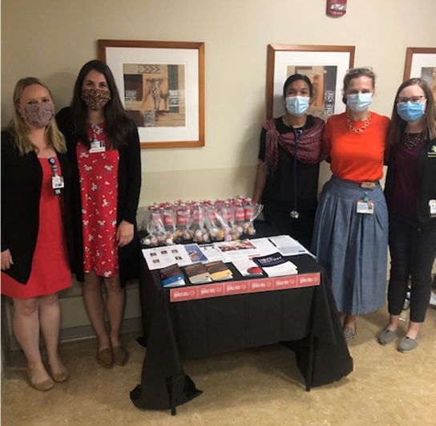
DISCLOSURES
Novartis- Consulting
Medscape- Consulting

Slide 3
Center for Special Health Care Needs- Where We Started
Nemours Children’s Health, Delaware- well-resourced pediatric center with ~290 patients from DE, New Jersey, and Pennsylvania
ChristianaCare- largest health system in the state of Delaware, mainly in New Castle County, starting to expand South
Adult Cancer Center had 3 private groups- 1 medical oncology, 1 hematology, 1 hematology and medical oncology
No other infrastructure for adult patients with sickle cell disease
Strong Med-Peds presence started Transition Care Practice

Slide 4
Sickle Cell Disease in Delaware
All encounters in any of 3 EDs between July 1, 2016-June 30, 2017 with primary or secondary diagnosis of ICD-10 code D57.XX
Excluded those with sickle cell trait
Based on provider coded diagnoses
Demographic and clinical data for each encounter were collected
Included inpatient admissions and observation stays which began with an ED visit

Slide 5
Christiana Care Health System Cohort
 | AYA Cohort | Older Patients | All Patients
Number of encounters | 343 | 207 | 550
Number of patients | 149 | 173 | 322
Age (%)*
18-29 | 62.1 |  | 38.7
30-39 | 37.9 |  | 23.6
40-49 |  | 31.9 | 12.0
50-59 |  | 51.2 | 19.3
60+ |  | 16.9 | 6.4
Sex (%)*
Male | 51.6 | 64.3 | 56.4
Female | 48.4 | 35.7 | 43.6
Encounter Type (%)*
ED only | 63.8 | 77.3 | 68.9
Observation Admit | 5.8 | 4.8 | 5.5
Inpatient Admit | 30.3 | 17.9 | 25.6
Encounter Location (%)*
Christiana | 47.2 | 31.4 | 41.2
Wilmington | 44.3 | 66.2 | 52.5
Middletown | 8.5 | 2.4 | 6.2
* For each percentage, the denominator is the number of encounters

Slide 6
Christiana Care Health System Cohort
Number of Visits per AYA Patient
Number of Inpatient/ED Encounters
Mean: 3.2 visits/patient
Median: 1 visit/patient
Patient

Slide 7
Delaware Patients Geographic Distribution

Slide 8
Delaware Patients Geographic Distribution

Slide 9
Discussion of Results
Significant cohort of adolescent/young adult patients who access acute care services at Christiana Care
Patients primarily come from New Castle County, centered around urban area of Wilmington
Admission rate of 38.2% from ED is lower than other published data
Evidence of need to address social determinants of health in order to adequately treat this population

Slide 10
Limitations of Study
Only 1 fiscal year of data. Expansion of date range would improve reliability of data
Relied on provider coding of “sickle cell disease” as an encounter diagnosis
No information on outpatient health care utilization or other details of sickle cell disease like genotype
More complete statistical analysis including further evaluation of random sample of charts would give more complete understanding

Slide 11
ChristianaCare ED Time to First Analgesic Administration Data
Retrospective cross-sectional study of Emergency Department sickle cell disease patient encounters from July 2016 to June 2017
Emergency Department Sickle Cell Disease Encounters
N = 548
Older Adult (>39) Patient Encounters
N = 206
Adolescent/Young Adult (18-39) Patient Encounters
N = 342
Encounter Diagnoses without Vaso-occlusive Crisis
N = 145
Encounter Diagnoses with Vaso-occlusive Crisis
N = 197
Encounters Admitted
N = 93
Encounters Discharged from Emergency Department
N = 104
Notes:
We conducted a retrospective cross sectional study of an electronic health record data set.
This flowchart of all of the ED SCD patient encounters from July 2016 to June 2017. My analyses were focused on the ED Adolescent and Young adult encounters with VOC and our final sample size was 197. Per universal definition, we looked at ages 18-39.

Slide 12
Descriptive Statistics
 | n=197
Gender Male Female | 46.7% 53.3%
Age Mean | 27.3 years
Race Black Other Race Unavailable White | 99.5% - 0.5% -
Insurance Commercial Dual Medicaid Medicare Self-pay | 28.9% 20.3% 38.1% 9.6% 3.0%
Notes:
Our sample size consisted of approximately half females and half males, with a mean age of 27.28. Almost all of our patients were black which is not a surprise as the majority of SC patients are black. About 70% of our patients have Medicaid, Medicare or both for insurance. These demographics are consistent with other sickle cell samples.
Among our sample, majority of the ED encounters took place at Christiana Hospital and Wilmington Hospital.
75.6% of the SCD encounters were given an Severity level of 3, which is lower than the national recommendation of 2.

Slide 13
Notes:
In the bar graph, we looked at adherence to national guidelines.
23.9% of ED encounters followed the ESI guidelines, 21.5% follow the time to first analgesic administration guidelines.
And only 4.1% of the all encounters followed both guidelines.

Slide 14
Current State- Strengths
200 patients have had at least 1 visit (~350-400 adult patients in DE)
~75% also utilize co-located primary care in CSHCN
2 full day clinics a month staffed by hematologist
PA-C to see patients for acute visits, follow ups, hospital discharges
Previously saw 2-4 new patients a month, closure of practice and retirement of local hematologist led to ~8-12 new patients a month
Full clinical team (Hematology, PCPs, PA, SW, MA, Nurse Navigator)
Primary Care embedded behavioral health
Addition of Community Health Workers in ED – home visits
Patient and Family Advisory Board
CSHCN, Center for Special Healthcare Needs

Slide 15
Current State- Strengths
Strong research program & collaboration with Institute for Research on Equity and Community Health (iREACH)
COBRE2 - research assistant hired
NASCC - Crizanlizumab registry & GRNDaD registry
SiNERGE network - Community needs assessment for nutrition in lifespan sickle cell patients
PCORI demonstration grant site- Ambulatory Infusion Center Toolkit
Strong relationship with pediatric sickle cell program at Nemours Center for Cancer and Blood Disorders

Slide 16
Weaknesses
Lack of inpatient continuity - virtual consults at main campus, PA coverage at Wilmington Hospital
Lack of dedicated infusion center space
Multiple ED and hospital campuses challenge continuity
Pain plans challenging to find and maintain in Cerner EHR
Gaps in Behavioral Health and Pain program clinical supports

Slide 17
Opportunities
Community partnerships with CBO -Delaware Chapter of SCDAA- Executive Board, William E. and Rubye T. Proudford Sickle Cell Fund at ChristianaCare
Planned expansion of CSHCN with infusion center chair in clinic
MedPeds Hospitalist service at main campus - QI Project to implement pain plans
Planned Palliative Care co-visits in clinic
Recently completed Medicaid data project provides foundation for care coordination demonstration projects
Satellite clinic in Southern Delaware to improve access for underserved areas
Revision of transition program and curriculum

Slide 18
Threats
No pain service currently available at Christiana
Financial situation of health system
Medicaid unwinding and unenrollment
Emergency Department experiences

Slide 19
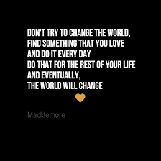
Get in the Community- Expand Your Definition of Health
“…Get back to community that raised you up
Read Langston Hughes, I suggest "A Raisin in the Sun"
Listen to Sam Cooke, a change gon' come
You put the work in, don't worry about the praise, my love…”
“…Find God, but leave the dogma
The quickest way to happiness? Learning to be selfless
Ask more questions, talk about yourself less
Study David Bowie, James Baldwin and 2Pac
Watch the sun set with best friends from a rooftop
Wear a helmet, don't be stupid
Jaywalk, but look before you do it
If it snows, go outside, build a jump, get some help
Get a sled, thrash the hill with your friends till it melts
Go to festivals, camp, fall in love and dance
You're only young once, my loved one, this is your chance
Take risks, cause life moves so fast
You're only young once, my loved one, this is your chance”
Growing Up (Sloane’s Song) by Ed Sheeran Featuring Macklemore & Ryan Lewis

Slide 20
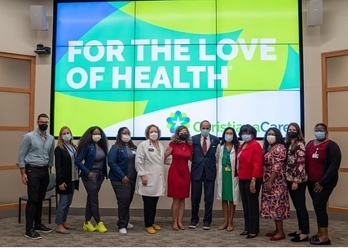
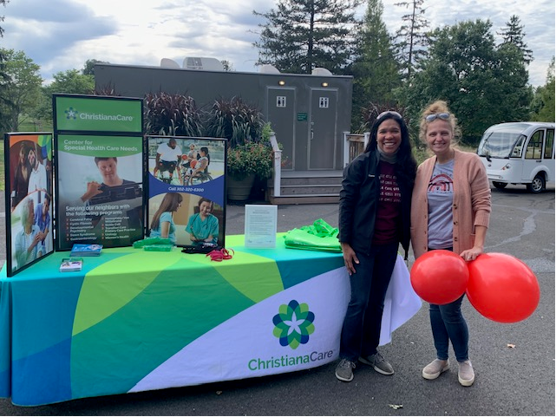
Don’t Do This Alone
You know I'm back like I never left
Another sprint, another step
Another day, another breath
Been chasing dreams, but I never slept
I got a new attitude and a lease on life
And some peace of mind
Seek and I find I can sleep when I die…
I heard you die twice, once when they bury you in the grave
And the second time is the last time that somebody mentions your name
So when I leave here on this earth, did I take more than I gave?
Did I look out for the people or did I do it all for fame?
Glorious

Slide 21
Don’t Be Afraid to Be Your Own Champion
This is my world, this is my arena
The TV told me something different I didn't believe it
I stand here in front of you today, all because of an idea
I could be who I wanted if I could see my potential
And I know that one day, I'ma be him
Put the gloves on, sparring with my ego
Everyone's greatest obstacle, I beat him
Celebrate that achievement
Same (stuff), different day, same struggle Slow motion as time slips through my knuckles Nothing beautiful about it No light at the tunnel For the people that put the passion before them being comfortable Raw, unmedicated heart, no substitute
Ten Thousand Hours

Slide 22
Celebrate Small Wins
No laws gonna change us…
We have to change us
Whatever God you believe in…
We come from the same one
Strip away all the fear…
Underneath its all the same love
The same fight that lead people to walk-outs and sit-ins
It's human rights for everybody
There is no difference
Live on! And be yourself!
When I was in church
They taught me something else
If you preach hate at the service
Those words aren't anointed
And that Holy Water
That you soak in
Is then poisoned
When everyone else
Is more comfortable
Remaining voiceless
Rather than fighting for humans
That have had their rights stolen
I might not be the same
But that's not important
No freedom 'til we're equal
…right I support it
Same Love

Slide 23
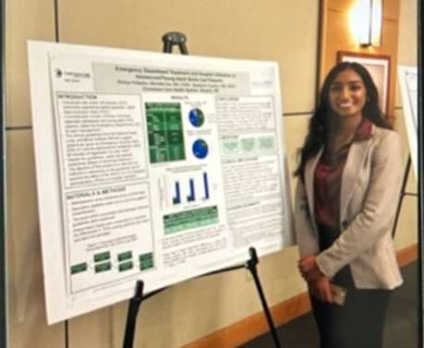
You Can Always Mentor
I'd like to take this opportunity and toast to me For bein’ exactly who I'm supposed to be 'Cause life is gonna do what life does I don't wanna look back and regret who I was Let go of the expectations and then fire one Forget the tally sheet before all my time's up And I know I gotta roll with it I'm well aware the universe doesn't owe me shit I know that all of this pain leads to growth, I think
Next Year

Slide 24
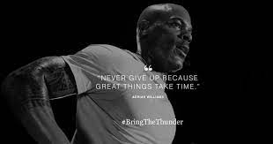
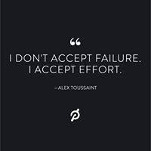
Take Care of Yourself
When we oppress anyone, we oppress ourselves Greatest gift I ever learned is helpin' someone else You build, believe and build 'cause you forget about yourself Service, purpose, works if you work it Love everyone regardless of the God they worship
Wednesday Morning

Slide 25
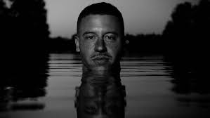
Setbacks are Going to Happen
On my grave, what quote will be etched in?
Never played the game to be a contestant
Never joined the league to ride benches
The wins hit different when they don't expect it
Yeah, and they they ain't gotta like me
There's no need to cry for me I'm a fighter, fighter You can't take my voice from me I will rise up, rise up So what are you waiting for?... The pain is where faith is born
I was supposed to be a one hit ringer Now I got too many rings and not enough fingers Keep doing my thing, they keep chasin' the wave
Chant

Slide 26
Stephanie.Guarino@christianacare.org (302) 932-2377

