Slide 1
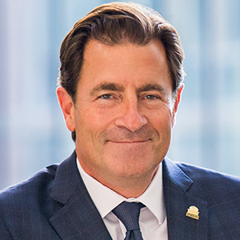
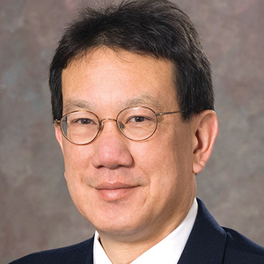
Practice Your Pitch
Mark Gladwin, MD
VP, Medical Affairs
Dean, School of Medicine
University of Maryland
Ted Wun, MD, FACP
Associate Dean for Research
Director, Clinical and Translational Science Center
Chief, Hematology and Oncology
University of California, Davis

Slide 2
Lessons Learned and Advice on the PERFECT PITCH for Sickle Cell Center Support
Mark T. Gladwin, MD Dean, University of Maryland School of Medicine Vice President for Medical Affairs, UM Baltimore John Z. and Akiko K. Bowers Distinguished Professor
Ted Wun, MD
Associate Dean for Research, UC Davis School of Medicine
Director, Clinical and Translational Science Center
Chief of Hematology and Oncology
UC Davis Health

Slide 3
Disclosures
Acknowledgements
I receive research support from NIH grants 5R01HL098032, 2R01HL125886, 5P01HL103455, UH3HL143192, Bayer Corporation, and Globin Solutions, Inc.
Conflict of interest
I am a co-inventor of patents and patent applications directed to the use of recombinant neuroglobin and heme-based molecules as antidotes for CO poisoning, which have been licensed by Globin Solutions, Inc. Dr. Gladwin is a shareholder, advisor, and director in Globin Solutions, Inc. Dr. Gladwin is also co-inventor on patents directed to the use of nitrite salts in cardiovascular diseases, which were previously licensed to United Therapeutics, and is now licensed to Globin Solutions and Hope Pharmaceuticals. Dr. Gladwin is a principal investigator in a research collaboration with Bayer Pharmaceuticals to evaluate riociguate as a treatment for patients with SCD.
Authorship
I am a textbook author and receive royalties from MedMaster Inc., and I am a textbook editor and receive royalties from McGraw-Hill.
Consulting Agreements
I actively serve as a scientific consultant for Forma Therapeutics (serving on RBC (red blood cell) scientific advisory board). I also served on Bayer HealthCare LLC’s Heart and Vascular Disease Research Advisory Board.

Slide 4
Lessons Learned About What to Do and NOT to Do

Slide 5
Avoid Surprises and Build Support
Despite the term “elevator pitch,” NEVER ask for resources in the elevator
Set up a meeting with key stakeholders, ideally moving up the food chain with sequential support
Have an agenda, be prepared, be brief, and have data

Slide 6
Communicate the VALUE Proposition
Despite the intrinsic value of your mission and your holy lordship as the ”only” committed physician, NEVER sermonize
Communicate importance of health care equity and unmet need as they relate to impact on reputation and mission
Communicate impact of program on hospital quality metrics (readmission, HCAPHPS, length of stay, etc.)
Alignment with payor models (payor provider, capitated support)
Understand financial impact (shared savings, clinical trials revenue, 340B programming, CMS quality payments)
HCAHPS, Hospital Consumer Assessment of Healthcare Providers and Systems

Slide 7
Alignment
Avoid the doldrums: the best crew and sailboat without wind will fail
Align incentives, partners, leaders, and advocates (health insurers, hospital quality leaders and administration, emergency room, medicine, research, education, clinical excellence, etc.)
Ensure alignment with payor models (payor provider, capitated support)
Understand financial impact (shared savings, clinical trials revenue, 340B programming, CMS quality payments)

Slide 8
Fill the Vacuum and Start With Wins
Never initiate a pitch without a track record or credibility
You need credibility as a leadership team who delivers on investments
Address opportunity and unmet need with limited resources
Commit time and passion
Align and recruit partners
Track metrics of success
Secure support and funding
Expand on proven success
Deliver on every commitment; more will follow!!!

Slide 9
Elements of an Effective Pitch
Ted Wun, MD
Associate Dean for Research, UC Davis School of Medicine
Director, Clinical and Translational Science Center
Chief of Hematology and Oncology
UC Davis Health

Slide 10
Disclosures
Served on Glycomimetics, Inc and Pfizer, Inc. Advisory Boards

Slide 11
Elements of an Effective Pitch
Short (5 minutes)
Simple
Strategic
What is your vision?

Slide 12
Before You Go…
Build partnerships
Nursing
ED
Population Management
Payers
CBO
Get buy-in

Slide 13
Specific Elements
Align with local priorities (eg, interests)
Unload ED, decrease LOS
Enhance quality
Enhance value
Improve outcomes
Lower costs (comprehensive evaluation)
What is the ROI?
Increase revenue (potential sources of external funding)
Enhance academic programs/profiles/career development
Boost community standing
Do the right thing

Slide 14
Q&A
Lessons learned and advice on the PERFECT PITCH for Sickle Cell Center support

