Slide 1
Comprehensive Sickle Cell Program at the Center for Special Health Care Needs
Stephanie Guarino, MD, MSHP, FAAP, FACP
Medical Director
May 2023

Slide 2
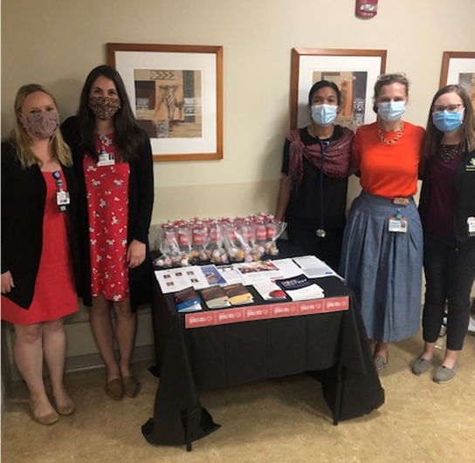
DISCLOSURES
Novartis-Consulting
Medscape-Consulting

Slide 3
Current State-Strengths
200 patients have had at least 1 visit (~350-400 adult patients in DE)
~75% also utilize co-located primary care in CSHCN
2 full day clinics a month staffed by hematologist
PA-C to see patients for acute visits, follow-ups, and hospital discharges
Previously saw 2-4 new patients a month, closure of practice, and retirement of local hematologist led to ~8-12 new patients a month
Full clinical team (Hematology, PCPs, PA, SW, MA, and Nurse Navigator)
Primary Care embedded behavioral health
Addition of Community Health Workers in ED–home visits
Patient and Family Advisory Board
CSHCN, Center for Special Healthcare Needs

Slide 4
Current State-Strengths
Strong research program & collaboration with Institute for Research on Equity and Community Health (iREACH)
COBRE2-research assistant hired
NASCC-Crizanlizumab registry and GRNDaD registry
SiNERGE network-Community needs assessment for nutrition in lifespan sickle cell patients
PCORI demonstration grant site-Ambulatory Infusion Center Toolkit
Strong relationship with pediatric sickle cell program at Nemours Center for Cancer and Blood Disorders

Slide 5
Weaknesses
Lack of inpatient continuity-virtual consults at main campus, PA coverage at Wilmington Hospital
Lack of dedicated infusion center space
Multiple ED and hospital campuses challenge continuity
Pain plans challenging to find and maintain in Cerner EHR
Gaps in Behavioral Health and Pain program clinical supports

Slide 6
Opportunities
Community partnerships with CBO-Delaware Chapter of SCDAA-Executive Board, William E. and Rubye T. Proudford Sickle Cell Fund at ChristianaCare
Planned expansion of CSHCN with infusion center chair in clinic
MedPeds Hospitalist service at main campus-QI Project to implement pain plans
Planned Palliative Care co-visits in clinic
Recently completed Medicaid data project provides foundation for care coordination demonstration projects
Satellite clinic in Southern Delaware to improve access for underserved areas
Revision of transition program and curriculum

Slide 7
Threats
No pain service currently available at Christiana
Financial situation of health system
Medicaid unwinding and unenrollments
Emergency Department experiences

