Slide 1
Driving Change in Sickle Cell Care at Your Institution
Payal Desai, MD
Atrium Health Care, Levine Cancer Institute
Wally R. Smith, MD
Virginia Commonwealth University

Slide 2
Disclosures
In compliance with ACCME policy, ASH requires disclosures to the session audience:
Payal Desai, MD
Payal Desai, MD, serves on non-CE speakers bureau for Novartis, non-CE consultant for Forma Therapeutics, and Global Blood Therapeutics.
Wally R. Smith, MD
Wally R. Smith, MD, serves as a non-CE consultant for Agios, Pfizer, Global Blood Therapeutics, Fera Pharmaceutical, Forma, Vertex, Emmaus, and GMI; contract research for Global Blood Therapeutics, Forma, Imara, and Novartis. He also serves on a non-CE speakers bureau for Global Blood Therapeutics and Emmaus.
Discussion of off-label drug use: N/A

Slide 3
After this session, learners will be able to…
Apply the process and steps to identify
strengths, weaknesses, opportunities and threats
to improved SCD care at their institution

Slide 4
Kurt Lewin (1890-1947): Change Theory
Equilibrium
Driving Forces
Restraining Forces
Three major concepts
Three major steps
Unfreezing
Changing
Refreezing
https://study.com/academy/lesson/lewins-3-stage-model-of-change-unfreezing-changing-refreezing.html

Slide 5
What are strengths, weaknesses, opportunities, and threats (SWOTs) to driving change in SCD care at YOUR institution?

Slide 6

SWOT: What to Bring to the Workshop
Strengths
Weaknesses
Opportunities
Threats

Slide 7
Strengths
What was the major genesis to have an adult SCD program in your area?
What personnel (numbers, types) are already present and engaged in SCD care?
  How many of these can you call SCD champions?
How many patients have you assembled who seek care regularly at your institution or affiliates?
What tangible resources have you and leaders been allocated (funds, space, personnel, administrative support, protected time, community support)?
Driving Forces

Slide 8
Weaknesses
What do you (partners) identify as the major needs of the adult SCD clinic/center/program in the next year?
Is there a plan to meet those needs?
Who in your institution’s senior administration has pledged to help you meet your needs?
Where might you go to get the support you need? Who do you trust?
Where are the institutional barriers? Space? Resources? Support?
Driving Forces

Slide 9
Opportunities
Unfreezing
Changing
Refreezing
What is your medical center’s/program’s geographic and population reach or catchment area?
How many SCD patients are in that catchment area?
Do you intend to reach all these patients?
What care services do you believe you can provide in 1 year? In 5 years?
Identifying potential allies both within and outside the department

Slide 10
Threats
Is there active resistance to you or your program at the medical center? Passive? What level?
Are there negative stereotypes about SCD at your center? About caregivers for SCD?
Are there financial, social, clinical, or space constraints that threaten your potential success in the next year? Five years?
Restraining Forces

Slide 11

Mount Sinai Hospital:
SWOT Analysis
Jena Simon, DNP, APRN-BC
Charleen Jacobs, MS, APRN-BC
Cassandra Dobson, PhD, RN
February 16, 2021
For Example:

Slide 12


Strengths
Care delivery
Revenue
Staff
Biggest strength: Our staff
Wrap around model
Robust research program
Clinic hours have expanded
Video visits
EMR (Epic) offers enhanced communication between sites
Institutional support
Grants
340b program
Insurance payments, especially commercial
payers
Innovative provider mix dedicated to SCD
Close collaboration with hospitalists and specialists
Partner with CBOs
CBO, community-based organization

Slide 13
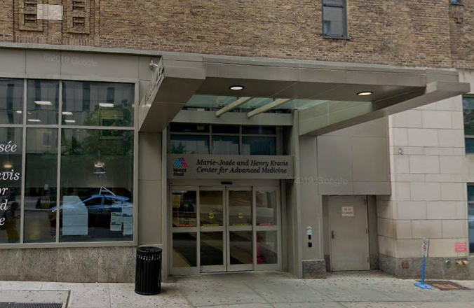
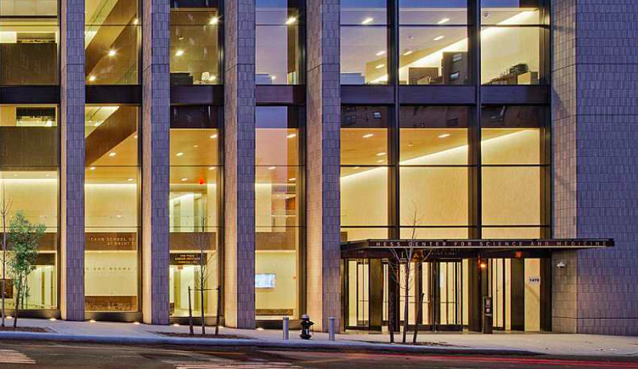
Weaknesses
Care delivery
Revenue
Staff
Institutional racism and unconscious bias create disparities in care
Ambulatory clinics are in 2 different locations
Limited access to infusion space for acute pain
Mental health services are lacking
Weekend coverage impacts patient safety negatively
Payer mix dominated by public payers
Excess days eat away at reimbursement
Reimbursement for crizanlizumab largely negative
APP billing still not resolved but getting there!
Burn-out
Administrative burden high
No succession plan
Clinics are in 2 locations

Slide 14

Opportunities
Care delivery
Revenue
Staff
Confront racism/bias through education and media campaign
Expand access to ambulatory care >> video visits
Expand access to infusions for pain and crizanlizumab
Maximize use of disease modifying therapies
Gene therapy trial
Certification
Ramp up community involvement
Reduce MSH admissions >> transfer 10% of patients to another hospital in system with lower costs
340b revenue >> partner with MSH specialty pharmacy
Increase revenue by inpatient SCD consults >> APPs to bill
Decrease excess days
Monitor for burnout and offer support
Provide mentorship and professional development
Train new staff: Social Worker and Admin Assistant
Succession planning

Slide 15
Threats
Care delivery
Revenue
Staff
Racism/bias >> negatively impacts care and hurts patients and staff
Internal competition for space/resources
Staff burn-out
Insurance denials
Insurance denials for readmissions
Decrease in 340b revenue
Demand by payers to shift crizanlizumab infusions to infusion center or home infusions
Administrative errors
Outside competition
Burn-out
Administrative burden competing with clinical duties

Slide 16
Prior to May 8 Arrival in DC
Email your 4 slides to jvajdos@francefoundation.com with the subject line “<YOUR INSTITUTION> Year 1 SWOT”
1 slide deck per institution

