Slide 1
Using Data to Show Value
ASH SCD Workshop Year 1 Cohort
Janis Bozzo, MSN, RN
Senior Innovation Scientist
Yale New Haven Health
March 21, 2023

Slide 2
Learning Objective
After this session, learners will be able to identify ways to visually display clinical and financial data in the service of building institutional support for an adult sickle cell disease program.

Slide 3
Goals of Session
Demonstrate how to show the value of your program through data display
Discuss how to access data/data analysis resources in your institution
Discuss how to secure institutional support for your program
Present examples of business planning
Notes:
The goals of this session are listed.
During this presentation, you should be thinking about:
Where are the clinical/financial resources for data abstraction located in your institution?
If you don’t already have access to these resources, who might you reach out to in your institution to develop them?
Where institutional resources may exist: Hospital Finance, Data Analytics, Quality Departments. If you don’t already have relationships with personnel in these departments, you might reach out to nursing/operational leaders in inpatient/outpatient departments to find out with whom they work for hospital budget issues. Those folks would likely be a conduit to personnel who do data analysis and business plans.
Optimally your institution may employ Data Scientists – data analysts who may clinical &/or operational background and understand those data.

Slide 4
What Is Health Care “Value?”
Health outcomes achieved per dollar spent
“Dollar spent” (cost) refers to total cost of the full care for the patient’s medical condition.
Porter ME. N Engl J Med 2010; 363:2477-2481. https://www.nejm.org/doi/full/10.1056/NEJMp1011024.
Notes:
Much has been written about “value” in health care.
It has been expressed this way by Healthcare Economist Michael E. Porter PhD.
Not everyone agrees with his approach, but the essential message is useful.
***Note that this view (*total* cost of care) aligns with CMS’ Bundled Payment arrangements, where reimbursement is for longitudinal care, not on a per-visit basis (e.g., Accountable Care Organizations [ACO]). CMS has been experimenting with these kinds of arrangements, including Bundled Payments for Care Improvement (BPCI) which have been voluntary but are slated to be mandatory within the next few years. Other payors have embraced these kinds of payment arrangements as well and they are likely to continue to expand.

Slide 5
YNHH’s Story
Yale University School of Medicine
1,541-bed academic medical center in urban New Haven, CT
Flagship for 5-hospital health system
Notes:
Present YNH’s story as a way to provide examples of clinical and financial data and business planning.

Slide 6
YNHH-Before SCD Program Changes
Chaos on the Floors
Inconsistent MD attitudes/approaches towards pain management
Patient refusal to engage during rounds
Multiple negotiations daily about pain regimens
Frequent, prolonged hospital stays
Frequent ED visits
And in the Clinic
Frequently skipped clinic visits
Many/most pain med refills by call/pick up
Poor monitoring of cumulative prescribed pain meds, signals of substance abuse
Notes:
At YNHH prior to 2013, there was very inconsistent treatment for people with SCD.
Providers had very different attitudes about treating patients with SCD,
and since covering providers rotated every 6 weeks, patients could be treated very differently depending upon who was on-service.
There was no consistent outpatient treatment and patients would be seen frequently in the ED.
Provider-Patient interactions complicated by the fact that SCD is more common among minorities, so conflicts escalated with accusations of racism.
YNHH administration recognized that this small group of patients was using a lot of resources in the form of ED visits and long hospitalizations,
outcomes were poor, and Patients and providers were very unhappy, with members of the local community raising alarms.

Slide 7
FY 2010 Inpatient LOS Benchmarks–Adults With SCD
Connecticut hospitals with > 60 adult inpatient discharges in FY 2010
Data Source: Connecticut Hospital Association CHIMEData
Notes:
Hospital Finance Dept was engaged to review the situation:
Found that YNHH had longest ALOS among CT hosp with at least 60 SCD disch per year
-far longer than CMS’ Arithmetic ALOS for SCD DRG, 812: Red Blood Cell Disorders Without MCC - highest volume DRG for patients with SCD in FY 2010.
Note that your state may have a local Hospital Association with a similar data platform that can be a source of data about your patients. Access to the data/analyses may be in the hospital’s “Strategic Planning” office.

Slide 8
Adult SCD Program Business Plan
Goal: Reduce inpatient ALOS from 11.5 to 7.5
Reduce Direct Costs
Increase Contribution Margin
Increase Operating Margin
Improve patient care
New Budget Investments in Adult SCD Team:
Medical Director
Inpatient and Outpatient APRNs
Inpatient Social Worker to augment existing Outpatient Social Worker
Psychiatrist embedded in clinic; inpatient Behavioral Intervention Team (BIT)
Notes:
Business plan was created in 2011, using 2010 data, with these goals.
Business plan goal: reduce inpatient ALOS from 11.5 to 7.5
Resources for the SCD team are listed - include Behavioral Health support for both inpatients and outpatients.

Slide 9
Clinical Vision of the Adult SCD Program
“Increased patient engagement in ambulatory care with consistent providers, resulting in improved management of pain and other symptoms, increased utilization of disease modifying drugs, attention to treatable complications, and routine health care maintenance.”
- John D. Roberts, MD
For more info, see:
”Utilization, financial outcomes and stakeholder perspectives of a re-organized adult sickle cell program.” https://journals.plos.org/plosone/article?id=10.1371/journal.pone.0236360.
Notes:
Dr. Roberts’ vision for the program is shown here.
YNH’s SCD program and outcomes are described in detail in the paper referenced.
Disease modifying drugs include Hydroxyurea, L-glutamine, voxelotor, crizanlizumab.
Treatable complications include iron overload, microproteinuria, retinopathy.
Routine health care maintenance includes vaccinations, reproductive planning.
(BTW, this aligns with CMS’ view, too, in their bundled payment programs.)

Slide 10
Consistent, Comprehensive Care
Small number of interested providers
Constantly identify and transfer inpatients to the dedicated unit
Shift as much care as possible to scheduled outpatient clinic visits
Offer specialty care, primary care, and coordination of care
Focus on appropriate health care utilization and monitoring of opioid use
Make patient specific recommendations available to ED and inpatient providers–individualized care plans in electronic medical record
Notes:
This was the plan for deploying the new resources.
“Comprehensive” center model.

Slide 11
Nursing Initiatives
Newly dedicated adult SCD inpatient nursing unit to cohort patients
New Nurse Manager with special interest in the population
Population-specific education for newly recruited nursing staff
Provided liaison to data management/financial analysis resources at hospital
Notes:
Additional interventions included:
A newly dedicated inpt unit to cohort inpatients
New PSM with special interest in the population
New staff nurses who were provided population-specific education
PSM also reached out to Hospital Finance and Data Analysis resources to support the program and measure outcomes.

Slide 12
Data Capture and Analysis
Population definition is very important
Principal diagnosis of SCD vs principal *or* secondary diagnosis of SCD?
Hospital administrative data: ICD-10 diagnoses
Age: Pediatric and/or Adult
Age 18+ vs age 21+
All patients or selected subset?
Selected by: Provider(s)? Campus? Department(s)? Nursing unit(s)?
Outpatient: ED, Observation Clinic, Infusion Area, other
Data validation*
* Michalik et al, Identification and Validation of a Sickle Cell Disease Cohort Within Electronic Health Records, Academic Pediatrics, 2017;17:283-287
Notes:
Identifying the appropriate data sources and population definition for program evaluation was key.
Business plan and ongoing analysis relies on hospital administrative data – i.e., the claims and other patient-related data collected by the institution for billing and other administrative purposes.
The data are in our Strata software platform, that is fed by the Epic EMR and has cost accounting functionality allowing for Financial analyses, such as Profit and Loss analyses.
The first step in any analysis of this kind is: Population Definition.
-Population Definition is driven by: nature of analysis, nature of population, nature of available data.
-A frequent question when approaching analyses of this is kind: Include cases with Principal *and* Secondary diagnoses, or just *Principal* diagnosis?
-For this population, most patients have multiple visits and it’s likely that at least one will be coded with SCD, and most visits *do* have a Principal Diagnosis of SCD.
-And for the patients with SCD *Secondary* (and not Principal) diagnoses, many are directly related to their SCD (e.g., vaso occlusive crisis).
-We include patients with Prin *or* Sec SCD dx, b/c our program takes a Population-Based approach and includes *all* patient visits (e.g., we include pts who go to ED even if they have not come to our clinic). If the hospital holds you accountable to whole population, that will include the ED patients.
-Patient Age – driven by age at which patients transition from Pediatric to adult Program.
-? Applying other criteria in defining the population, to reduce “false positives” such as patients with diagnoses/codes of SCD but who actually have SCD Trait

Slide 13
Program Outcomes: Inpatient ALOS Reduction
Notes:
Program investments ($) made, new resources were identified and recruited in 2012, and the Program was fully up and running starting in FY 2013.
This slides shows the ALOS reduction – i.e., the target metric for the Business Plan.
ALOS got worse in 2011 and 2012 before the program changes were put in place, but then sharply decreased, starting in 2013 where the ALOS reduction even surpassed the 7.5 day target.
ALOS continued to drop and has remained at 6.0 days or below through 2021.
Note slight uptick in ALOS to 6.5 in 2022: Overall increased inpatient ALOS related to Covid, plus SCD program leadership changes – Medical Director moved into new role, so now SCD program uses rotating inpatient Hospitalists instead of Program Director and dedicated Hospitalist doing 90% of rounding, and outpatient Social Worker position empty for a period of months. Led to less consistency on inpatient side, but new plan to designate selected small group of inpatient Hospitalists for SCD care.
VERY IMPORTANT: In displaying program outcomes we ALWAYS keep the pre-program time frame on the chart. Finance may review programs in a year-over-year fashion, where the gains made as compared to the pre-program time will be forgotten. We pushed to keep the comparison between the yearly outcomes and the *pre-program* time, and, since the program was so successful, and Finance Leadership agreed.

Slide 14
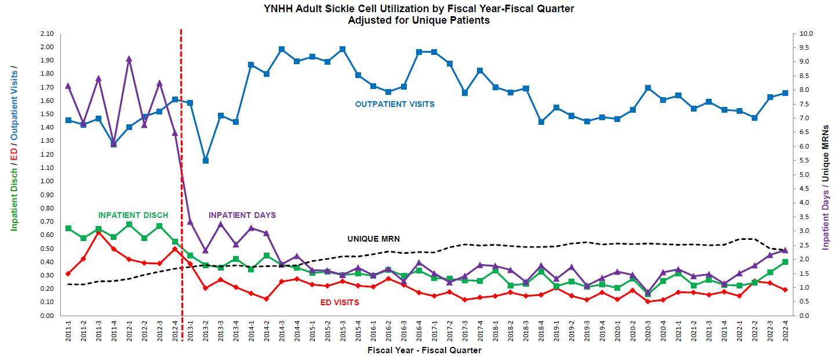
Program Outcomes: Clinical/Operational View
Visit volumes adjusted for number of unique individuals
Notes:
Finance was happy with the LOS reduction, but the program Medical Director wanted to understand the full picture of visit utilization. This slide shows a comprehensive view of the program outcomes – what is happening to the population across the inpatient/outpatient care continuum.
Starting in FY 2013, expensive inpatient and ED utilization was replaced by cost-effective outpatient care, in the context of program growth, with increasing numbers of unique patients.
Note slight uptick in acute care utilization (inpatient disch [green] and days [purple]) as noted in last slide.

Slide 15
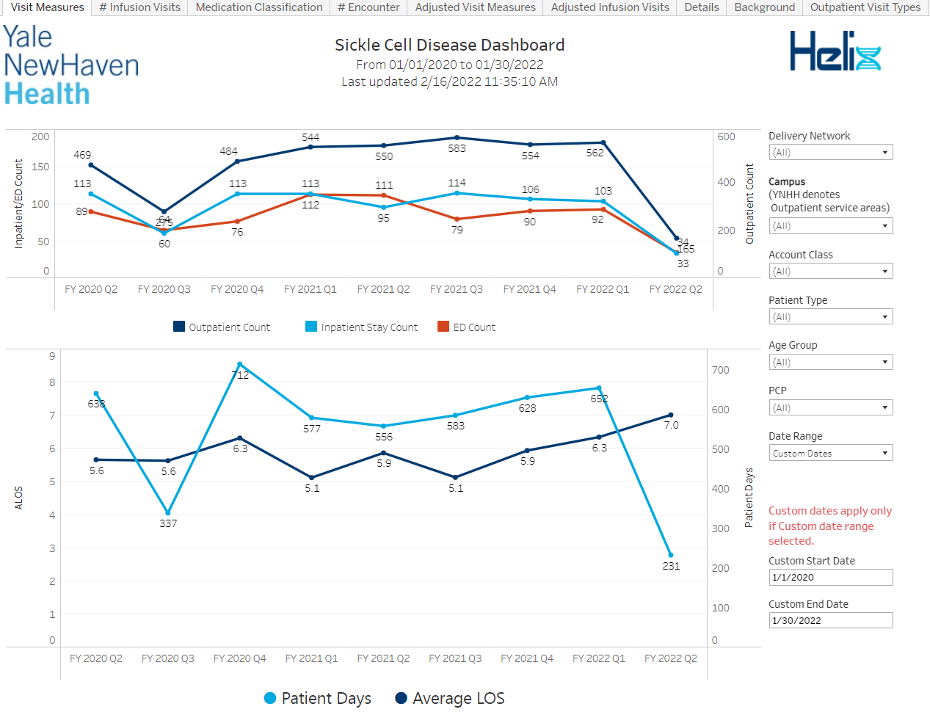
Current Online Interactive Dashboard

Slide 16
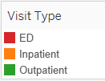
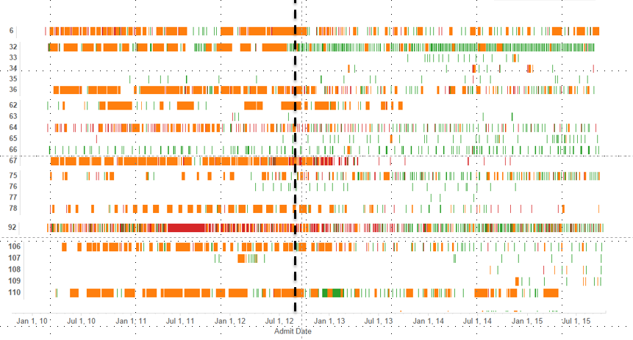
Visit Patterns by Patient
Pt ID
Notes:
Another view of the same data for selected high-utilizing patients – Tableau visual.
One line per patient. Time period is on X-axis – dotted line is program start time.
Width of orange bar corresponds to inpatient length of stay in days.
Note increased green lines (outpatient) after start of program, and reduced red/orange.

Slide 17
Additional Clinical Successes*
Improved overall patient satisfaction
Improved staff satisfaction among providers/clinicians in inpatient and ED settings
Improved clinical care including reduced inpatient central line associated blood stream infections (CLABSI)
*For more info, see:
”Utilization, financial outcomes and stakeholder perspectives of a re-organized adult sickle cell program.” https://journals.plos.org/plosone/article?id=10.1371/journal.pone.0236360.

Slide 18
Financial Outcomes of Re-organization
?

Slide 19
Billing and Reimbursement
Your program likely has two billing entities:
Hospital (facility fees)
Physicians and APPs-professional fees (“pro fees”), based upon RVUs generated by billing E&M CPT codes
Difficult to support physician/APP efforts on pro fees alone
Engage others (practice plan, school of medicine, hospital) in supporting the medical director’s/APPs’ efforts

Slide 20
Hospital Billing and Reimbursement
Two types of payment arrangements
Fee-for-service
Contract based
Reimbursement based on negotiated payments
Usually commercial insurance
Revenue usually > Hospital Costs
Case-based reimbursement
Reimbursement based on fixed payments (Diagnosis Related Groups [DRGs] for inpatients)
MCaid/MCare plus a growing number of commercial payors
For MCaid/MCare, revenue usually < Hospital Costs

Slide 21
Hospital Financial Data: Charges, Costs, and Revenue with examples from one patient visit
Charge:
Sticker price
Source: Chargemaster
Cost:
Cost to the Provider
“Direct” vs “Indirect”
Source: Cost Accounting
$30,992
$15,098
Net Revenue:
Expected payment.
Source: Contracts; MCare and MCaid Payment rates
Payments:
Actual dollars paid
$0
DENIED
$17,488
Notes:
Quick overview of Hospital Financial Terminology:
CHARGES: Calculated from acquisition costs + mark-up.
COSTS: These are the costs to the Hospital.
-Calculated in the cost-accounting software, using general ledger data and RVUs.
-Two types:
-Direct Costs: Costs for products/services used in direct care and billed to patients, e.g., R&B, meds, DI.
-Indirect Costs: Overhead – things that have to be paid for, but are not billed to patients, e.g., administration, utilities, salaries for non-caregivers.
NET REVENUE: Expected payments based on contracts & case rates, plus adjustments for lump-sum payments and deductions.
-Net Rev differs by payor, so the same type of clinical case can be paid very differently for different payors.
-We work hard to come up with contracts with commercial payors that are financially favorable to us, but for MCaid, we are paid, on avg, 35 cents on $1.00.
PAYMENTS: The actual dollars we collect. In the case of insurance denials, we may collect nothing.

Slide 22
Important Financial Calculations: Margin
Contribution Margin (“CM”):
Net Revenue minus Direct Cost
Operating Margin (“OM” or “Gain/Loss”):
Net Revenue minus Total Cost
Payer Mix drives reimbursement
Notes:
CALCULATIONS TO ASSESS FINANCIAL PROFIT & LOSS:
CONTRIBUTION MARGIN (CM)
The revenue gained after paying for the direct costs of care. Indicates whether the revenue from the program is covering the direct costs of the program.
OPERATING MARGIN (OM)
The revenue gained after the direct costs *and* overhead are covered.
Obviously, the hospital would prefer a (+) OM, but for some institutions &/or some programs a (+) CM may be considered adequate, as the clinical program is not held accountable for the institution’s overhead.

Slide 23
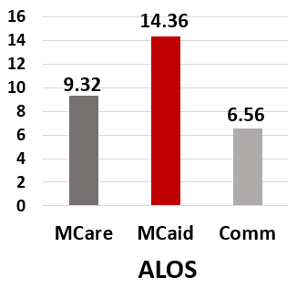
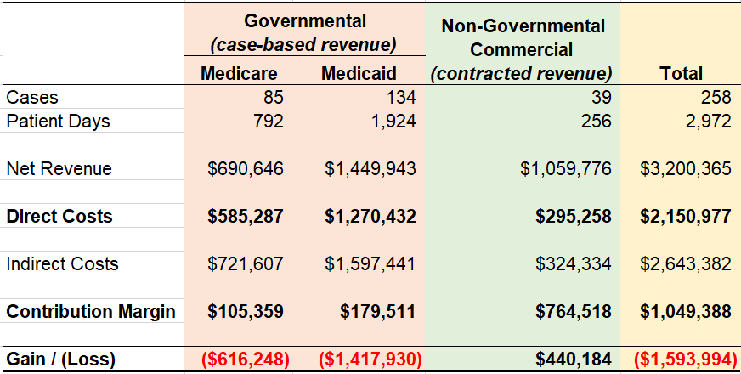
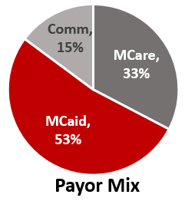
YNHH-FY 2010 Statement of Revenue and Expenses Inpatient Discharges
Notes:
In 2011 YNHH started putting together a Business Plan to address SCD program, with a focus on Inpatient discharges b/c that was the area of concern.
(Note that we speak of inpatient “discharges” – as opposed to inpatient “admissions” – b/c cases are captured by discharge date rather than admit date. That is how CMS and other payors capture cases in payment systems.)
P&L for SCD in FY 2010 – Simplified for discussion, grouping the payors into MCare, MCaid, and Non-Gov’t payors – in 2010 this was generally per-case (MCare/MCaid) vs. per-diem payment.
Two big issues that drive bottom line: Payor Mix and ALOS
-Payor Mix shows that SCD population ~ 85% Gov’t payors:
50% MCaid (we get paid ~ 35 cents on $1.00 overall; ~50 cents on $1.00 in this population)
33% MCare (we get paid ~ 95 cents on $1.00)
15% Commercial (we get paid > 100 cents on $1.00)
-ALOS is twice as long for MCaid vs. Commercial.
Result: Financial loss driven by MCaid produces overwhelmingly (-) bottom line.

Slide 24
YNHH-FY 2010 Statement of Revenue and Expenses Inpatient Discharges
Notes:
YNHH wanted to better understand the nature of the expenses, and the product-based cost accounting allows drill down into the Direct expenses to answer the question,
What is the driver of the costs associated with the care of this population?

Slide 25
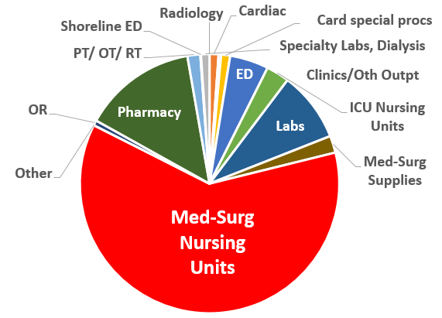
Direct Expenses
Notes:
Slide shows proportion of Direct Costs in each product (supply/service) category.
Most of the costs are in Med-surg (non-ICU) Nursing (room & board) – that’s LOS.
The high proportion of costs in Nursing is not surprising, since this is a Medical population (not O.R. or other expensive procedures).
So, if reduce inpatient LOS, will reduce costs.
If we want to see all the actual supplies/services that roll up into these categories, our product-based cost accounting system allows drill-down into this.

Slide 26
Inpatient-Outpatient Direct Cost Improvements
*Inpt adult SCD Nsg unit changed to a “Covid” unit during FY2020-2021 Q1; Covid(-) SCD inpts managed on other inpt Nsg units, by non-SCD staff. Additionally, indirect-direct cost allocation methods changed in FY21.

Slide 27
Cumulative Cost Reduction
Cumulative savings over 6 years, FY 2013-2018*:
Inpatient direct cost decrease: $14.8 million
Outpatient direct cost increase: $1.8 million
Total Inpatient and Outpatient:
$13.0 million in cumulative savings
*Sum of costs for each year, 2013 to 2018, minus cost of baseline year, 2012
Notes:
This slide summarizes the reduction in hospital cost for the years since the program started, compared to the level of costs in the baseline year, 2012.
Note that this analysis highlights the *cost* reduction, which is unequivocally good. Given the unfavorable payor mix of the population, the potential increase in “profit” is limited so the success is more about decreased loss.
To repeat a point made earlier: This slide compares the post-program performance with the pre-program baseline, not a year-over-year comparison. Unless you keep the pre-program costs in view, you risk losing sight of the overall improvements brought by the program.
Overall strategy to draw institutional support for the program: Engage with Finance and give them something they can boast about, something they can present to the Hospital Board to show the institution’s embrace of Value in care. For us, it has also been a plus for the institution to highlight investment in improved care for an underserved population.

Slide 28
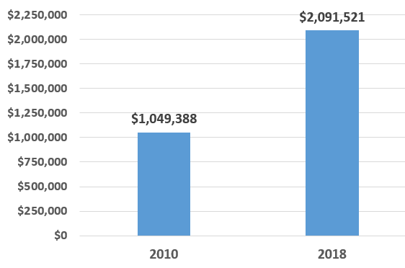
Contribution Margin for Inpatient Discharges
Before
After
Notes:
Since costs are reduced, the CM (Net Rev minus direct cost) goes up, and the hospital now had $1M more to apply against indirect costs.
In fact, the FY 2018 Net Rev actually covered the *total* (direct and indirect) costs in 2018 (i.e., break even financially) which was a huge accomplishment.

Slide 29
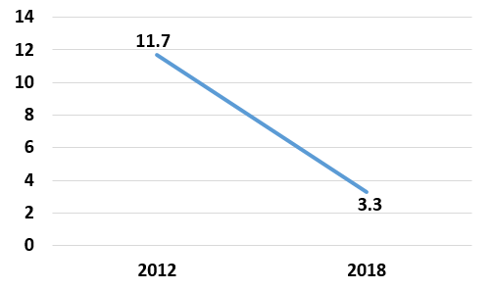
Revenue Opportunity From Freeing Up Beds: Backfill
SCD Inpatient Nursing Unit
Average Daily Census (ADC)
8.4 more inpatient beds per day available
Opportunities:
Move patients out of Emergency Department
Avoid elective admission delays
Backfill–potential incremental revenue
Notes:
Comparing ADC from 2012 to 2018: 8.4 more beds per day are available to other patients.
Note that the benefit of freeing up beds depends in part on the institution’s capacity: If you are very full, it makes sense to invest in initiatives that will free-up beds.
Benefits include the ability to decant the ED and avoidance of elective admission delays

Slide 30
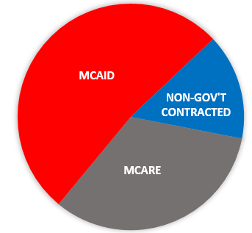
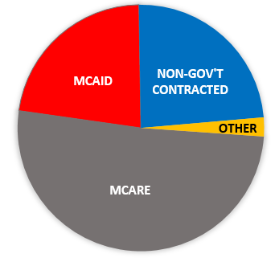
Revenue Opportunity From Freeing Up Beds
Inpatient Payor Mix
Adults with SCD
Adult General Medicine
More favorable payer mix
Notes:
Of course, no one knows which patients will fill the beds vacated by patients with SCD.
If freed-up beds are filled with other patients associated with financial loss, the benefit is less clear.
But, on average, the Gen Med case types likely to fill these beds have a more favorable payor mix than do pts with SCD.
And, the SCD unit also accepts off-service oncology patients, who tend to have an even more favorable payor mix.

Slide 31
Other Considerations: 340B
Drug pricing program for outpatient medications, including infusions such as high-cost chemotherapy as well as P.O. medications
Administered by U.S. Health and Human Services
Intended to reduce federal costs and make high-cost medications more affordable for economically and/or medically vulnerable patients, as well as providing more funds to safety net hospitals for care of vulnerable populations
Eligibility determined at the institution level: Medicare/Medicaid Disproportionate Share Hospitals, children’s hospitals, other safety net providers
Criticized for providing outsized windfalls to hospitals without sufficient benefit for vulnerable populations, and recently challenged in court, but upheld by Supreme Court in June 2022
Notes:
In addition to reduction in costs and inpatient utilization through a reorganized Sickle Cell Disease program, another vehicle to forge a connection with Hospital Finance is the 340B program, for hospitals that are eligible.
If you are in a safety net institution, your Finance department is likely very familiar with the 340B program, but they may not be aware of the 340B opportunity in the SCD population.

Slide 32
What was most critical to securing funding for the business plan?
Strong medical director with a vision for program improvements
Strong nursing support for program improvements
Existing outpatient clinic space and resources
All of the above
Other
Notes:
Trick question: the most important component was “other”: the most important factor in securing funding for the business plan was that Finance was totally on-board with it.
All the other answers were critical to the success of the program, but to get it funded, nothing was more critical than Finance’s support.

Slide 33
Creating a Business Plan (in a nutshell)
1. Determine new resources needed
2. Senior administrative support
3. Financial and data analysts
Chicken-egg problem
Notes:
Here are three things you need for a Business Plan (refer to Patti Engblom’s presentation for more detail):
1-Determine the new expenses being requested for the SCD program, including new budgeted Full Time Equivalents (FTEs) and space, equipment needs, etc. (To determine program needs, see other Workshop presentations, including “essential elements” for a SCD program.)
2-Secure administrative support for the new budgeted expenses.
3-Secure Finance and Data Analysis partners to help put together an analysis to show the (a) proposed budget and (b) how new expenses will be paid for.
Chicken-egg problem:
Unless you already have Finance/data analysis resources, you may need Administrative support to get them, but you may need to show a financial analysis in order to secure Administrative support.
How to solve this? Possible ways to get support to complete your financial analysis:
-Network with clinical managers – who does their budgets? Can these folks be enlisted to help?
-Use existing reports – contact the creator(s), if possible, and clarify how the analysis was performed, including the population definition - ensure that it includes the patients you are targeting.
-Reach out to your contacts at the University &/or the Hospital side – whomever holds the budget for the resources you need, &/or has power to influence whomever holds the budget for those resources.
- Show examples of other institutions’ outcomes to Administration and make convincing argument that you can do the same.
- Appeal to Administration’s wishes for good patient care and equity (e.g., SCD is more prevalent in general population than Hemophilia and Cystic Fibrosis, but CF often gets more medical and institutional resources than SCD https://pediatrics.aappublications.org/content/123/1/407.long).
-Note: If you identify analytic resources and are requesting a new report, don’t assume the data analyst understands what you need – be *very* explicit in your request. The analyst likely does not have a clinical background and needs help understanding how match your request to the available data sources.

Slide 34
Business Planning to Secure Incremental Resources
Goal: Show how you are going to pay for new resources/expenses
Best: new revenue
Next best: reduction in financial loss
Associated corollaries: backfill and downstream utilization
Notes:
Best: New Revenue
-May be difficult since pts with SCD may be already coming to your institution and SCD population often has an unfavorable payor mix.
-Explore local reimbursement for 340B and consider increasing outpatient infusion capacity for 340B medications
Next Best: Reduction in financial loss.
-Shown in the YNH examples.
-Saves $ for institution that can be used for other things, e.g., to support a clinical population with a (+) margin. -Problem: Reducing cost of care doesn’t necessarily take any expense out of the budget - problematic if there is not a more profitable population for which to use the $. (e.g., a community hospital that runs at only half capacity and makes a (+) margin on the SCD patients who come to the ED for episodic pain management may not see the advantage in investing new resources that result in reducing that SCD ED volume.)
Associated corollary: “backfill”
-Bring in new patients with a better payor mix to fill the capacity freed up by SCD patients’ reduced visits/LOS.
-Note: this hinges on your institution running at full capacity. If not, this argument is not so compelling.

Slide 35
Business Plan Example: YNHH’s Outpatient Infusion Center
History: A 3-chair outpatient infusion area had been created within the SCD inpatient unit with only incremental 0.5 FTE RN staffing resource with much success. It resulted in increased patient satisfaction, reduced ED visits, and > $200,000 annual incremental CM.
Notes:
YNH Example: Evaluation of Pilot Infusion Center and request for resources to expand.
-Background: in FY 2017, Adult SCD program successful X 5 years with decreased inpt/ED visits and increased outpatient engagement, including increasing demand for outpatient infusion visits.
-Outpatient infusion area shared with Oncology resulting in with limited access SCD pts, since Oncology was the priority population.
-Response by SCD team: gather data about the problem:
-1-2 SCD patients per day turned away, and 92% of SCD patients reported difficulty accessing Infusion area.
-SCD Patient alternatives: ED or self-care, resulting in inadequate treatment for pts, and patient/staff dissatisfaction.
Proposal: Pilot (more palatable to administration than budget additions).
Creative solution: “trade” 3 inpt beds for 3 outpatient infusion chairs on inpt unit.
Timing and luck: inpatient beds opening up elsewhere; hospital seeking to eliminate 3-bed rooms.
*No incremental staffing resources requested.*

Slide 36
Outpatient Infusion Center Business Plan
January 2020: Successful track record for 2+ years
Challenges:
Increased volume–need more resources
Unpredictable infusion center closings driven by inpatient bed shortages
Response:
SCD program leaders mounted a new business plan
Notes:
Fast forward to January 2020: SCD Infusion center up and running for over 2 years –
Working well, increased efficiency, increased volume.
Challenges:
Increased volume resulted in need for more staffing resources.
YNH inpatient census “surges” forced Infusion center closings for days or weeks at a time when the room was switched back to an inpatient area – very disruptive to the SCD pts’ care.

Slide 37
Outpatient Infusion Center-New Business Plan
Situation
Background
Assessment
Recommendation
Notes:
Business Plan was put together by James Flaherty, SCD PSM, in the form of an SBAR including extensive data analyses/displays.

Slide 38
Outpatient Infusion Center S.B.A.R.
Situation:
SCD infusion center clinically and financially successful since April 2017
Current budgeted staffing will be inadequate for anticipated patient volume in 2020
Increased visit volumes
Anticipating new crizanlizumab infusions
Intermittent infusion center closure during inpatient census surges; negatively impacts patient care

Slide 39
Outpatient Infusion Center S.B.A.R.
Background
Success of infusion center since initiation in April 2017:
Decreased ED/inpatient visits
Improved quality of life among patients with SCD
Financial gains with (+) CM
Program growth with increased MRNs
Increased visits and expansion of services offered
Budgeted resources (0.5 RN FTE) support 20 hrs/week (4 hrs/day)
BUT
Administrative tasks are increasingly time consuming
Increased demand so center increased to 40 hrs/week (8 hrs/day) by supplementing with inpatient staff–not sustainable
Notes:
Increased services (in addition to pain management, hydration, phlebotomy, and blood transfusions):
Now offering more primary care services including vaccine administration, routine preventative visits for medically complicated patients.
Increasing volume of administrative tasks:
Patient phone calls, appointment scheduling arranging transportation, etc.
Increasingly pulling in inpt RNs to meet increased Infusion demand.

Slide 40
Outpatient Infusion Center S.B.A.R.
Assessment:
Patient care negatively effected by unpredictable infusion center closures during hospital surges
Results: Increased ED utilization and inpatient admissions
Crizanlizumab is expected to drive even higher volume
Expect infusion volume increase 99.2% from 250 (2019) to 498 (2020)
Will need RN FTE increase from 0.5 to 1.0
Funds to off-set cost of incremental resources will come from incremental infusion volume plus 340B program reimbursement for crizanlizumab

Slide 41
Outpatient Infusion Center S.B.A.R.
Recommendations:
1.12 RN FTE dedicated to infusion center*
Includes replacement factor for time off
1.0 Administrative Assistant FTE*
Protection of infusion area–prevent closure during inpatient census surges
Designated SCD infusion cost center, separate from inpatient unit
*See Appendix for data/calculations to determine new resources (FTEs) needed

Slide 42
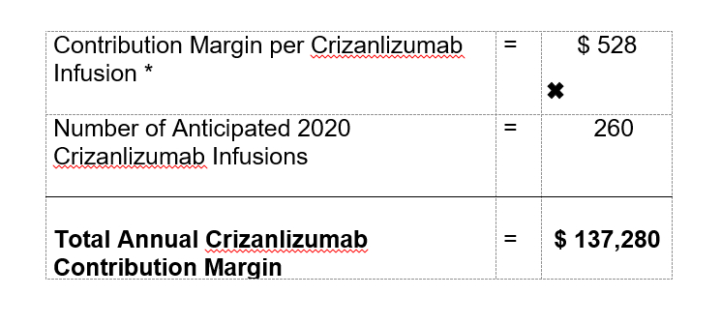
Outpatient Infusion Center–Data
Estimated Annual Crizanlizumab Contribution Margin
*Based on data and assumptions available as of late calendar 2019
Prepared by James Flaherty, BSN, RN, CCRN
Adult SCD Program Patient Services Manager
Notes:
Estimated CM provided by Pharmacy Financial analysts based and data and assumptions available at the time.
Would need to revisit assumptions to confirm that this calculation is still valid currently.
Slide shows method for calculating CM. Volume of anticipated Criz infusions is conservative, not taking into account expected growth nor other potential new infusions.

Slide 43
What Happened?
Administration was very receptive to business plan and even suggested it could be expanded
BUT
COVID-19 arrived
The SCD inpatient unit was temporarily changed to a COVID-19 unit and SCD patients were transferred to other units
The SCD infusions were returned to the Oncology infusion area
Notes:
The VP who heard the presentation was very supportive and signaled an interest in potential expansion of the SCD program in light of new therapies.
BUT
Covid hit Connecticut shortly after this Business Plan was presented.
The adult SCD inpatient unit was temporarily flipped to a Covid unit and the patients with SCD were relocated to other units.
The infusions were temporarily returned to the outpatient Oncology Infusion area.

Slide 44
Takeaways
Secure institutional support for your program
Network with hospital-based colleagues to find data/data analysis resources
Appeal to hospital leadership for financial and other support
Show the value of your program to the hospital
Cost reduction
Revenue enhancement
Patient and staff satisfaction
Community satisfaction and endorsement
Note: Proposing a “Pilot” program and then showing incremental successes can be an effective way to secure institutional support

Slide 45
Thank you for your attention!
Questions?

Slide 46
Appendix

Slide 47
Revenue Opportunity From Freeing Up Beds
Backfill Calculation example:
Start with N = 100 SCD inpatient discharges
An average LOS (ALOS) reduction of 5.5 days to 4.75 days per discharge produces a 0.75 day reduction per discharge
0.75 days per discharge times 100 discharges produces 75 “freed up” days available for other patients
Assume those 75 days are likely to be filled by general medicine admissions from the ED, and the general medicine patients’ ALOS = 5.0 days
75 “freed up” days divided by 5.0 day LOS = 15 newly available admissions for general medicine patients
Assume the average margin for a general medicine discharge = $2,000
$2,000 times 15 newly available admissions = $30,000 incremental margin

Slide 48
340B Opportunity Example
Jadenu (Deferasirox) 360mg
NDC: 00078065615/30 Tablets
Average Wholesale Price (AWP) | $5,630 | Manufacturer-recommended price for hospital to sell Jadenu
Typical AWP Contract Pricing | -17.5% | Discount that payors negotiate to pay hospital for medication
Revenue Received per Package | $4,640 | Amount that hospital receives for medication from payors
Jadenu 340B Price | $2,310 | Cost to hospital for medication from manufacturer
Contribution Margin (CM) per Package | $2,330 | Margin for hospital for medication ($4,640-$2,310)
CM per patient, per year | $56,697 | Assumes 720mg per patient/day
Notes:
For the SCD population, 340B medications include Jadenu and Endari ((L-glutamine).
This slide shows an example of the Jadenu opportunity for non-MCaid patients (in CT the State takes the advantageous pricing for MCaid patients, and so the hospital carves the MCaid patients out of our 340B program).
When we approached them, our pharmacists were very aware of the 340B opportunities associated with Oncology meds, but were not aware of the opportunity associated with Jadenu, which is mostly Rx by Hematology.
YNHH has about 23 non-MCaid patients with SCD on Jadenu, summing to CM of > $1M per year.

