Slide 1
The Unmet Need in Sickle Cell Disease:
Sickle Cell Centers
Sophie Lanzkron, MD
Professor of Medicine and Oncology
Johns Hopkins School of Medicine

Slide 2
Learning Objective
Learners will be able to identify the key elements needed to provide high quality comprehensive care to adults with sickle cell disease

Slide 3
Introduction
Sickle Cell Disease: A rare disease that still limits life expectancy due to chronic complications DESPITE childhood survival and availability of therapies
Many individuals with SCD have complex health care needs that get more complicated as they grow older
Health care providers with disease-specific knowledge are critical for prevention of complications throughout the lifespan
At the individual level, it is about where you live:
  Health care opportunities and insurance are state-based and even more local than that
  Insurance may be available but ≠ access to necessary care
  Best care often equilibrates to best advocates or knowledge
  GOAL: Shift programmatic emphasis to how to build a system of care to enhance access and coordination of care (for affected adults)

Slide 4
SCD Is a Multi-System Disease
Neurocognitive dysfunction
Meningitis
Stroke
Retinopathy
Post-hyphema glaucoma
Retinal infarction
Indirect hyperbilirubinemia
Sickle hepatopathy
Pulmonary hypertension
Acute chest syndrome
Acute pain event
Gallstones
Cardiomegaly
Diastolic heart failure
Albuminuria
Isosthenuria
Substantial kidney injury
Papillary necrosis
Functional asplenia
Splenic infarction
Splenic sequestration
Complications of pregnancy
Skin ulcers
Delayed puberty
Erectile dysfunction
Priapism
Avascular necrosis
Bone marrow infarction
Osteomyelitis
Chronic pain
Acute complications
Chronic complications
Anemia
Leukocytosis
Septicemia
Kato GJ, et al. Nature Reviews Disease Primers. V4: 18010 (2018).
© Medscape, LLC

Slide 5
SCD and Mortality in the US
Childhood survival 96%-98% for all genotypes
In 2014, most deaths (66%) occurred at ages 25-54 yrs
More recent surveillance data from Georgia and California show mean age at death 43 yrs for women, 41 yrs for men
Quinn CT et al. Blood. 2010;115:3447;
Paulukonis ST et al. Public Health Reports. 2016;131:367-375.

Slide 6
What Do We Need to Treat Complicated, Chronic, and Complex Disease?
Cystic Fibrosis is a model of disease treatment
  Lifelong, chronic disease that is diagnosed at birth
  Complications accrue with age
  Affected individuals require disease-specific, highly coordinated care
To improve the quality of care for cystic fibrosis
  Longitudinal clinical data collection (a registry)
  Coordinated efforts to target improvements in care
  Funding for quality improvement
  Funding for therapeutic development

Slide 7
Systems Level Barriers to Care in SCD
Lack of knowledgeable providers in SCD
Lack of available centers that can provide expert care to the SCD population
While SCD is more prevalent than hemophilia and cystic fibrosis combined, there are only a handful of comprehensive adult SCD centers in the US (approximately 10) compared to 100 each for hemophilia and cystic fibrosis
Result: The few FDA-approved medications are used in < 50% of people who could benefit from them

Slide 8
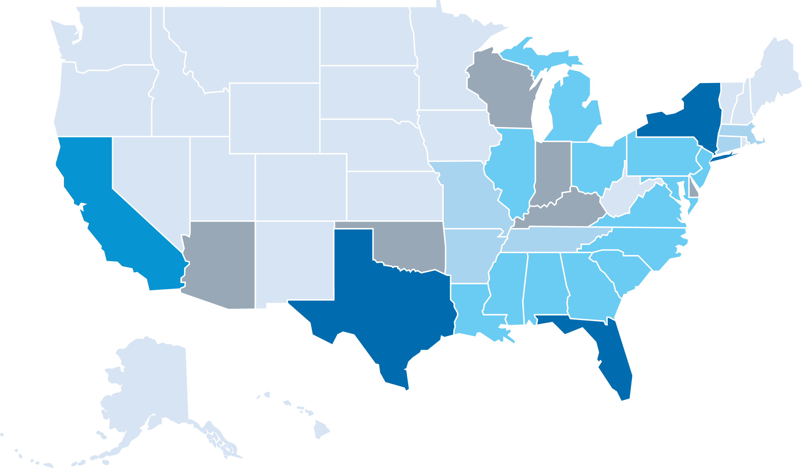
SCD Population Overwhelms US SCD Workforce
Prevalence:
Estimated⁴
~100,000 people in US affected by SCD¹⁻⁴
Highest concentrations in south and east ^{5,6}
West coast has poor outcomes^{5,6}
  CA life expectancy < 40y, vs national median life expectancy 42 to 47y
    Difference believed to be due to access to knowledgeable providers
≥ 7000
5000-6999
2500-4999
1000-2499
500-999
< 500
Slide credit: Dr. Wally Smith
Image created by Symbiotix, LLC
1. Sickle Cell Disease (SCD). Centre for Disease Control and Prevention. https://www.cdc.gov/ncbddd/sicklecell/data.html. Accessed May 18, 2019. 2. Adams-Graves P, Bronte-Jordan L. Expert Rev Hematol. 2016;9(6):541-552. 3. Strouse JJ et al. Blood. 2013;122(21):1739. 4.Hassell KL. Am J Prev Med. 2010;38(4S):S512–S521. 5. Azevedo M. (2016, June 17). Sickle Cell Disease Foundation of California Highlights Needs of Adult Patients on World Awareness Day. Sickle Cell Anemia News. https://sicklecellanemianews.com/2016/06/17/sickle-cell-disease-foundation-california-highlights-needs-adult-patients-world-sickle-cell-awareness-day/. Accessed May 18, 2019. 6. Fitzmaurice S. Case Study: Rare Patients With Sickle Cell Disease Live Nearly Twice as Long as National Average. https://www.hematology.org/Newsroom/Press-Releases/2016/6731.aspx. Accessed May 18, 2019.
Notes:
Discuss the prevalence of SCD in the United States:
SCD is a rare disease in the United States that garners less attention than other genetic diseases, such as hemophilia and cystic fibrosis¹⁻³
Approximately 100,000 people are impacted by SCD⁴
Emphasize the variable prevalence of SCD throughout the United States as shown on the map
The highest concentrations of SCD are seen in the southern and eastern United States^{5,6}
Patients in the west coast experience poorer outcomes than those in the rest of the United States^{5,6}
While the national median life expectancy of an SCD patient is 42 to 47 years of age, those in California have a lower expectancy of less than 40 years of age
This is believed to be due to a historical lack of dedicated care centers
References:
Centre for Disease Control and Prevention. (2017, August 9). Sickle Cell Disease (SCD). Retrieved from https://www.cdc.gov/ncbddd/sicklecell/data.html
Adams-Graves P, Bronte-Jordan L. Recent treatment guidelines for managing adult patients with sickle cell disease: challenges in access to care, social issues, and adherence. Expert Rev Hematol. 2016;9(6):541-552.
Strouse JJ, Lobner K, Lanzkron S, Haywood C Jr. NIH and National Foundation Expenditures for sickle cell disease and cystic fibrosis are associated with Pubmed publications and FDA approvals. Blood. 2013;122(21):1739.
Hassell KL. Population estimates of sickle cell disease in the U.S. Am J Prev Med. 2010;38(4S):S512–S521.
Azevedo M. (2016, June 17). Sickle Cell Disease Foundation of California Highlights Needs of Adult Patients on World Awareness Day. Retrieved from https://sicklecellanemianews.com/2016/06/17/sickle-cell-disease-foundation-california-highlights-needs-adult-patients-world-sickle-cell-awareness-day/
Fitzmaurice S. (2016, October 4). Case study: rare patients with sickle cell disease live nearly twice as long as national average. Retrieved from https://www.hematology.org/Newsroom/Press-Releases/2016/6731.aspx

Slide 9
We Need to Model Other Lifespans, Chronic Conditions to Study and Improve Outcomes in SCD
Sickle Cell Disease
NEEDS the same attention to disease-specific, highly coordinated care
NEEDS cooperative efforts to collect longitudinal, clinical data
NEEDS attention to quality improvement
NEEDS SCD centers to work together as an alliance to achieve these goals
NEEDS dedicated funding for this at-risk population who have suffered more health disparities than those with cystic fibrosis, hemophilia, and other genetic diseases COMBINED
THEN….we need to take this show on the road to those who need it most

Slide 10
What Is a Sickle Cell Center?
A thoughtful, team-based care approach to individuals living with sickle cell disease
Consistent, comprehensive, and coordinated care for adults with sickle cell disease throughout the “medical environment”
A center with a programmatic emphasis on SCD for affected adults
A center that coordinates SCD care

Slide 11
Sickle Cell Center

Slide 12
ESSENTIALS of a Sickle Cell Center
A programmatic, multidisciplinary, team-based approach to care
The SCD center should be the recognized authority (leader within its larger hospital or academic center) for managing SCD as a patient population
A physician lead who is considered a Sickle Cell Disease specialist
  This individual will accept responsibility for establishing protocols for care, training, implementing audits, and share in the overall responsibility for the management of the clinic and patients
  The lead SCD specialist should be comfortable providing evidence-based pain management, should undertake continuing professional development of relevance to this role, and have an established plan for how to cover for absences
One or more social workers
A patient coordinator (sometimes called a patient navigator or case manager)
Dedicated nursing staff
Ability to offer acute and chronic pain management
Transfusion (including apheresis)
Timely access to specialist services

Slide 13
What Institutional Framework Do You Need?
MUST HAVE:
A plan to provide Team-Based Care for individuals with SCD
Institutional support
SHOULD HAVE:
A business plan (at least in the beginning)
A plan for interaction with community-based organizations
A plan for quality assessment and improvement

Slide 14
OPTIMAL to Also Have:
Lead nurse/clinic manager who can also serve as the center director or co-director with the SCD specialist
  This person helps share responsibility with the director for upkeep and implementation of guidelines and protocols as well as training and audits related to the center
  The clinic manager can have additional responsibilities including quality improvement and oversight
Dedicated infusion space or a day hospital*
Behavioral and mental health provider (psychologist)*
Transition plan for helping children adapt and transfer to the adult care setting
Access to a gynecology provider or other means of providing contraception for women with SCD
*Longer to reach consensus

Slide 15
Adjunct/Suggested:
Preferred but not necessary
Primary care provider
Physical therapist
Occupational therapist
Pharmacist
Accessible dental care (as may be available through hemophilia treatment centers)
SCD educator

Slide 16
Elements of a Sickle Cell Center
Kanter J, et al. Blood Adv. 2020;4(16):3804-3813.

Slide 17
Models of Sickle Cell Centers

Slide 18
Sickle Cell Center Models
Treatment centers are NOT one size fits all
Centers may be designed differently to meet the needs of the population based on:
  The size of the center
  Patient population
  Structure (within a division or department), academic or non-academic
  Services to provide (whether they had primary care within the SCD center) and staffing for care delivery
We can also define models based on their location of services and whether they are stand-alone clinics or embedded within other divisions/departments/clinics

Slide 19
Sickle Cell Center Models
MODELS:
SCD Comprehensive Care Clinic (Stand-alone)
Embedded SCD Program
Specialized SCD medical home
What about Sickle Cell Programs that don’t quite meet the definition for a “Center”?
Associate Centers: some components of a sickle cell center while developing a full center:
  Centers–in-development
  Data collection can be ongoing
  Additions can be made as growth allows
Hub and Spokes Model of Care
Sickle Cell Center + Affiliate Center(s)
  Affiliates: spokes of the SCD center that provide care as an affiliation with a SCD center who may rely on the center for some of the components

Slide 20
Things to Consider When Developing a Sickle Cell Center:
What type of center will you be:
  Ambulatory care center vs. dedicated infusion center/clinical care
How big is your SCD population?
How big is your team (and who is missing from your center model and what is the timeline)?
What resources are currently available?
Hours of operation, adapting for various circumstances (critical patients, workflow, and chain of command)

Slide 21
MODEL: Classic SCD Comprehensive Center
Provides excellent team-based SCD Care
Dedicated clinical space and staff
Includes an infusion center/day hospital
Led by a sickle cell specialist
Has access to all necessary subspecialists to provide true comprehensive care
Urban model where the focus is not on reaching an outside population
Has a plan for primary care and co-management with PCP
Includes mental health within the SCD care model

Slide 22
Model: Embedded SCD Center
Partnership model, often within the heme-onc clinic (but other options)
Shares clinical space and personnel with heme-onc or other multi-specialty clinics
Provides excellent team-based SCD Care
Often shares an infusion center/day hospital
Led by a sickle cell specialist but has multiple team members with hematologic experience and practice
Has access to all necessary subspecialists but they may not be directly associated with the SCD center

Slide 23
Model: Specialized SCD Medical Home
Dedicated clinical space and staff for SCD
Provides excellent team-based SCD Care
Includes primary care within the medical home
Must have a care coordinator within the medical home
May/may not include an infusion center/day hospital (but must have a plan to provide necessary pain management)
Led by a sickle cell specialist
Suburban or urban model where individuals may come in from further away or have difficulty coordinating care

Slide 24
Model: Hub and Spoke Model of Care
Provides excellent team-based SCD Care
The Hub can be a part of any of the above centers
  Led by a sickle cell specialist
  Has access to all necessary subspecialists
The spokes:
  May be run by primary care physicians with contacts to the hub
  May be run by specialized Advanced Care Providers
  May have SCD infusion areas or (more likely) shared infusion space in which they can provide pain management
  Should include telehealth/outreach with the Hub
Includes a plan for co-management and emergency management

Slide 25
All Models Must Provide Comprehensive SCD Medical Practice:
Disease modifying therapy: Hydroxyurea, glutamine, etc
SCD prevention practice
Iron overload program
Blood transfusion management (to avoid inappropriate blood transfusion, provide extended cross-matching of blood)
Pain management plan/program
Family planning
Mental health plan

Slide 26
Other Adjunct Opportunities:
Telehealth: Used to provide direct PROVIDER to Patient Care
  Enhance hub-spoke model of care
  Can be used to help provide inpatient care
Telementoring (ECHO)
  Increasing local physician knowledge and self-efficacy in managing individuals with SCD (based on the ECHO program)
Extended Hours
  Hours outside of typical 8-5 clinic hours used to provide additional pain management or off-hours clinic management
ER/ED Observation Units
  Partnership with ER/ED facility to provide extended care (that does not require admission)
Developing affiliates
  Identify affiliated care programs to increase access to care for individuals in more remote areas

Slide 27
Bottom Line
SCD centers must provide compassionate, comprehensive care that is coordinated to ensure continuous and personalized care with attention to both the physical and emotional well-being of the individual
Providing standardized, equitable patient-centered management will ensure higher quality, more cost-effective care for this vulnerable patient population

Slide 28
What Else?
Institutional support is key
Tracking outcomes and quality improvement should be built in (even if not there at the beginning)
Don’t forget the community
Guidelines and policies
AND: A plan for comparative quality assessment and improvement

Slide 29

INTRODUCING

Slide 30
National Alliance of Sickle Cell Centers
Mission: To support sickle cell disease (SCD) centers in delivering high-quality comprehensive care by setting standards of care and promoting their adoption; identifying opportunities and resources to strengthen SCD centers; and advocating for access to comprehensive care to improve health outcomes, quality of life, and survival

Slide 31
National Alliance of Sickle Cell Centers
Goals:
Create an infrastructure for adult and pediatric SCD centers to define, continually enhance, and promote the adoption of standards of primary and specialized care that comprise a comprehensive care center for individuals with SCD
Develop tools and share information with SCD centers to use in implementing and operating a comprehensive care model within their organization
Utilize the Globin Research Network for Data and Discovery (GRNDaD), a multi-site registry to optimize quality improvement and quality assurance through data analytics
Identify opportunities and resources (federal, state, and private) that SCD centers can utilize to sustain funding and ensure equitable access to comprehensive care
Create and sustain an advisory board of stakeholders committed to improving outcomes in SCD
Work with the American Society of Hematology, and other similar organizations, to accomplish these goals and to collaborate on research, data collection, advocacy, and other efforts of mutual interest

Slide 32
Thank You!!!!
American Society of Hematology
Dr. Kanter
Co-authors: Payal Desai, Marsha Treadwell, Biree Andemariam, Jane Little, Diane Nugent, Susan Claster, Deepa Manwani, John Strouse, Ifeyinwa (Ify) Osunkwo, Rosalyn Stewart, Allison King, Lisa Shook, and Judith Baker
Blood Advances for publishing “Building access to care in adult sickle cell disease: Defining models of care, essential components, and economic aspects today”

Slide 33
Questions?

